Slide 1
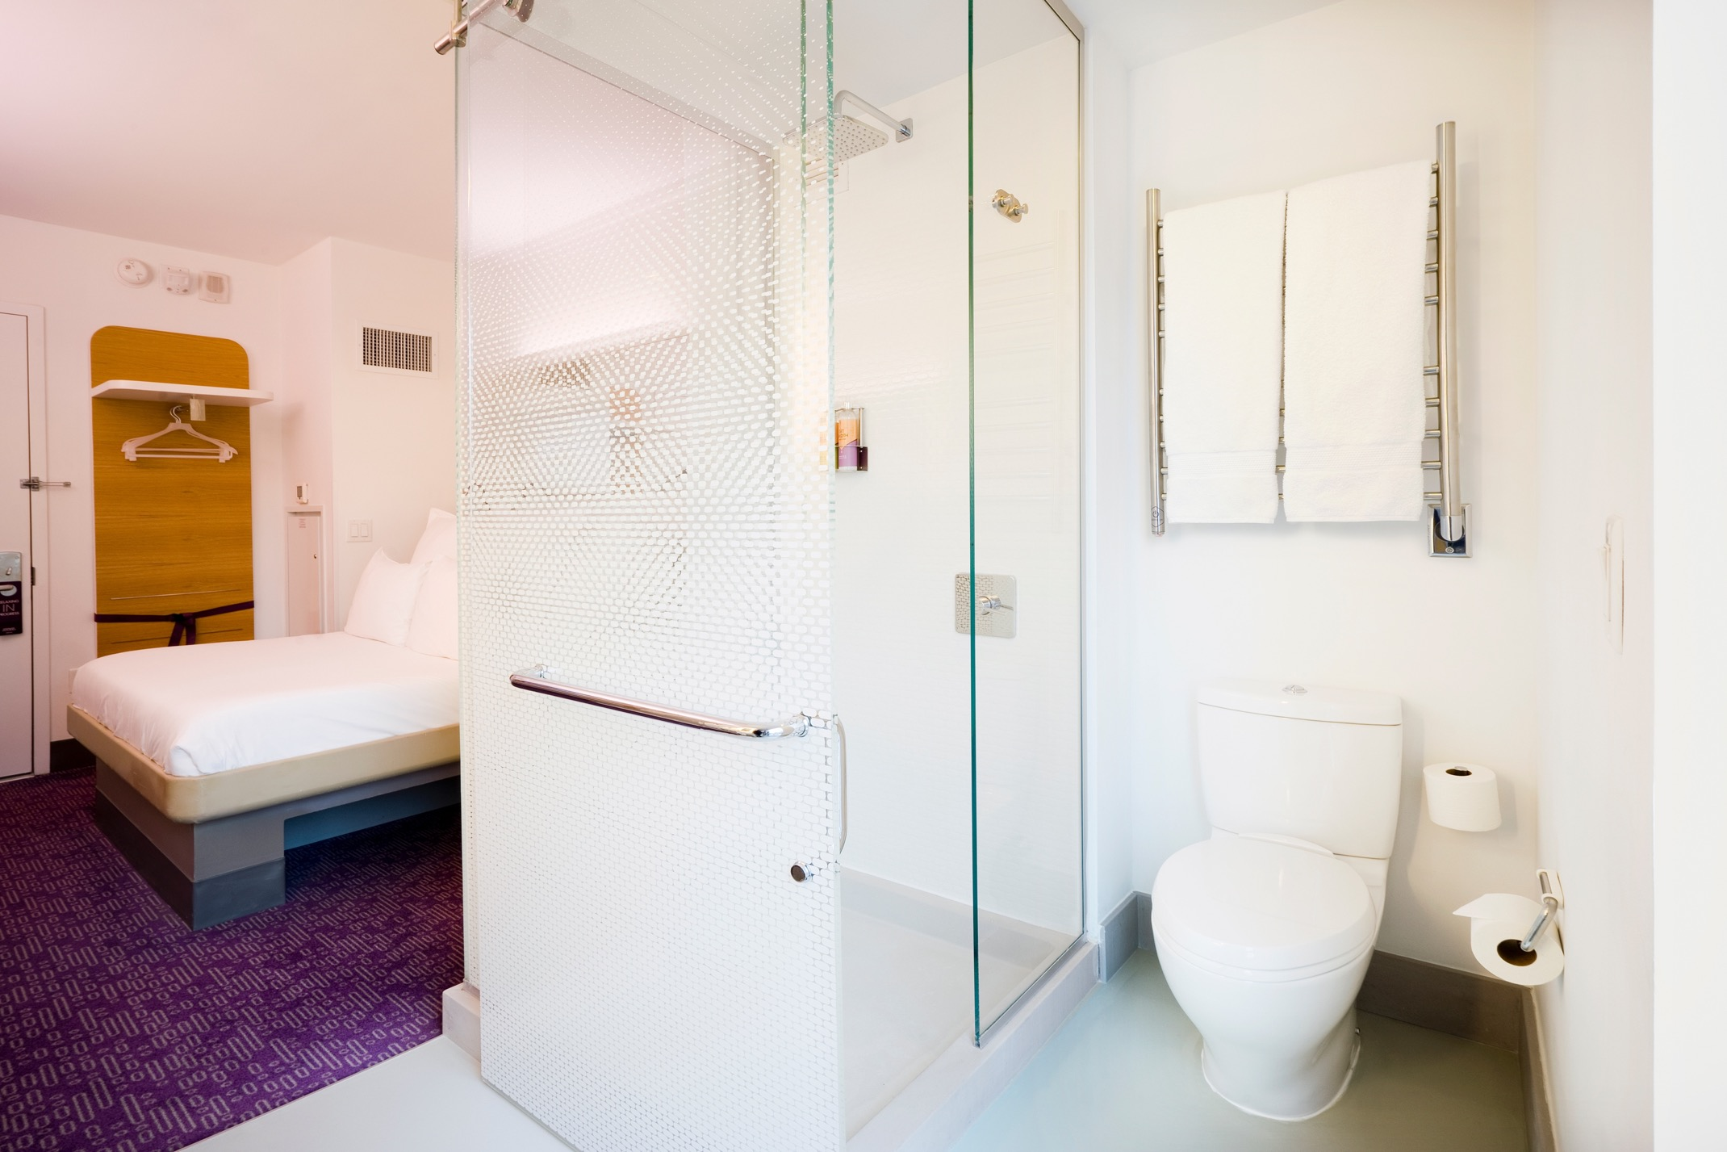
HEATED TOWEL RACKS Product Knowledge Training
TOWEL WARMERS | SPACE HEATERS | DRYING RACKS

Slide 2
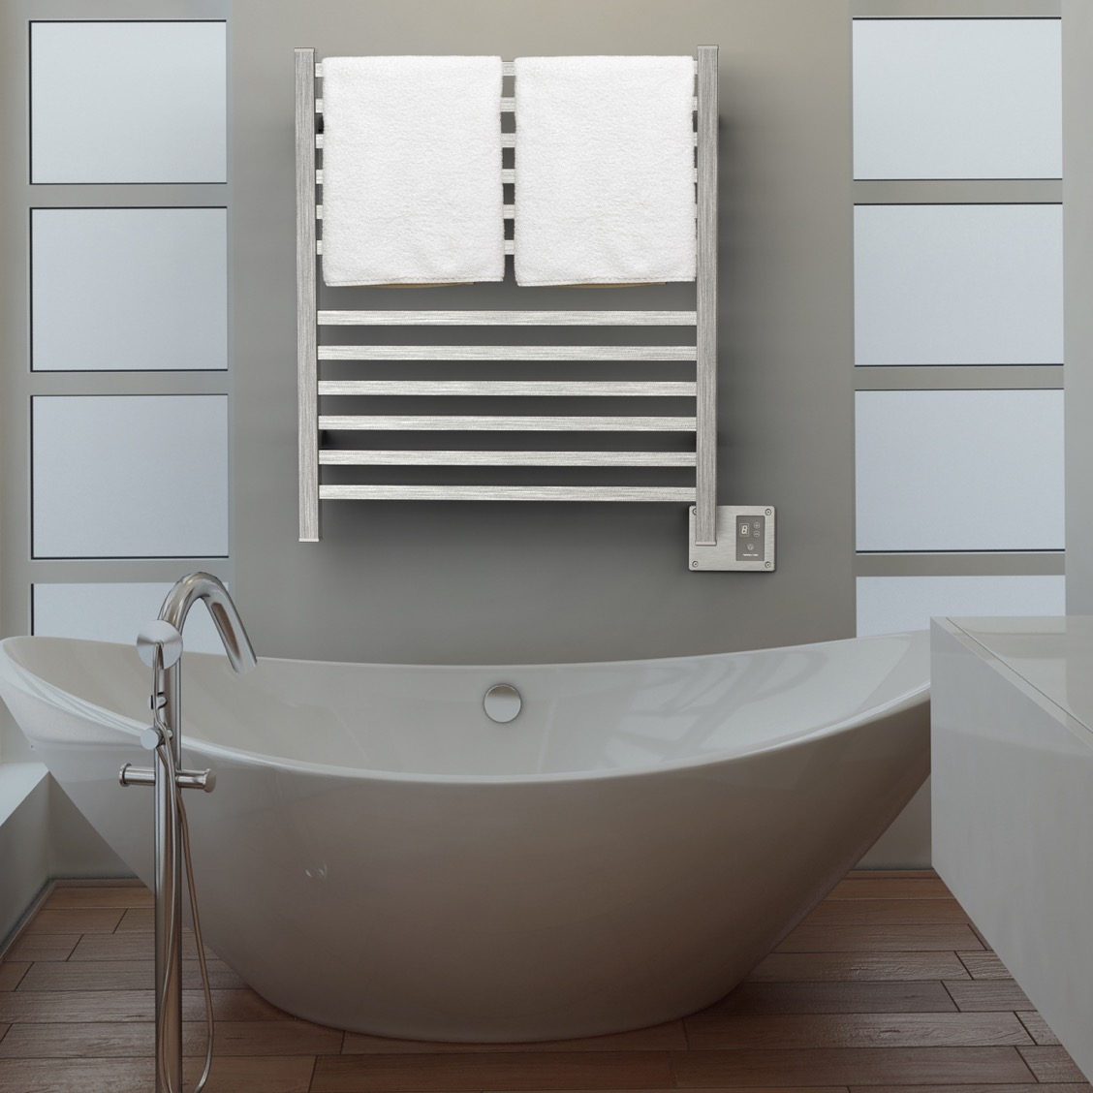
Learning Objectives
Benefits, functions and applications
Technology
How to Sell
Collections and Accessories
Q2833B

Slide 3
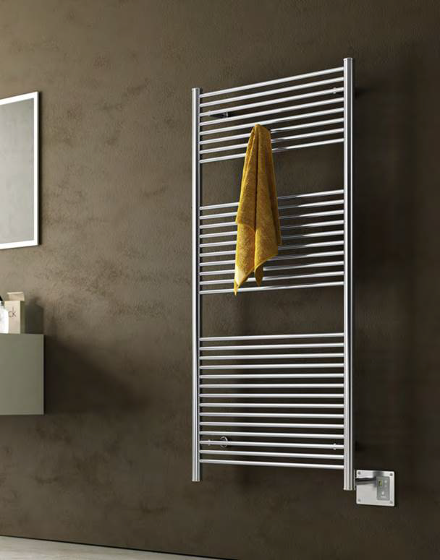
Benefits
There are 3 major benefits of Heated Towel Racks
Luxury & Comfort
Health & Wellness
Cost Savings
A2856B

Slide 4
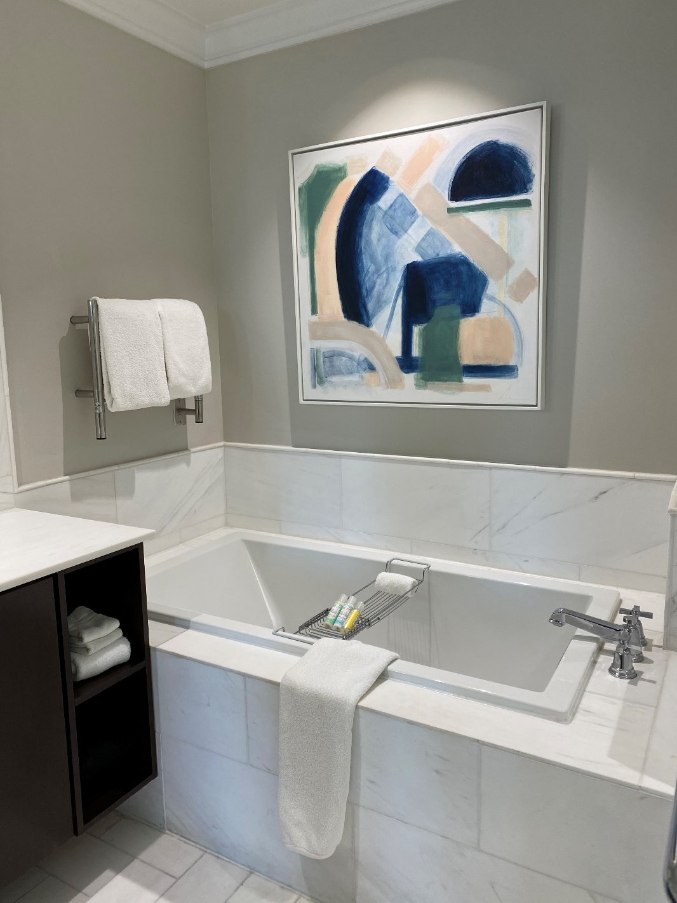
Luxury & comfort
Heated Towel Racks provide a wonderful luxury and comfort as one finishes their bathing routine.
Wrap yourself in a warm, cozy towel or bathrobe after a shower/bath.
Provides radiant heat to a bathroom, improving the guest’s comfort.
Plays into the senses of temperature & touch: It’s like a warm embrace.
Never use a damp and smelly towel again!
The Spectator Hotel – Jeeves HSP

Slide 5
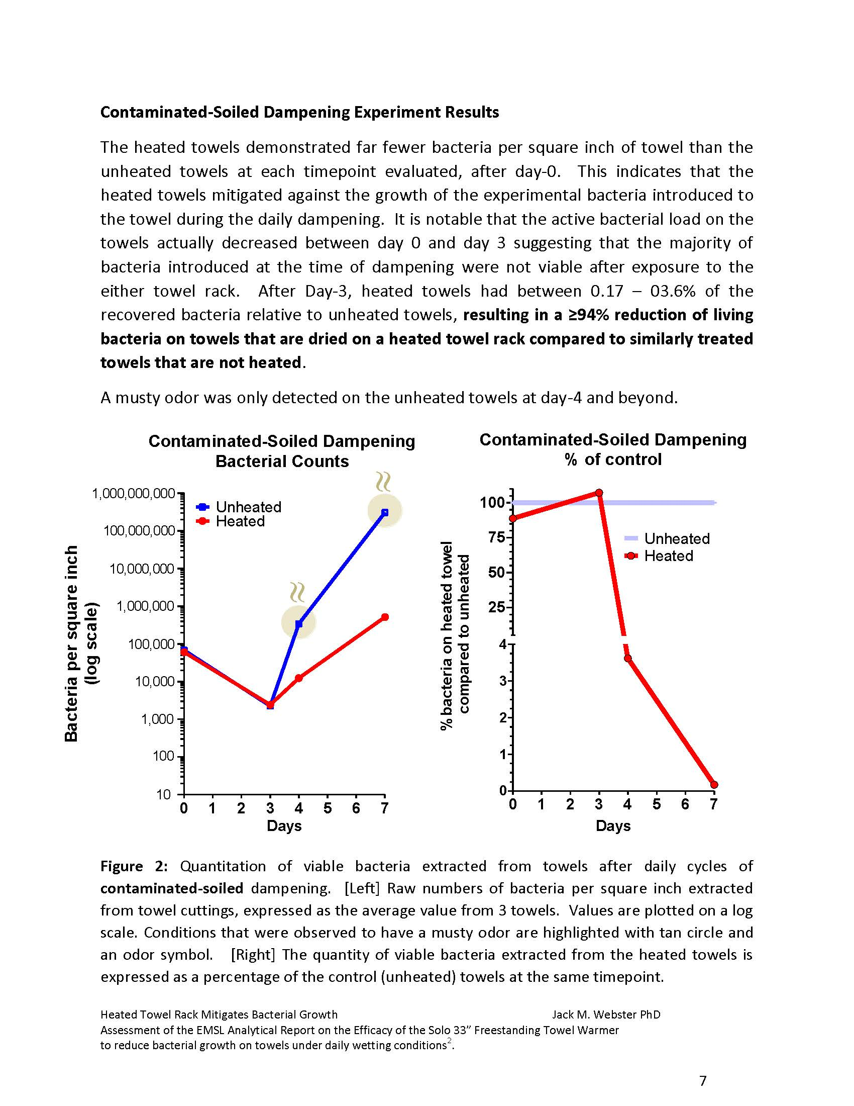
Health & Wellness
Health & Wellness has become an important element in interior design.
Heated Towel Racks have been proven to reduce bacteria growth on towels:
94% reduction after 3 days
99% reduction after 7 days
Eliminates foul odors caused by mold and bacteria – towels always smell fresh and clean.
Reduce humidity in bathroom by eliminating moisture.
Promotes a healthier and more hygienic environment by drying towels and spaces which helps prevent mold, mildew and bacteria growth.

Slide 6
Cost Savings
Heated Towel Racks can provide significant savings to any household:
Time – less laundry as towels are used longer = more time doing the things you love.
About 2 - 2.5hrs to wash, dry & fold a single load of towels
Electricity – it costs about $4/mo to run for 4hrs day/7 days a week. It costs $16/mo to wash & dry a single load of towels.
Water – average washing machine is 14/gal per load or almost 675gal/yr assuming 1 load per week. Reducing your wash frequency to every other week will cut your water consumption in half.
Wear & tear – washing your towels less frequently will prolong the life of the towel and reduce how frequently they get replaced.
Assumptions: Average household: 4 people
Towels per week per person: 2
Laundry loads per week: 1
National avg cost of power: $0.23 kWh
Average Towel Warmer rating: 150W
Reducing your laundry frequency from 4x per month to 2x per month will save you on average:
Time: 4–5hrs per/mo. or 48–60hrs per/yr.
Electricity: $8/mo. or $96 per/yr.
Water: 28gal/mo. or 336/gal per/yr.

Slide 7
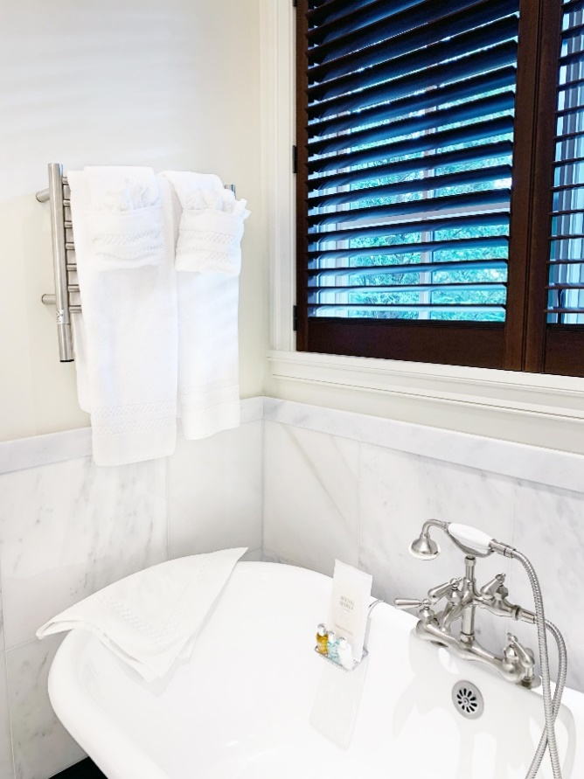
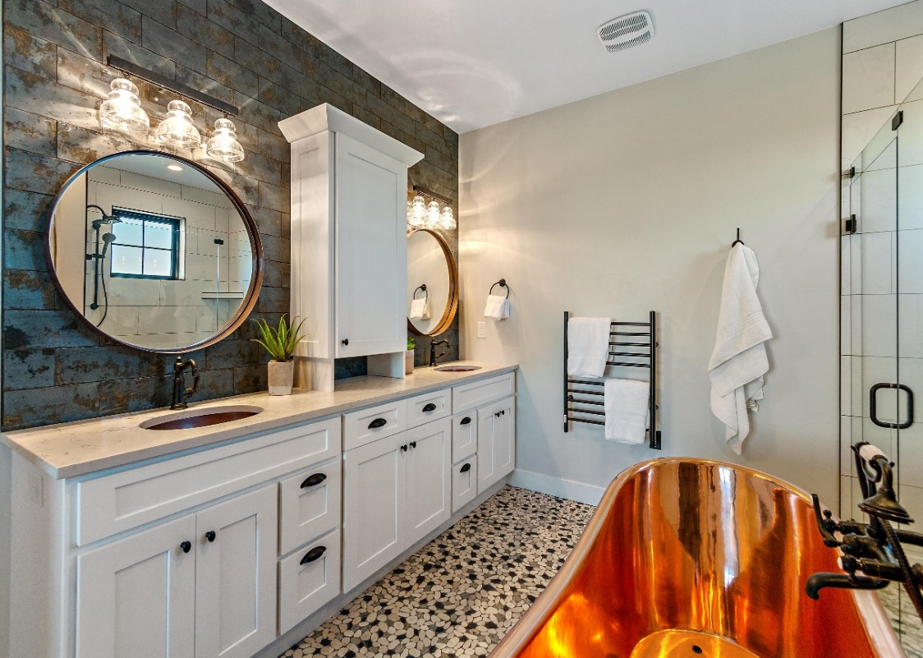
Applications: Bathrooms
Most Heated Towel Racks are installed in bathrooms. Whether its to provide radiant heat, dry damp towels after use, or warm them up, they offer many improvements over a standard towel bar or robe hook.
Add comfort and luxury to bathing experience
Keep towels and bathrobes dry and warm
Clean, fresh and fluffy towels – every time!
Provide radiant heat to bathroom – take cool edge off during cold winter mornings

Slide 8
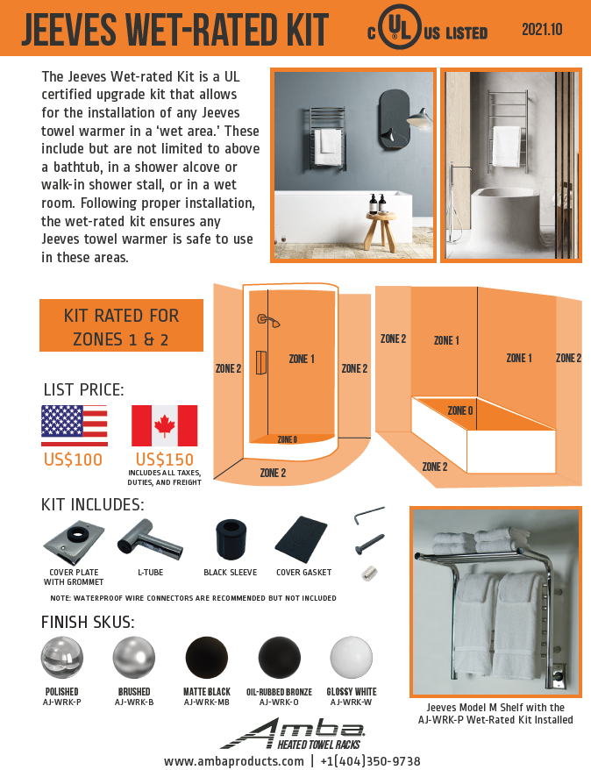
Wet Area applications – Jeeves Collection
When installing a towel warmer in a ‘wet area’, additional precautions need to be taken to meet code & safety requirements
Jeeves collection offers a UL Certified wet rated kit that makes any Jeeves model safe for wet areas
Wet Rated Kit eliminates restrictions and provides more convenience and flexibility for installation
Approved for NEC Zone 1 & Zone 2 locations:
Above a bathtub
In a shower
In a wet room or wet area

Slide 9
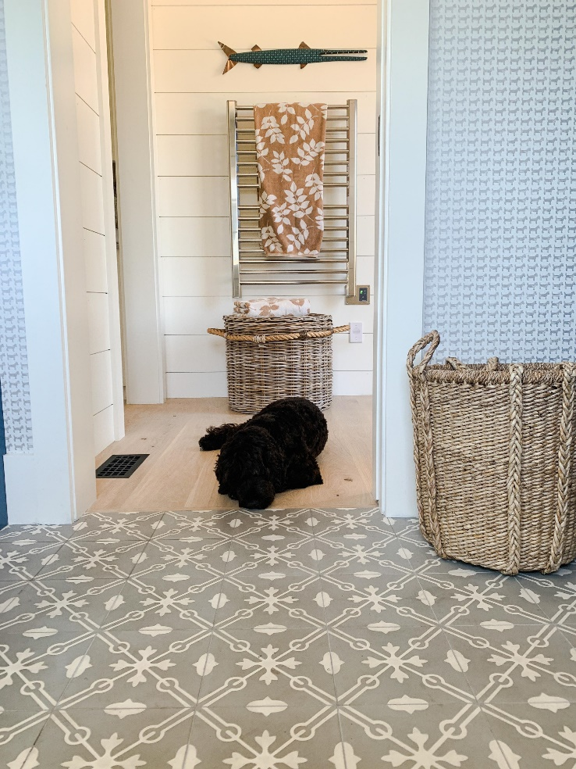
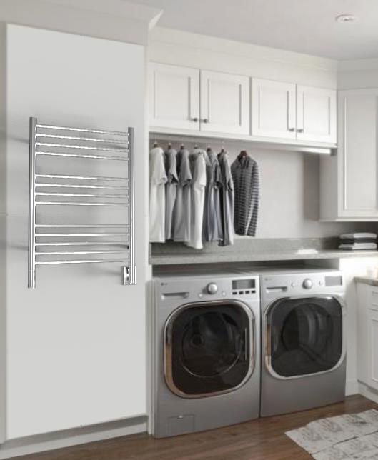
Applications: Laundry & Mud Rooms
Laundry Rooms:
Dry delicates, silks and other fabrics/garments that don’t go in a tumble dryer.
Reduce wrinkles while gently drying clothes.
Keeps laundry organized – no longer hanging on banisters, shower curtain rods or door handles.
Mud or Wet Rooms:
Hang and dry coats, scarves, mittens etc on cold & wet winter days.
Dry bathing suits, pool/beach towels, wet suits and life jackets during the summer.
Reduces humidity and provides warmth during colder months.

Slide 10
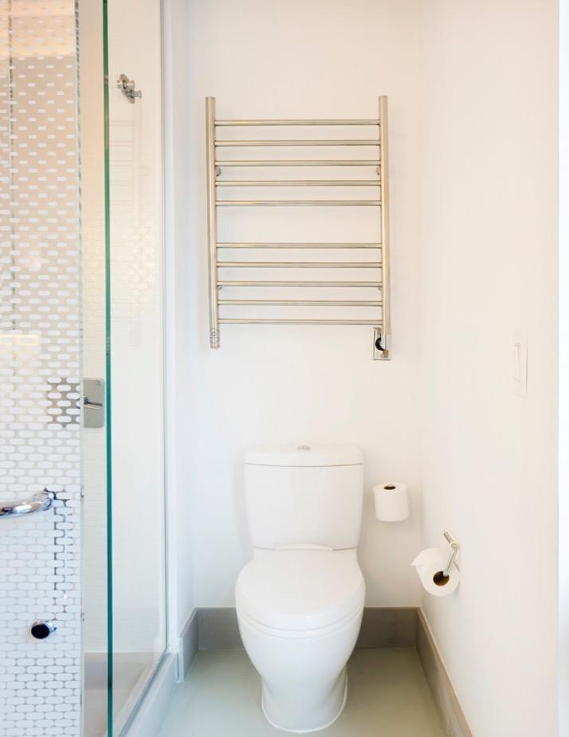
Applications: Other
Some applications that are less common, but still offer plenty of benefits include:
Pool house
Basement
Garage/workshop
Nursery
Boats/RVs
Commercial: Hotels, assisted living, spas/gyms, multi-family
Yotel Hotel – Radiant RWH-SP

Slide 11
Heating Time & Technology
Dry Element (DE) Technology - units have a wire cable that run through all vertical & horizontal bars (Many competitors only heat the horizontal bars).
Pros: Fast heat up time – only 10 to 15min with heat starting in as little as 5min
Cons: Heating cables cannot be repaired – entire unit must be replaced
Collections: Sirio, Quadro, Antus, Vega, Radiant, Solo & Swivel
Liquid Filled (LF) technology - Units are filled with a glycol-water solution. A heating element heats the liquid which heats the bars.
Pros: Heating element can be replaced if it fails; entire unit does not need to be replaced
Cons: Longer heat up times – range from 15 to 45min depending on the size of the unit
Collections: Jeeves & Traditional

Slide 12
Why sell Amba?
Choose from 9 different collections
Good: Radiant, Solo, Swivel
Better: Jeeves, Traditional
Best: Antus, Quadro, Sirio, Vega
Choose from 10 stocked finishes
Polished SS, Brushed SS, Polished Nickel, Brushed Nickel, Matte Black, Satin Brass, Brushed Bronze, Polished Gold, ORB, White
Over 175+ stocked SKUs with <1week lead time
We offer custom sizes & finishes – can color match other MFGs unique finishes.

Slide 13
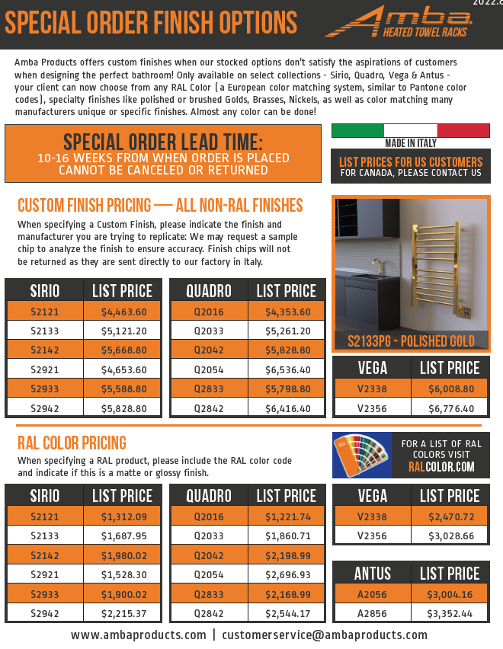
Custom sizes & finishes
Only available for Italian Collections:
Sirio, Quadro, Vega & Antus
RAL Color Codes – match your towel warmer to your faucet or tub surround
Custom Finishes – match almost any finish from MFGs to keep a consistent look
Lead time is 10-16 weeks
Factory may require sample chip to analyze and match your finish

Slide 14
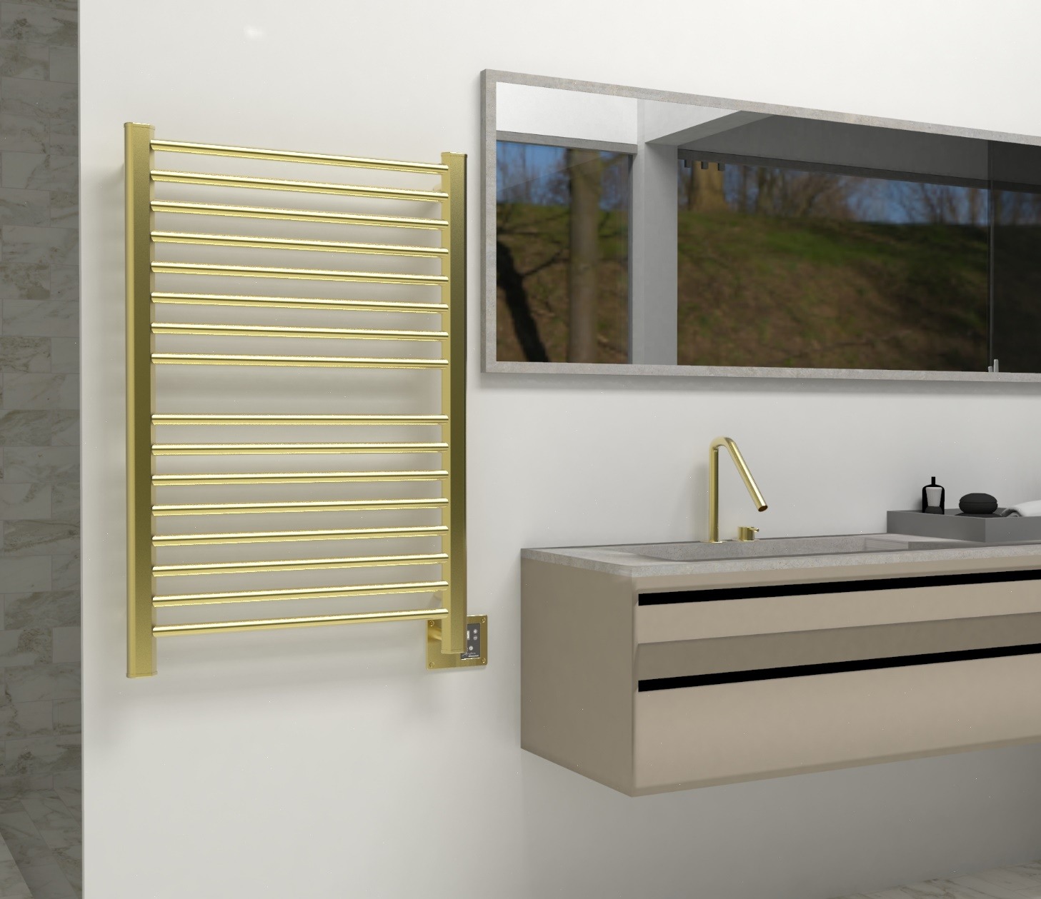
How to sell Heated towel racks
Accessories are usually the last to be picked, leaving minimal budget
In most primary bathrooms, you specify 2x towel bars & 2x robe hooks
Reallocate that $$$ to 1 towel warmer – you’re not adding more costs!
1 towel warmer replaces all 4 accessories
Upgrades the bathroom and provides a more luxurious, bathroom oasis.
Some models can even save money compared to the cost of robe hooks and towel bars
Hang bathrobes from top of vertical bars
Section 1
Section 2
There are two sections on this towel warmer to hold 2 towels; the vertical bars double as robe hooks to hold 2 bathrobes

Slide 15
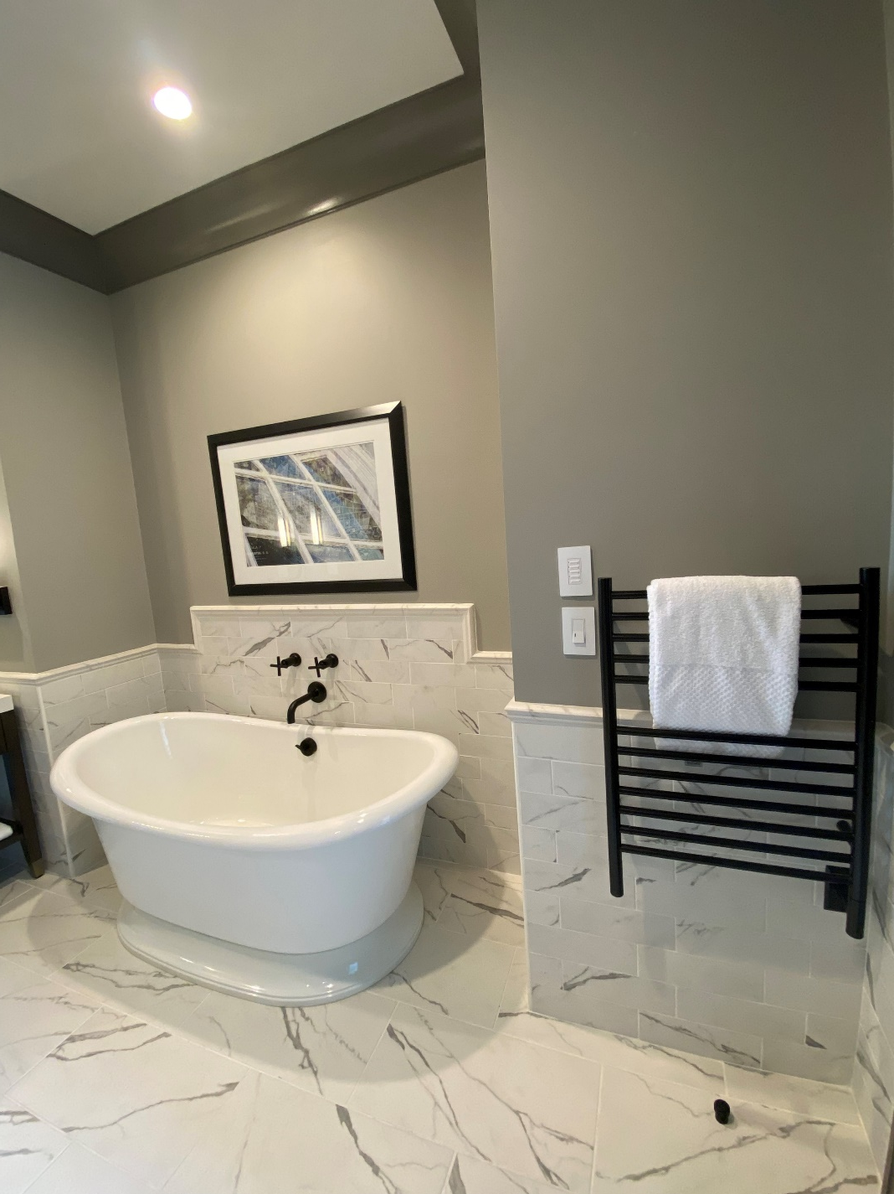
requirements
It is important that your client will be able to install the product. Below are some basic requirements.
Electricity:
Requires standard 120V connection.
Doesn’t require a dedicated circuit.
Space:
They must have the wall/floor space for the unit to fit.
Backing is recommended for wall mounted units.
Code:
National Electrical Code (NEC) dictates a towel warmer must be 3’ from water source (unless using Jeeves Wet Rated Kit).
Local codes supersede national code.
All products are UL or ETL certified for USA & Canada
Liberty Hotel by Hilton – Jeeves ESMB

Slide 16
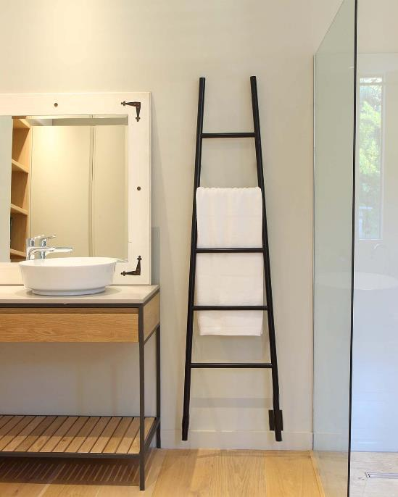
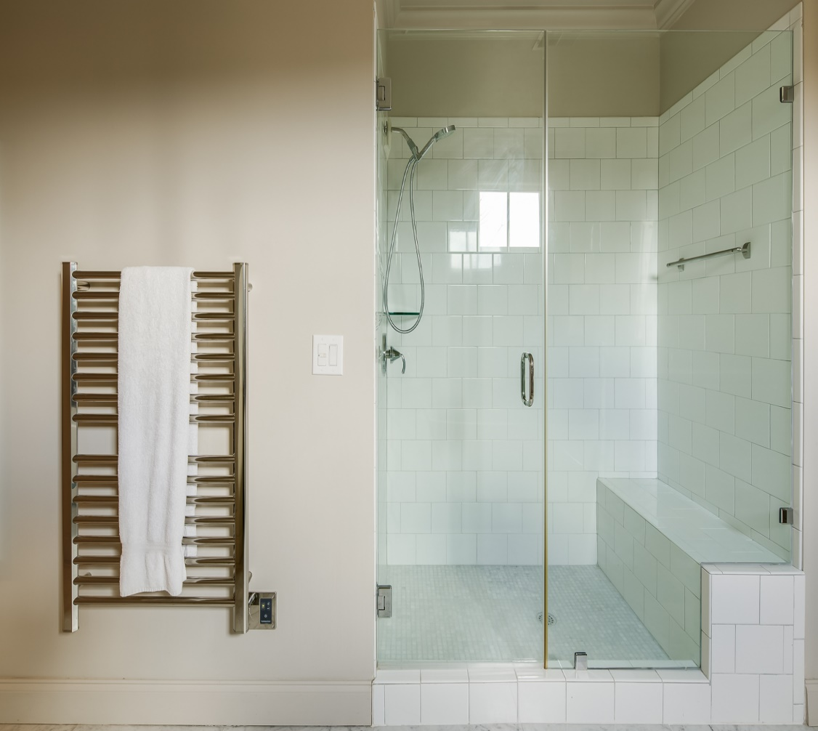
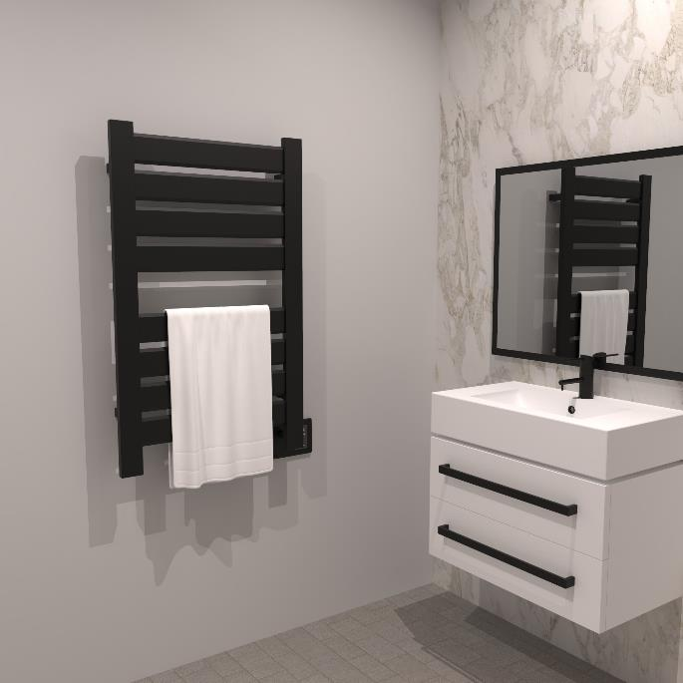
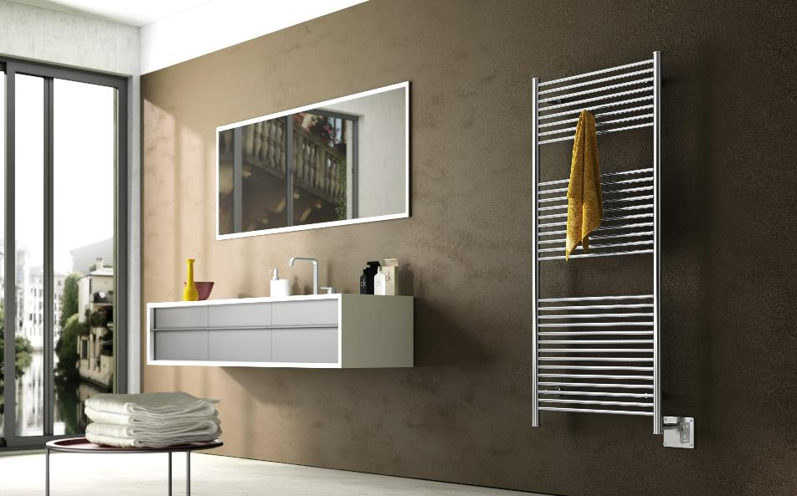
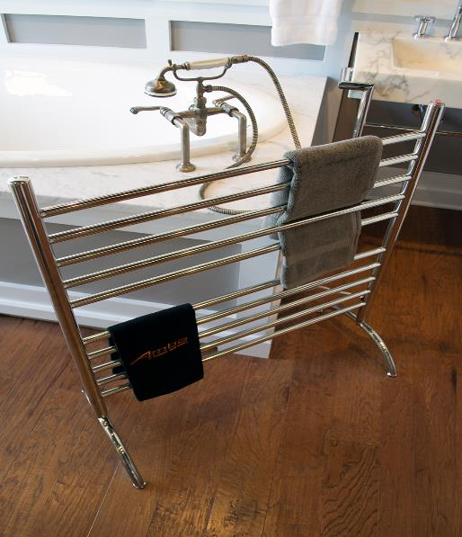
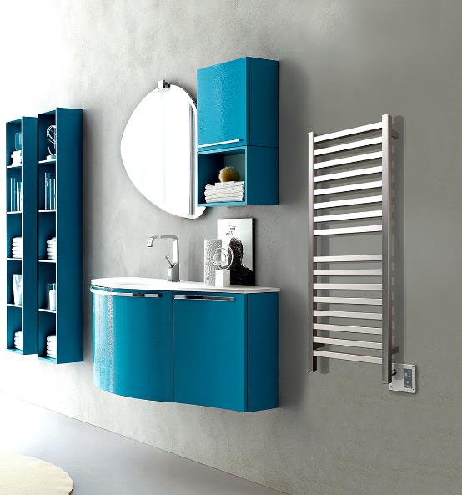
Collections & Accessories

Slide 17
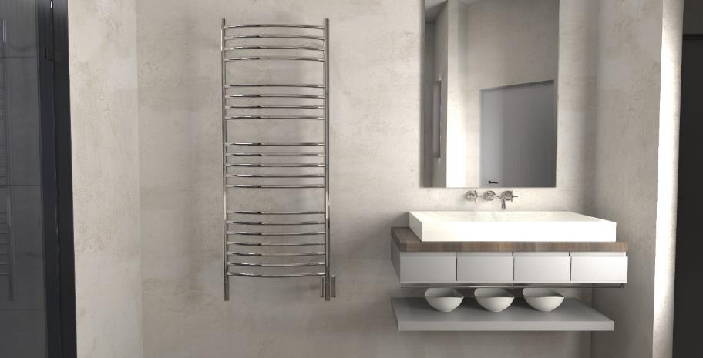
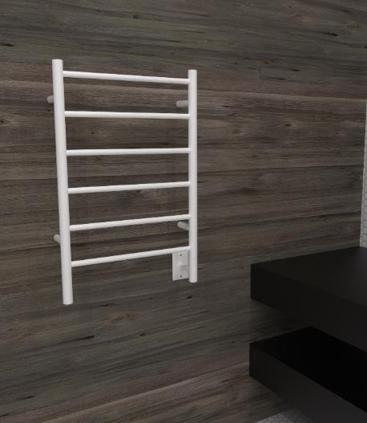
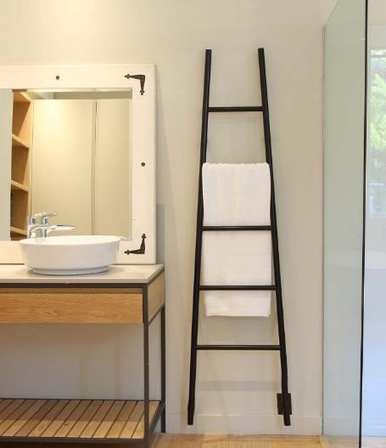
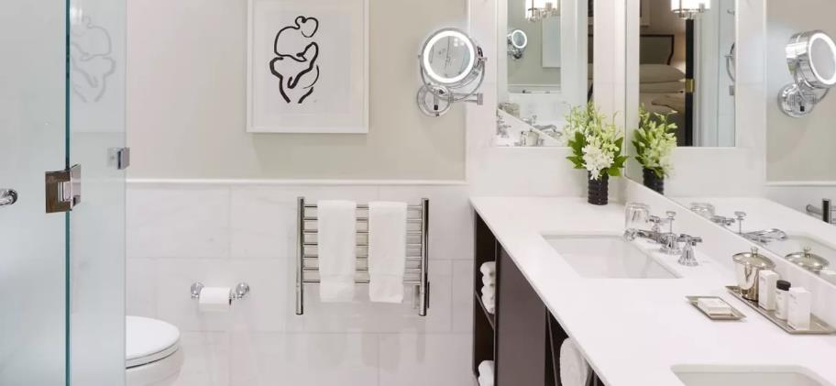
JEEVES COLLECTION
Highlights:
5 Stocked Finishes: Brushed, Polished, Matte Black, ORB & White
Custom Sizes available in catalog
UL-certified “Wet-rated Upgrade Kit” available
Heat up time: 15 to 45min
Liquid filled heating technology - replaceable heating element
Left hand electrical wiring available
What to Order:
Included: Hardwire kit & mounting hardware
Required: Timer or On/Off Switch
Optional: Double gang plate; bathrobe hanger
DCP
JSW
ASMB
HSP

Slide 18
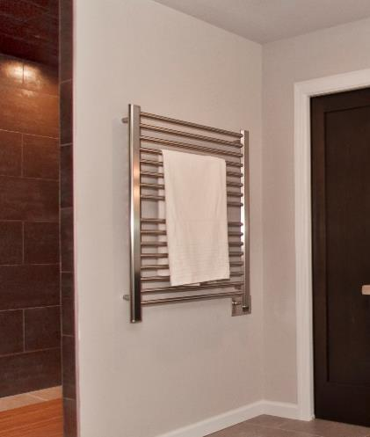
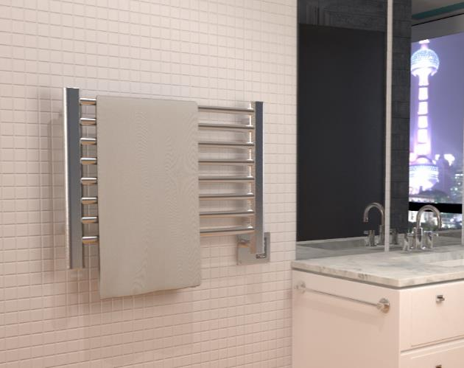
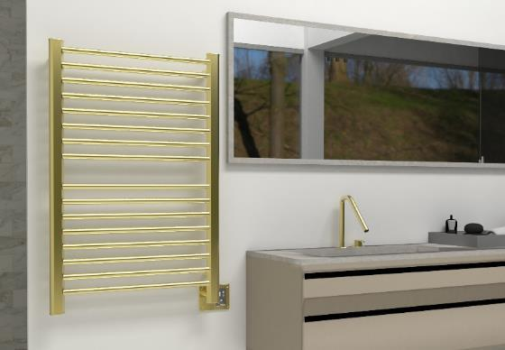
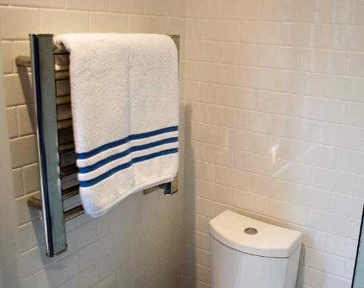
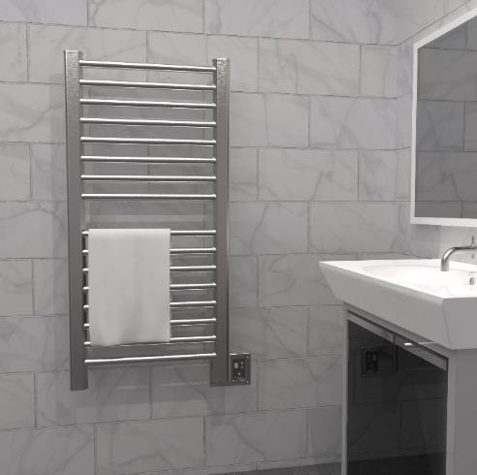
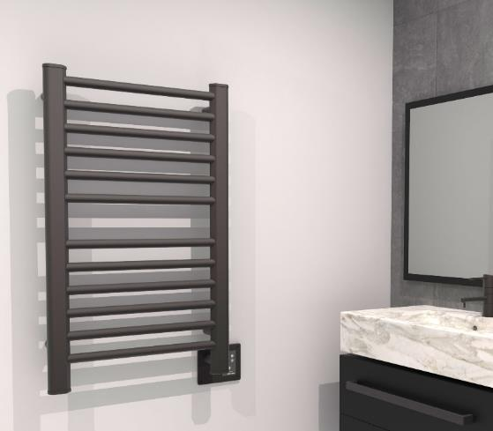
SIRIO COLLECTION
Highlights:
Dry element technology: 10-15min heat up time
Stocked Finishes: Brushed, Polished, ORB and Satin Brass
Digital Heat Controller: 9 levels of temperature control (standard on all models except S2121 – optional)
Dual-purpose function: Heated Towel rack and space heater
Custom sizes and finishes available – special order
Left hand electrical available – special order
What to order:
Included: Hardwire Kit, Mounting Hardware, Digital Heat Controller (except S2121 – On/Off switch)
Required: Nothing additional
Optional: Remote DHC; Timer; Bathrobe hook
S2942P
S2921B
S2942SB
S2121P
S2142B
S2133O

Slide 19
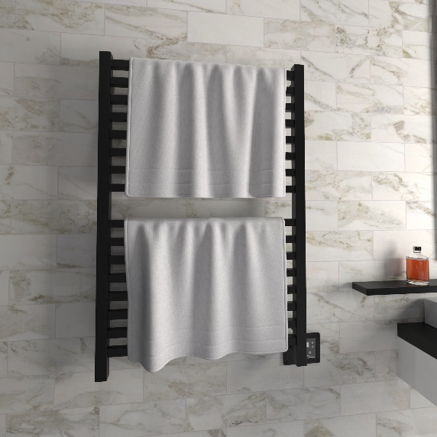
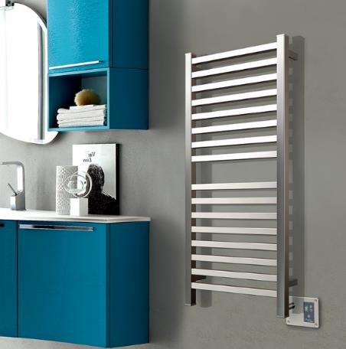
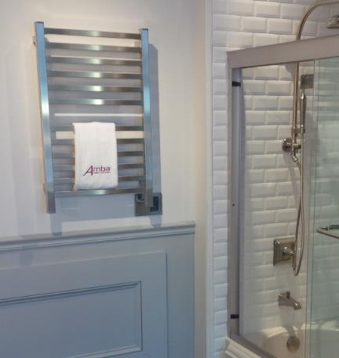
QUADRO COLLECTION
Highlights:
Dry element technology: 10-15min heat up time
Stocked Finishes: Brushed, Matte Black & Polished
Digital Heat Controller: 9 levels of temperature control (standard on all models except Q2016 – optional)
Dual-purpose function: Heated Towel rack and space heater
Custom sizes and finishes available – special order
Left hand electrical available – special order
What to order:
Included: Hardwire Kit, Mounting Hardware, Digital Heat Controller (except Q2016 – On/Off switch)
Required: Nothing additional
Optional: Remote DHC; Timer; Bathrobe hook
Q2842MB
Q2042B
Q2033P

Slide 20
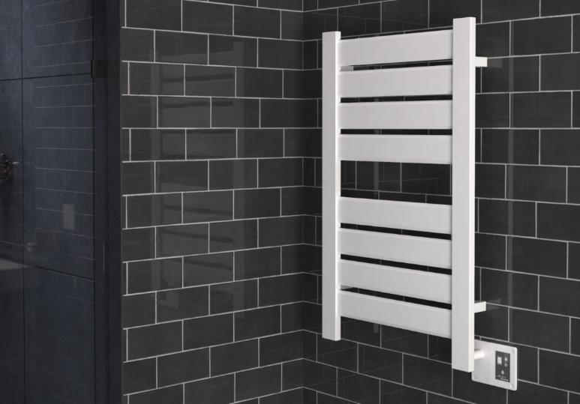
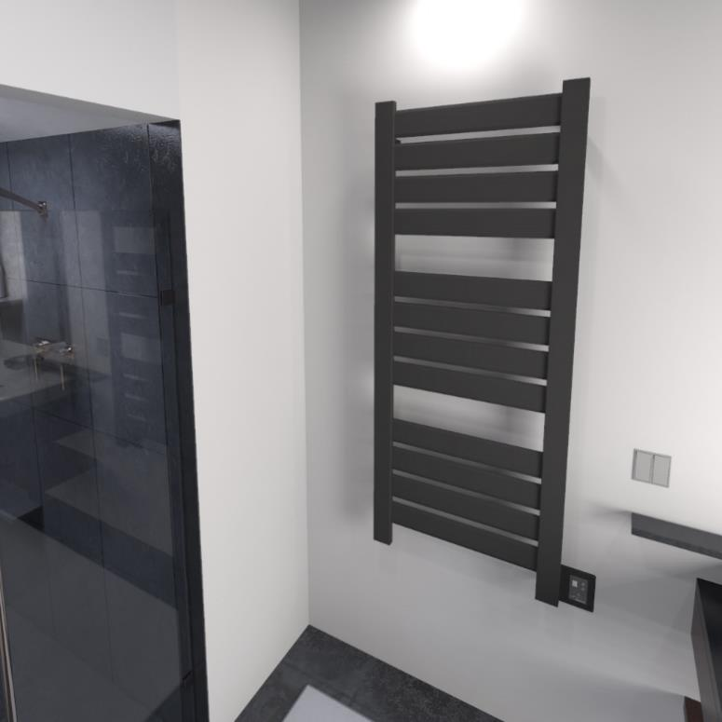
HEATED TOWEL RACK / SPACE HEATER:
VEGA COLLECTION
Highlights:
Dry element technology: 10-15min heat up time
Stocked Finishes: Brushed, Matte Black, Polished & White
Flat panels = more surface area – most efficient collection
Digital Heat Controller: 9 levels of temperature control
Dual-purpose function: Heated Towel rack and space heater
Custom sizes and finishes available – special order
Left hand electrical available – special order
What to order:
Included: Hardwire Kit, Mounting Hardware, Digital Heat Controller
Required: Nothing additional
Optional: Remote DHC; Timer; Bathrobe hook
V2338W
V2356MB

Slide 21
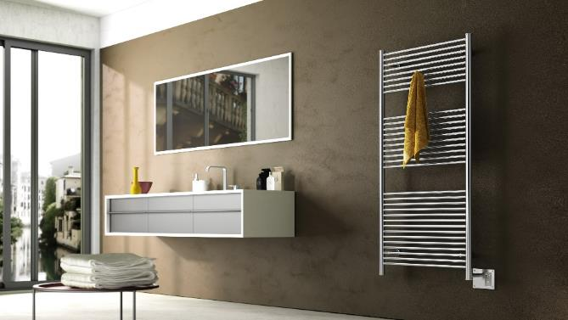
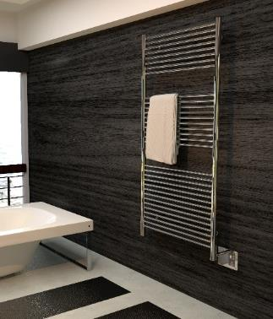
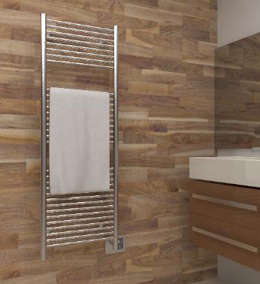
HEATED TOWEL RACK / SPACE HEATER:
ANTUS COLLECTION
Highlights:
Dry element technology: 10-15min heat up time
Stocked Finishes: Brushed & Polished
Digital Heat Controller: 9 levels of temperature control
Dual-purpose function: Heated Towel rack and space heater
Custom sizes and finishes available – special order
Left hand electrical available – special order
What to order:
Included: Hardwire Kit, Mounting Hardware, Digital Heat Controller
Required: Nothing additional
Optional: Remote DHC; Timer; Bathrobe hook
A2856B
A2856P
A2056B

Slide 22
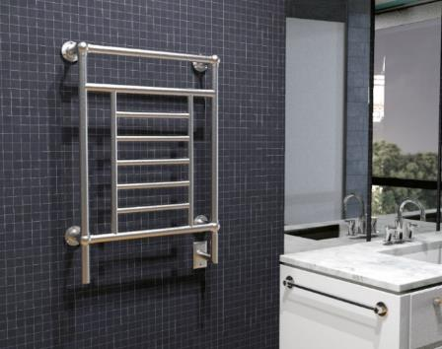
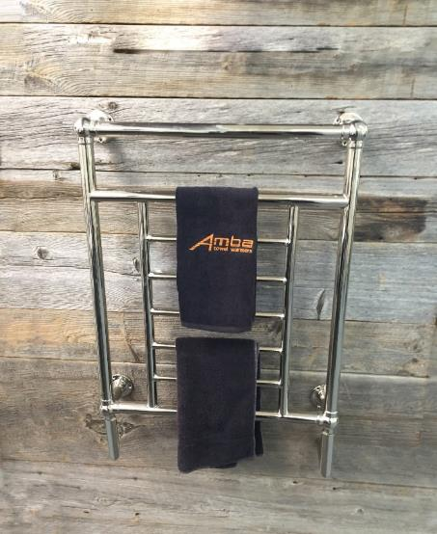
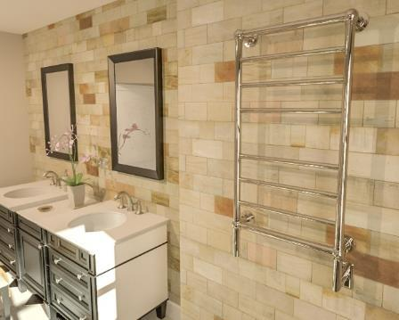
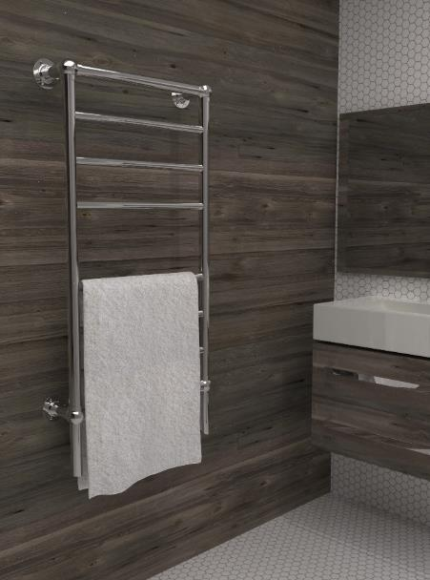
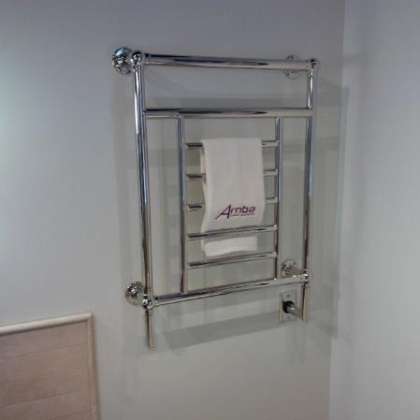
TRADITIONAL COLLECTION
Highlights:
Beautifully crafted finials create a decorative design
Liquid filled heating technology – replaceable heating element
Stocked finishes: Brushed Nickel & Polished Nickel
Heat up time: 30-40min
Left hand electrical wiring available
What to order:
Included: Hardwire kit & Mounting Hardware
Required: Timer or Switch
T-2536PN
T-2536PN
T-2040BN
T-2536PN
T-2040PN

Slide 23
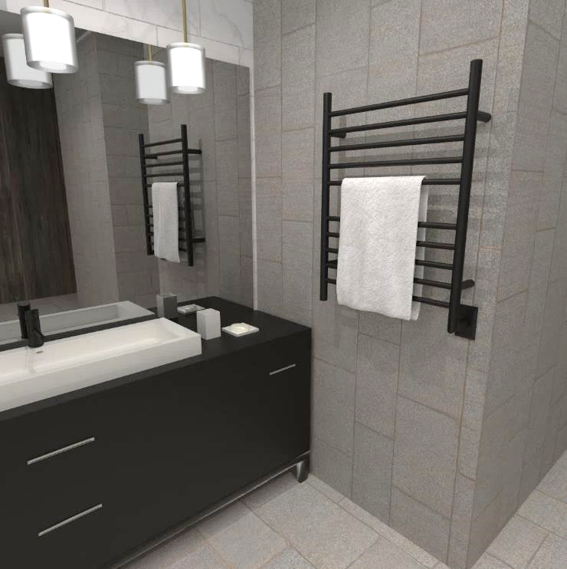
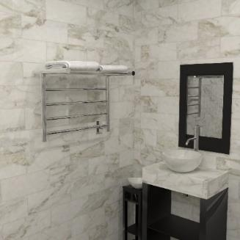
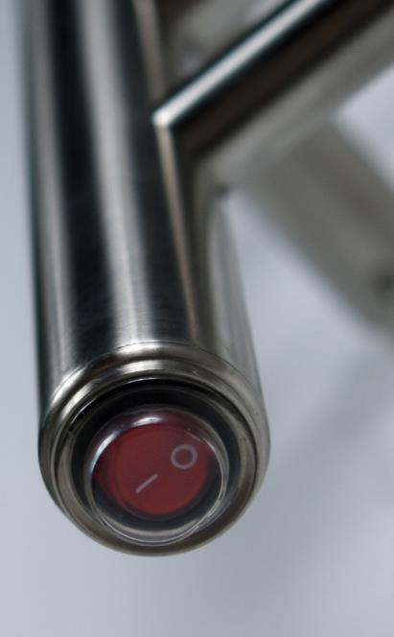
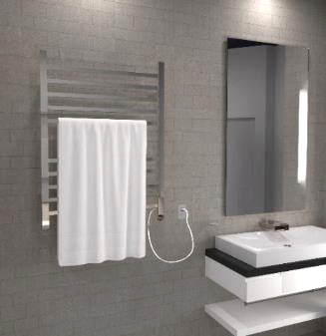
RADIANT COLLECTION
Highlights:
Round and square bar options available to suit your style
Stocked finishes: Brushed & Polished (all models); Matte Black, Satin Brass and Polished Gold in specific models only
Sizes: Small, Medium & Large and a Shelf unit
Dry element technology: 10-15min heat up time
Integrated On/Off switch located on bottom of vertical bar
Hardwired and plug-in options available for most models
What to order:
Included: Mounting Hardware; Hardwire Kit for hardwired models; On/Off switch
Required: Nothing additional
Optional: Timer; Double gang plate
RWH-SMB
RSH-P
RSWP-P

Slide 24
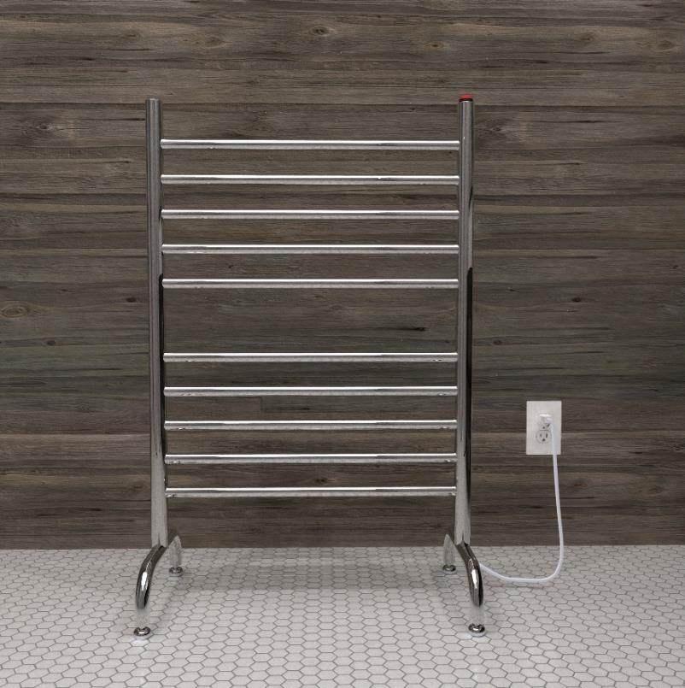
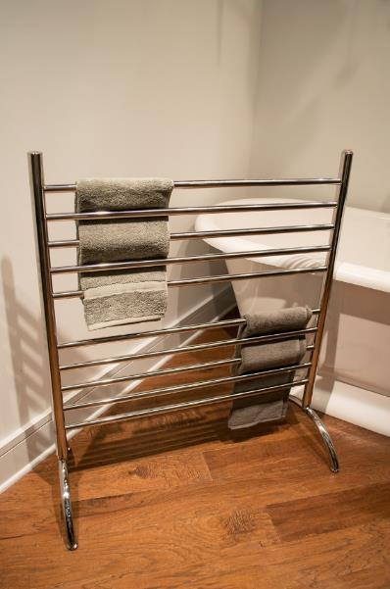
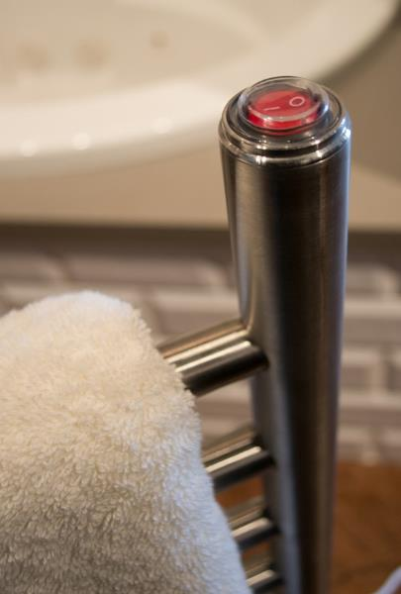
SOLO COLLECTION
Highlights:
Freestanding model – stands on its own and plugs into outlet
Stocked finishes: Brushed, Polished & Matte Black
Lightweight & portable – move from bathroom to laundry room or outdoor pool/jacuzzi etc
Ideal for use next to freestanding and walk-in bathtubs
Dry element technology: 10-15min heat up time
What to order:
Included: Mounting legs, plug-in kit, On/Off Switch
Optional: Plug-in programmable timer
SAFSP-24
SAFSB-33

Slide 25
SWIVEL COLLECTION
Highlights:
External Temperature range: 110F to 160F
Plug-in collection
Stocked Finishes: Brushed & Polished
Dry element technology: 10-15min heat up time
Individual bars can swivel 180 degrees
Each arm can be moved independently
Simple to install
What to order:
Included: Mounting Hardware & Plug-in kit
Optional: Plug-in programmable timer
J-D005P
J-B004P
J-D005B

Slide 26
DIGITAL HEAT CONTROLLER
Designed to allow users to have control over the temperature; there are 9 heat levels to choose from.
Digital Heat Controller is included with our Italian collections: Quadro, Sirio, Antus, &Vega.
A remotely wired DHC is available if you want to locate the controller away from the unit itself. This could be due to space constraints or to make it easier to interact with.
Standard Digital Heat Controller
Remotely Wired Digital Heat Controller

Slide 27
TIMERS & SWITCHES
A choice of controls that can be used with our heated towel racks.
On/Off switch:
ATW-S-W – Hardwired
24hr/7day Programmable Timers:
ATW-T24 – Hardwired
ATW-T24-BL – Black color change kit
ATW-P24 – Plug-in
Wi-Fi Smart switch:
ATW-SS - Hardwired
ATW-SS-BL – Black color change kit
Countdown timer:
ATW-CDT – Hardwired
ATW-CDT-BL – Black color change kit
PLUG-IN PROGRAMMABLE TIMER
ON/OFF
SWITCH
COUNTDOWN TIMER
Wi-Fi Smart Switch & Hardwired Programmable Timer
Note: BLACK COLOR CHANGE KITS SOLD SEPARATELY

Slide 28
DOUBLE GANG PLATE
The double gang plate is an optional accessory which replaces the standard single gang plate.
It allows for placement of switch/timer next to towel warmer. This makes for a cleaner, more purpose designed look.
Fits a standard US double gang box, and comes in matching finishes
Jeeves: AJ-DGP-*Finish Code*
Radiant: AR-DGP-*Finish Code*
Radiant Square Models use
the Jeeves Double Gang Plate

Slide 29
BATHROBE HOOKS
Available for Jeeves, Sirio, Quadro, Vega & Antus Collections.
Only stocked in Brushed & Polished finishes – Special finishes available upon request
Easily secures to the unit

Slide 30
Shipping & Handling chart
1. Take the first 3 digits of
the Ship To zip code to
determine your zone
2. Find the collection and model you are shipping, then find the appropriate zone to see the freight cost
Ex: Jeeves model E, shipping to zip: 10005
Step 1: First three digits of zip = “100” … so it falls within Zone 2
Step 2: Find the Collection & model on chart
Step 3: Freight rate is $40

Slide 31
CUSTOMER SERVICE
Fast deliver of all stocked items – 24hr order processing time
Drop shipping at no extra price
Telephone Customer support available 8am–6pm EST: +1(404)350-9738

Slide 32
ONLINE RESOURCES
CATALOGS & PRICE LISTS:
SHOWROOM LOCATOR
ambaproducts.com/catalogs
EASY ORDER TRACKING:
ambaproducts.com/order-status/
STOCK CHECK: https://ambaproducts.com/stockcheck/
CEU COURSES:
ambaproducts.com/CEU
Display Program
ambaproducts.com/showrooms
EMAIL CONTACTS:
customerservice@ambaproducts.com
orders@ambaproducts.com returns@ambaproducts.com

Slide 33
IN SUMMARY
Pamper and indulge yourself with an affordable luxury
Prevent growth of bacteria and promote health, wellness & hygiene
Use in a variety of locations, not just bathrooms
Help keep rooms mold and mildew free
Variety of designs, finishes, and sizes
US List Prices start at $370
Add comfort to any room
Keep towels warm and dry
Reduce laundry loads, electricity and water consumption
FSP

