Slide 1
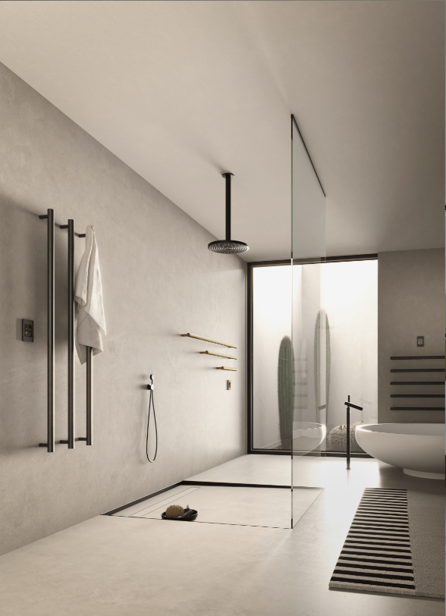
HEATED TOWEL RACKS Product Knowledge Training
TOWEL WARMERS | SPACE HEATERS | DRYING RACKS

Slide 2
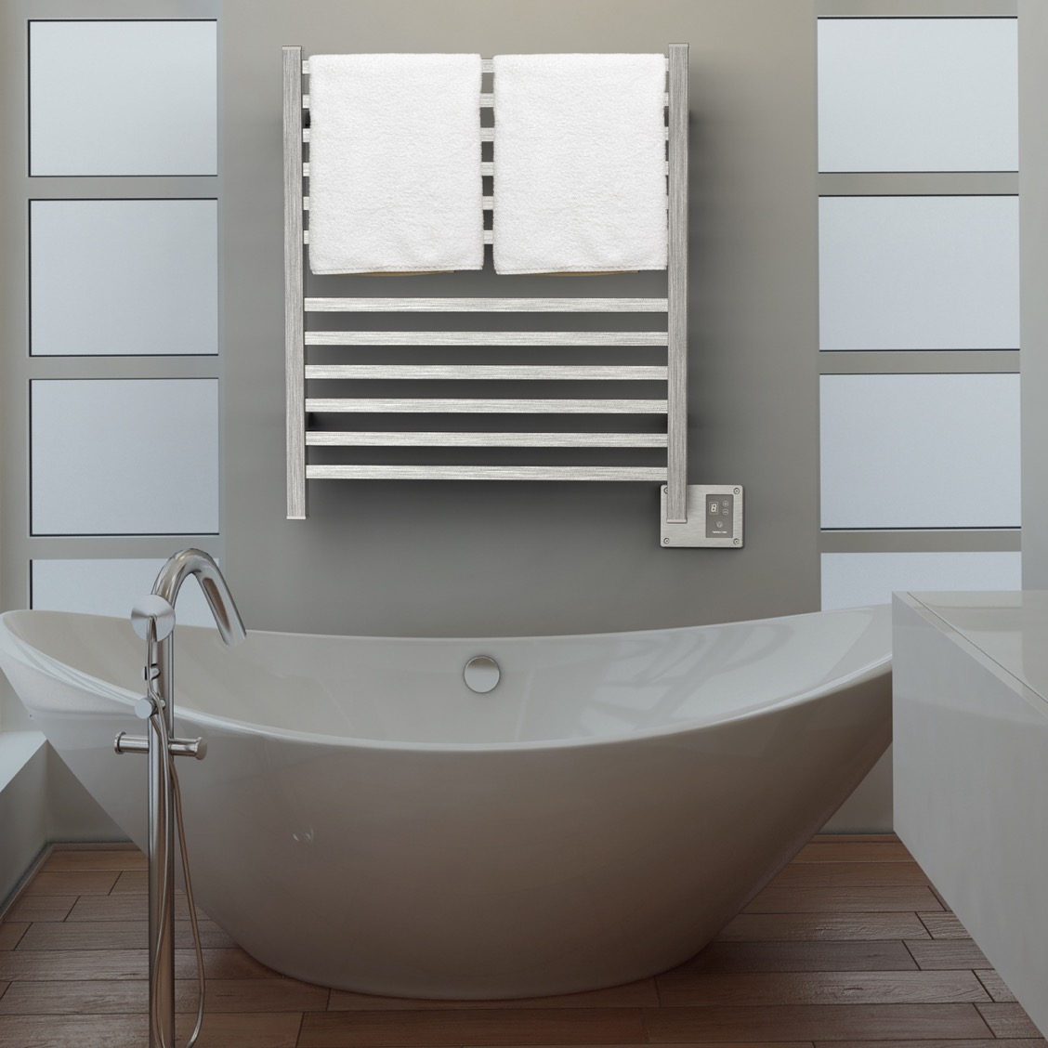
Learning Objectives
Benefits, functions and applications
Technology
How to Sell
Collections and Accessories
Q2833B

Slide 3
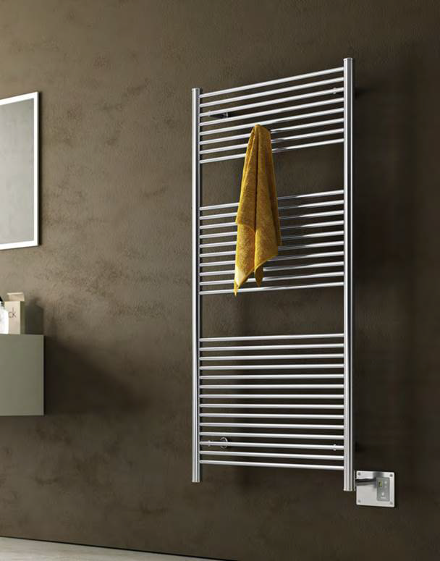
Benefits
There are 3 major benefits of Heated Towel Racks
Luxury & Comfort
Health & Wellness
Cost Savings
A2856B

Slide 4
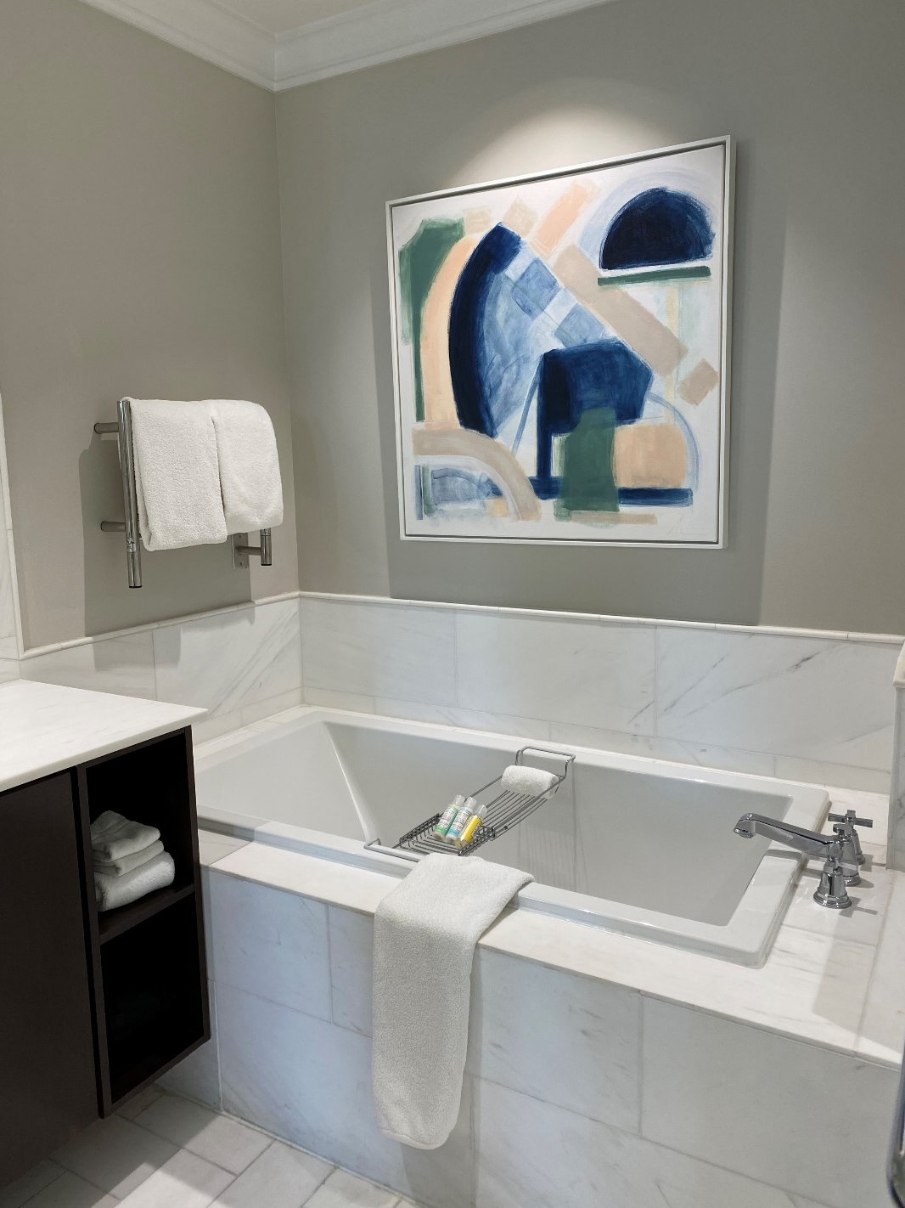
Luxury & comfort
Heated Towel Racks provide a wonderful luxury and comfort as one finishes their bathing routine.
Wrap yourself in a warm, cozy towel or bathrobe after a shower/bath.
Provides radiant heat to a bathroom, improving the guest’s comfort.
Plays into the senses of temperature & touch: It’s like a warm embrace.
Never use a damp and smelly towel again!
The Spectator Hotel – Jeeves HSP

Slide 5
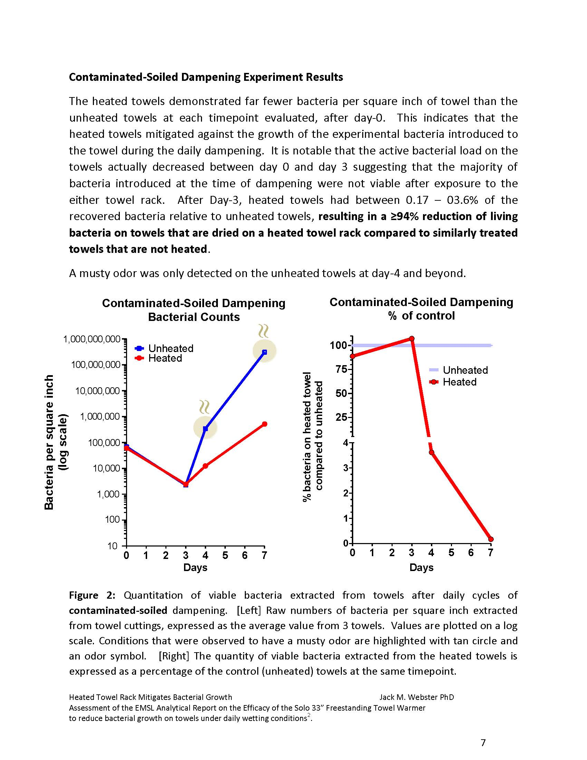
Health & Wellness
Health & Wellness has become an important element in interior design.
Heated Towel Racks have been proven to reduce bacteria growth on towels:
94% reduction after 3 days
99% reduction after 7 days
Eliminates foul odors caused by mold and bacteria – towels always smell fresh and clean.
Reduce humidity in bathroom by eliminating moisture.
Promotes a healthier and more hygienic environment by drying towels and spaces which helps prevent mold, mildew and bacteria growth.

Slide 6
Cost Savings
Drawing from a survey of 3,000 households, we've distilled key insights into the everyday savings afforded by heated towel racks. Our analysis quantifies the savings in terms of time, electricity, water, and detergent use.
Time Savings: If laundry takes 2 hours per week, using a heated towel rack to extend the time between washes to every other week frees up roughly 26 hours a year for an average household.
Electricity Savings: A heated towel rack costs about $4 per month to run. In contrast, the average washing machine and dryer can cost around $16 per month to operate weekly. By extending towel use and halving laundry frequency, a household could save roughly $8 per month on their electricity bill.
Water Conservation: By shifting to bi-weekly laundering, a household that uses 20 gallons of water per laundry load can save an impressive 520 gallons of water yearly, a stride toward more sustainable living.
Detergent Savings: Decreasing wash frequency by half means you also halve your detergent consumption, fostering financial savings and a lighter ecological footprint.
Wear & Tear: Heated towel racks can reduce towel wear, extending their lifespan and reducing the need for replacements—a subtle yet significant saving.
Assumptions: Laundry Loads per Week: 1
Average Household: 4 People
Towels per person per Week: 2
Average HTR Rating: 150W
Electricity Cost: $0.17 per kWh
Savings with Bi-Weekly Towel Washing Using a Heated Towel Rack:
Time: 2.17 hours monthly / 26 hours yearly saved
Electricity: ~$10 yearly
Water: 40 gallons monthly / 520 gallons yearly saved

Slide 7
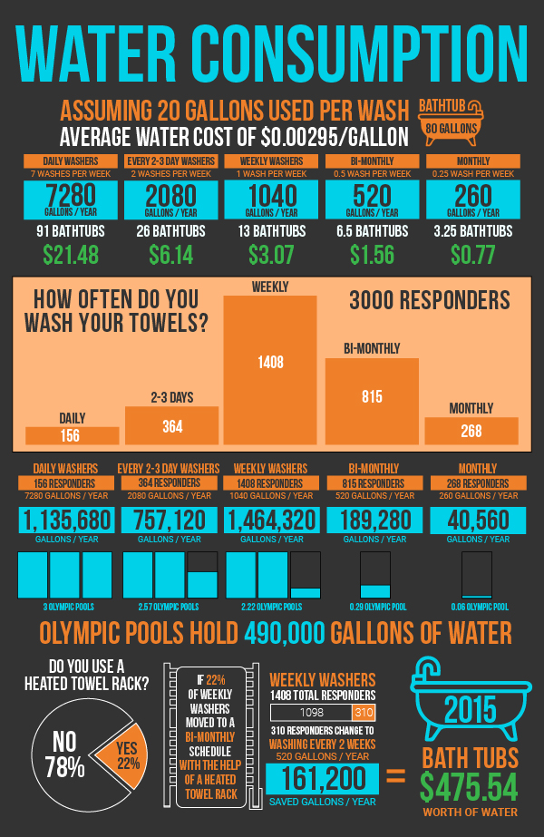
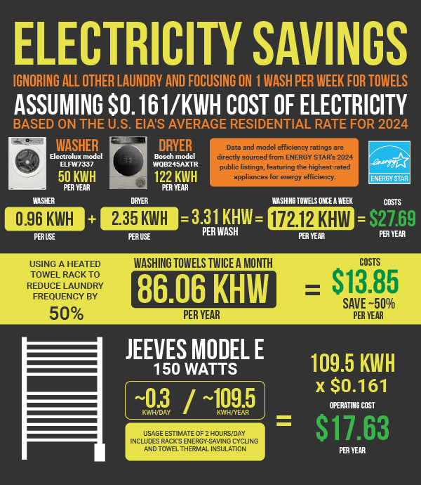
Comparison Stats – Water & Electricity

Slide 8
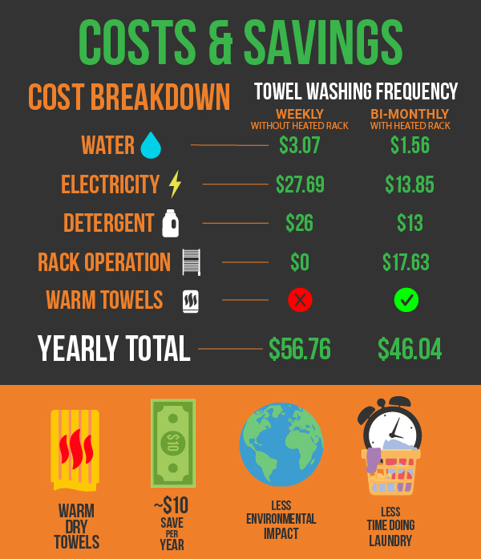
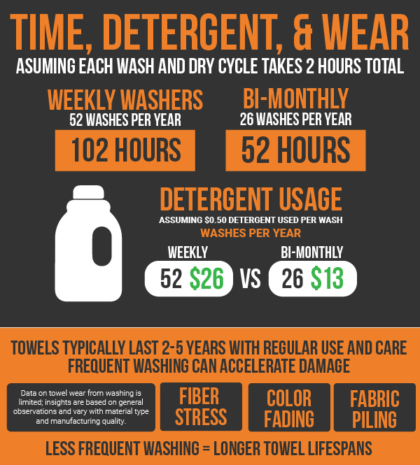
Comparison Stats & Summary

Slide 9
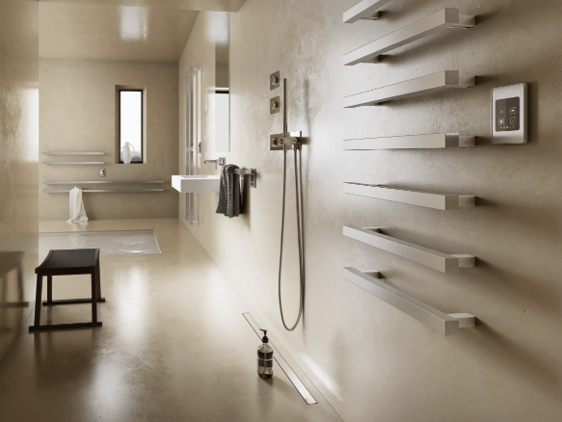
Where to use Heated Towel Racks

Slide 10
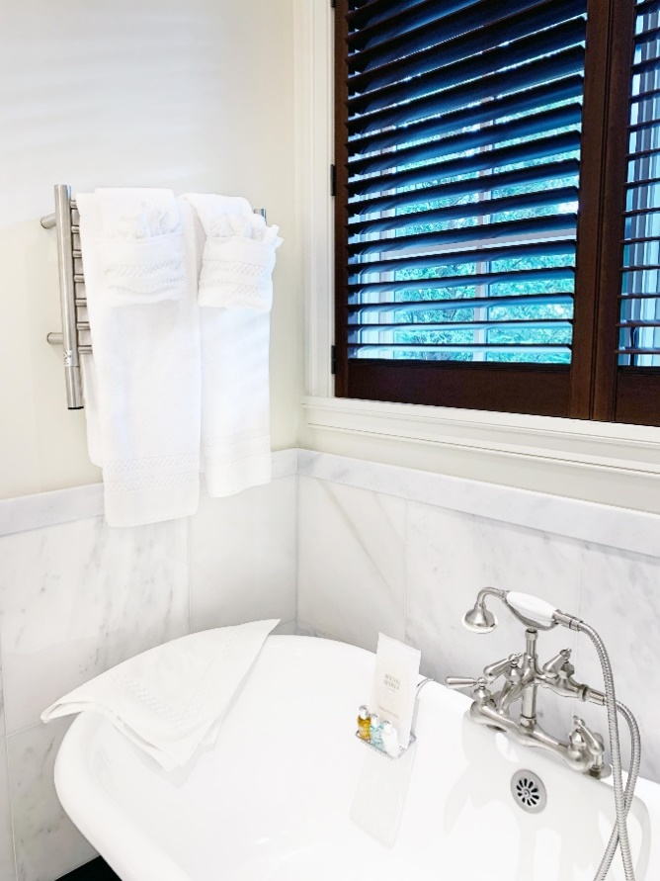
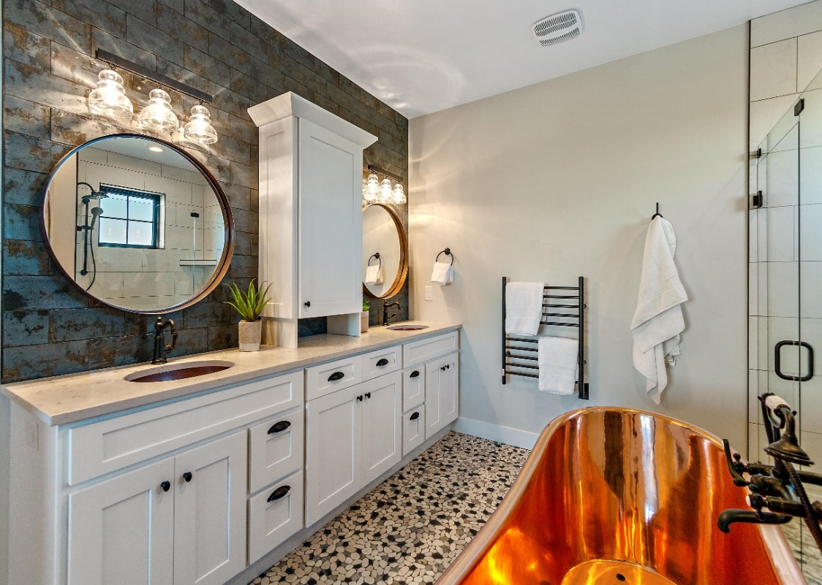
Bathrooms
Most Heated Towel Racks are installed in bathrooms. Whether its to provide radiant heat, dry damp towels after use, or warm them up, they offer many improvements over a standard towel bar or robe hook.
Add comfort and luxury to bathing experience
Keep towels and bathrobes dry and warm
Clean, fresh and fluffy towels – every time!
Provide radiant heat to bathroom – take cool edge off during cold winter mornings
Reduces humidity & moisture in bathroom
Replaces need for towel bars & robe hooks

Slide 11
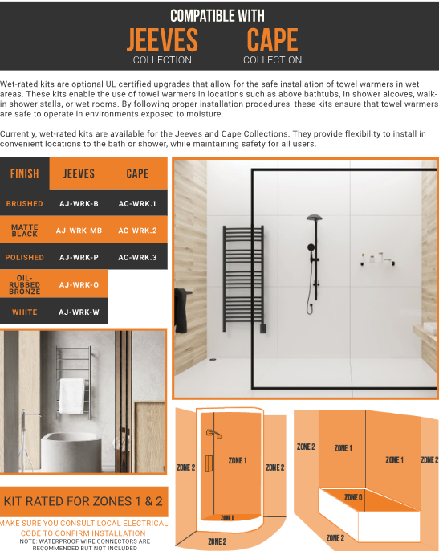
Wet Area applications – Jeeves & Cape Collections
When installing a towel warmer in a ‘wet area’, additional precautions need to be taken to meet code & safety requirements
Amba’s UL Certified wet rated kit makes any Jeeves or Cape model safe for wet areas
Wet Rated Kit eliminates restrictions and provides more convenience and flexibility for installation
Approved for NEC Zone 1 & Zone 2 locations:
Above a bathtub
In a shower
In a wet room or wet area

Slide 12
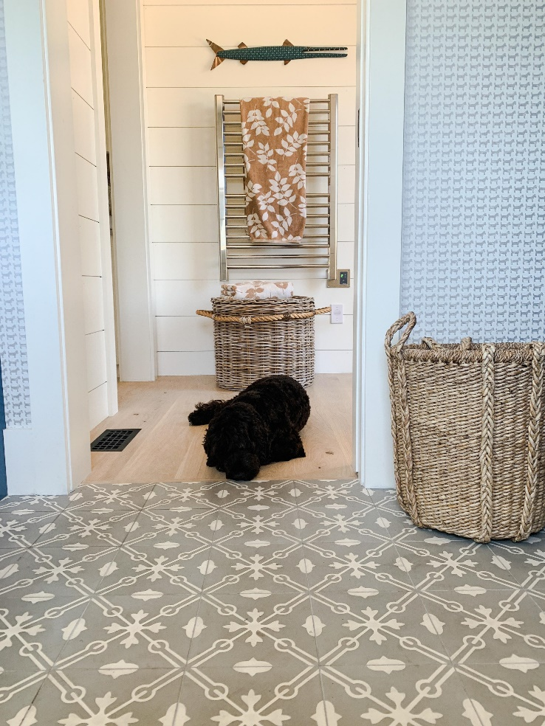
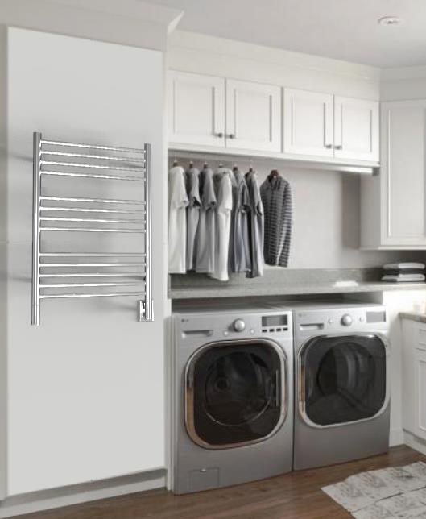
Applications: Laundry & Mud Rooms
Laundry Rooms:
Dry delicates, silks and other fabrics/garments that don’t go in a tumble dryer.
Reduce wrinkles while gently drying clothes.
Keeps laundry organized – no longer hanging on banisters, shower curtain rods or door handles.
Mud or Wet Rooms:
Hang and dry coats, scarves, mittens etc on cold & wet winter days.
Dry bathing suits, pool/beach towels, wet suits and life jackets during the summer.
Reduces humidity and provides warmth during colder months.

Slide 13
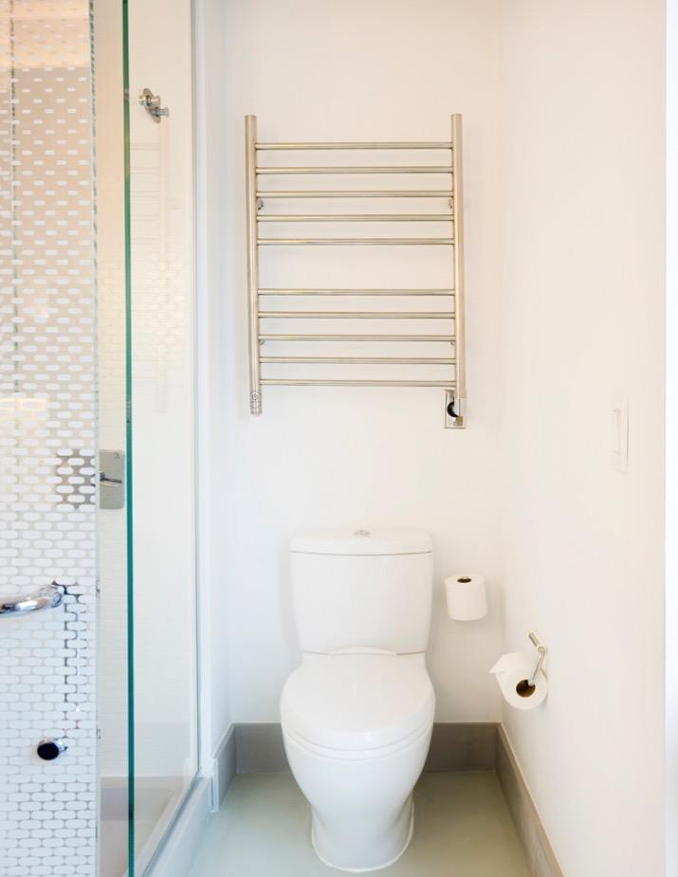
Other Applications
Some applications that are less common, but still offer plenty of benefits include:
Pool house
Basement
Garage/Workshop/Home Gym
Nursery
Boats/RVs
Commercial: Hotels, assisted living, spas/gyms, multi-family
Yotel Hotel – Radiant RWH-SP

Slide 14
Heating Technology
Dry Element (DE) Technology - units have a wire cable that run through all vertical & horizontal bars (Many competitors only heat the horizontal bars).
Pros: Fast heat up time – only 10 to 15min with heat starting in as little as 5min
Cons: Heating cables cannot be repaired – entire unit must be replaced
Collections:
Italy: Sirio, Quadro, Antus, Vega, Modello i
South Africa: Cape
China: Radiant, Solo & Swivel
Liquid Filled (LF) technology - Units are filled with a glycol-water solution. A heating element heats the liquid which heats the bars.
Pros: Heating element can be replaced if it fails; entire unit does not need to be replaced
Cons: Longer heat up times – range from 15 to 45min depending on the size of the unit
Collections:
South Africa: Jeeves
China: Traditional

Slide 15
Competitive Advantages
Amba only sells heated towel racks– we are the experts!
Choose from 11 different collections
Good: Cape, Radiant, Solo, Swivel
Better: Jeeves, Traditional
Best: Antus, Quadro, Sirio, Vega, Modello i
Choose from 10 stocked finishes
Polished SS, Brushed SS, Polished Nickel, Brushed Nickel, Matte Black, Satin Brass, Brushed Bronze, Polished Gold, ORB, White
Over 175+ SKUs stocked in GA with <1week lead time.
Over 250+ special order sizes – as narrow as 13” wide and up to 80” tall to fit unique spaces
Custom finishes – RAL & PVD; color match other MFGs

Slide 16
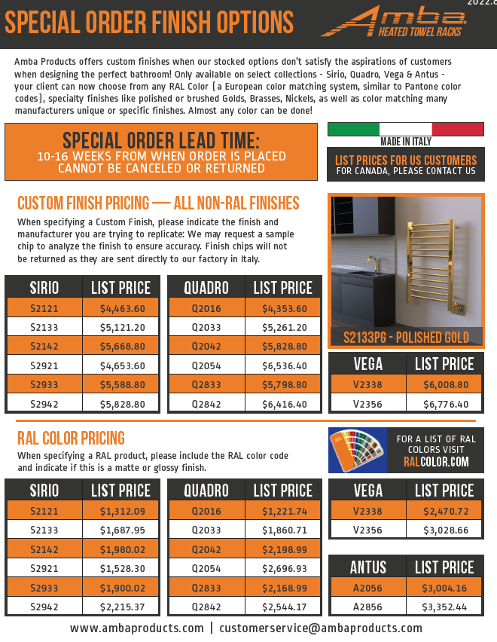
Custom sizes & finishes
Available for our Italian Collections:
Sirio, Quadro, Vega, Antus & Modello i
RAL Color Codes – match your towel warmer to your faucet or tub surround
Custom Finishes (PVD) – match almost any finish from MFGs (No living finishes)
Lead time is 10-16 weeks
Factory may require sample chip to analyze and match your finish

Slide 17
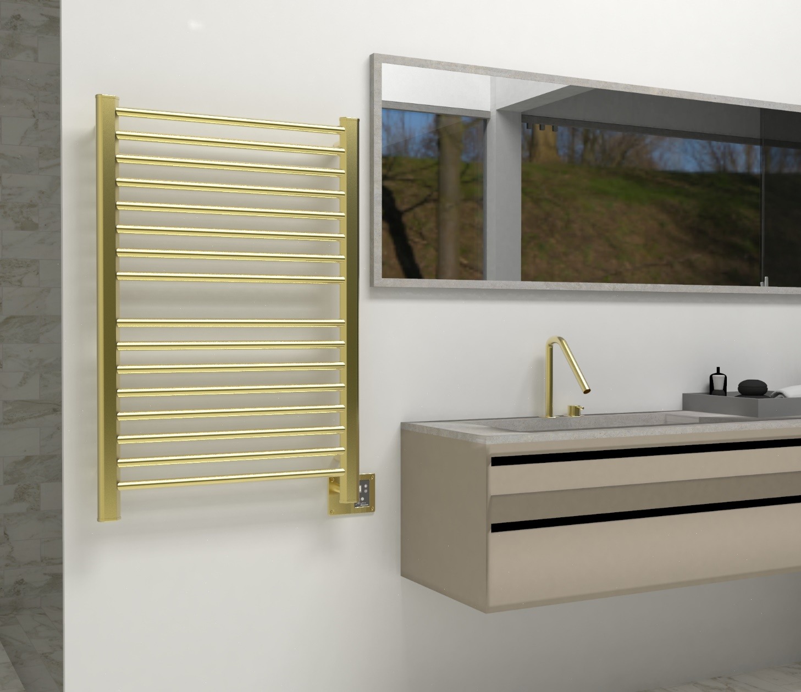
How to sell Heated towel racks
Accessories are usually the last to be picked, leaving minimal budget
In most primary bathrooms, you specify 2x towel bars & 2x robe hooks
Reallocate that $$$ to 1 towel warmer – you’re not adding more costs!
1 towel warmer replaces all 4 accessories
Upgrades the bathroom and provides a more luxurious, bathroom oasis.
Some models can even save money compared to the cost of robe hooks and towel bars
Hang bathrobes from top of vertical bars
Section 1
Section 2
There are two sections on this towel warmer to hold 2 towels; the vertical bars double as robe hooks to hold 2 bathrobes

Slide 18
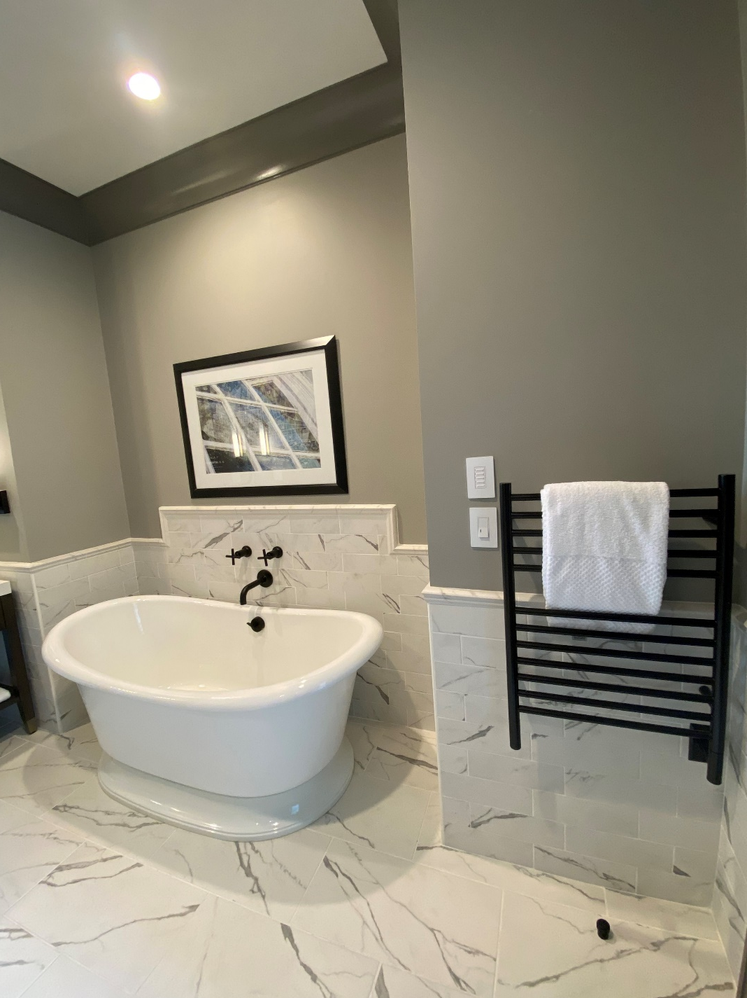
requirements
It is important that your client be able to install the product. Below are some basic requirements.
Electricity:
Requires standard 120V connection.
Doesn’t require a dedicated circuit.
Space:
They must have the wall/floor space for the unit to fit.
Backing is recommended for wall mounted units.
Code:
National Electrical Code (NEC) dictates a towel warmer must be 3’ from water source (unless using a Wet Rated Kit).
Local codes supersede national code.
All products are UL or ETL certified for USA & Canada
Liberty Hotel by Hilton – Jeeves ESMB

Slide 19
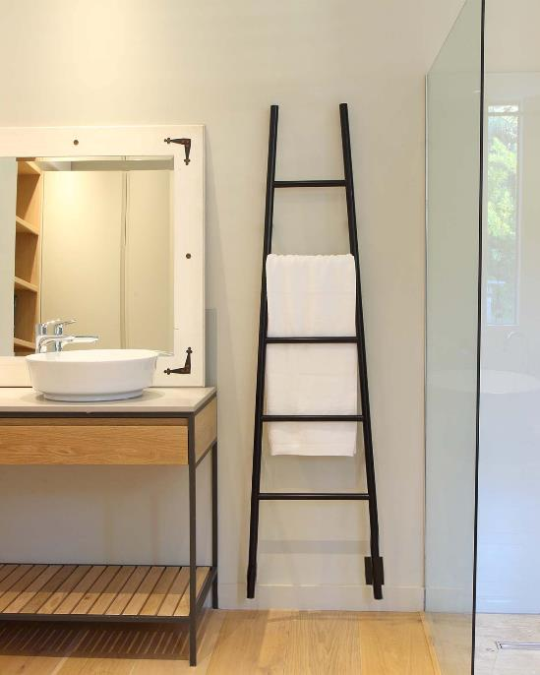
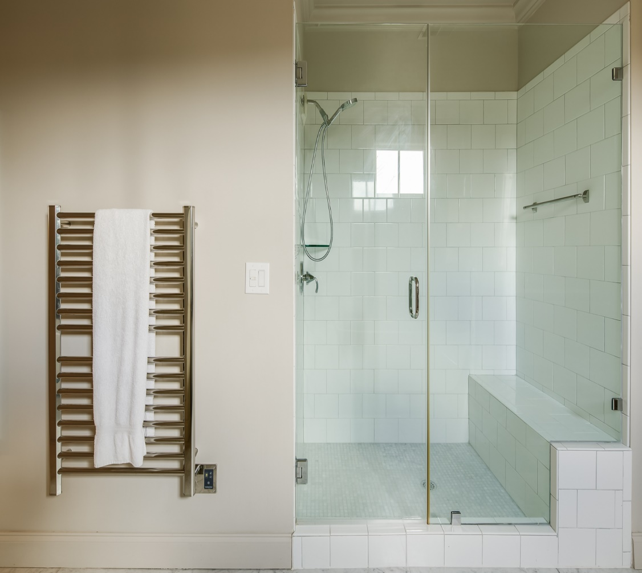
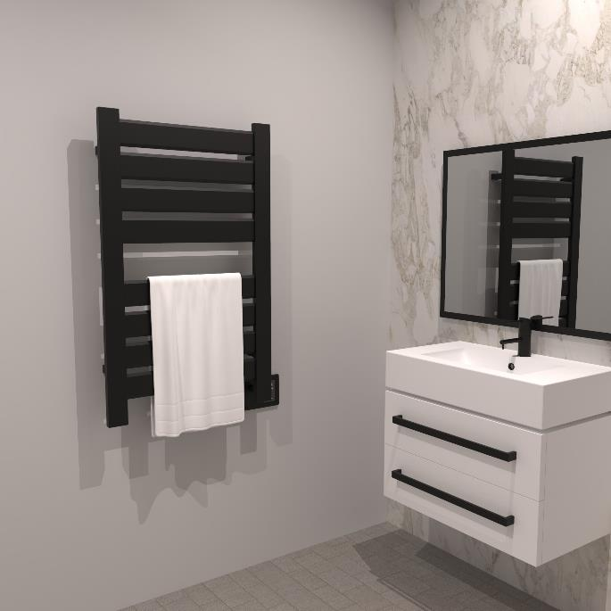
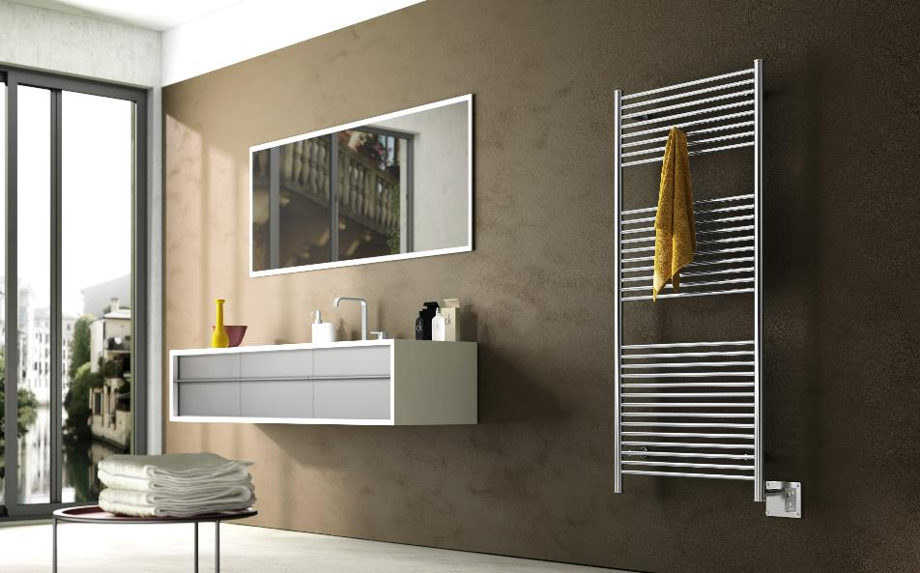
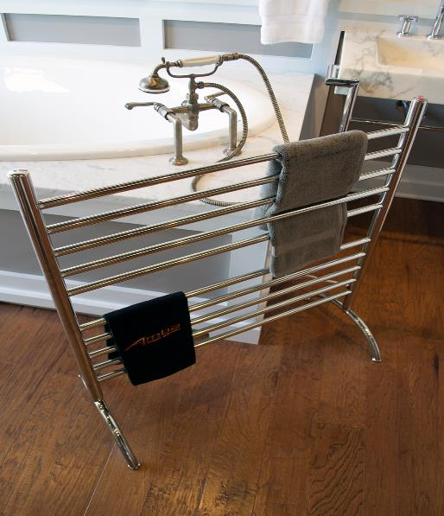
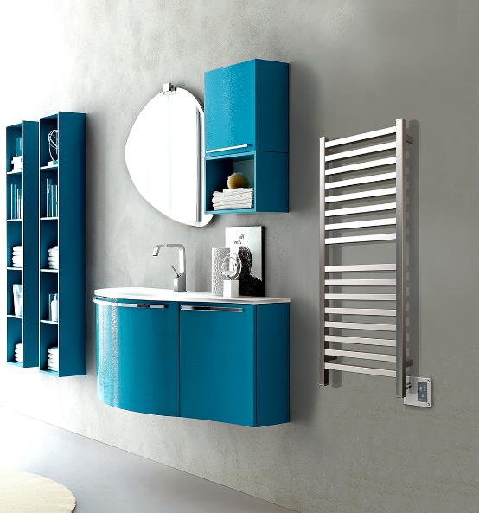
Collections & Accessories

Slide 20
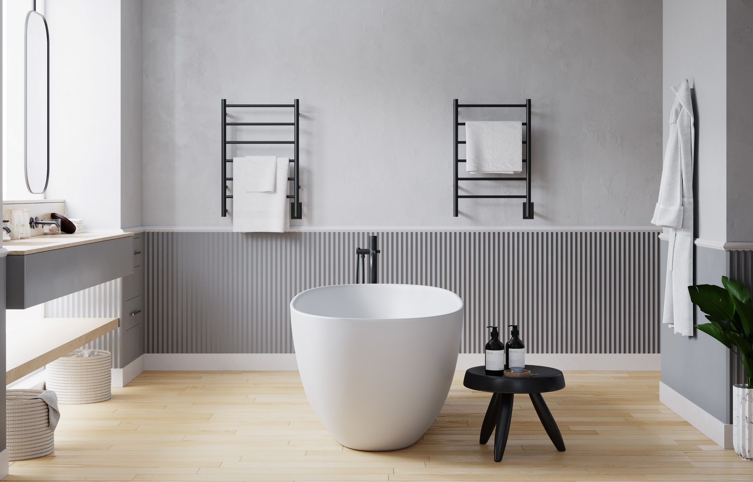
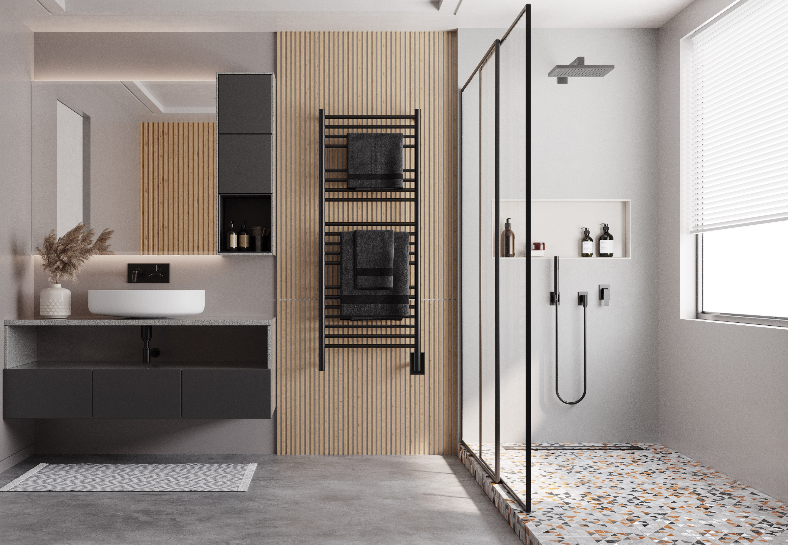
JEEVES COLLECTION
Highlights:
5 Stocked Finishes: Brushed, Polished, Matte Black, ORB & White
Custom Sizes available – see catalog: 13” W, 16”W & 24”W options
UL-certified “Wet-rated Kit” available
Heat up time: 15 to 45min
Liquid filled heating technology - replaceable heating element
Left hand electrical wiring available by request
What to Order:
Included: Unit comes with hardwire kit & mounting hardware
Required: Timer or On/Off Switch
Optional: Double gang plate; bathrobe hanger

Slide 21
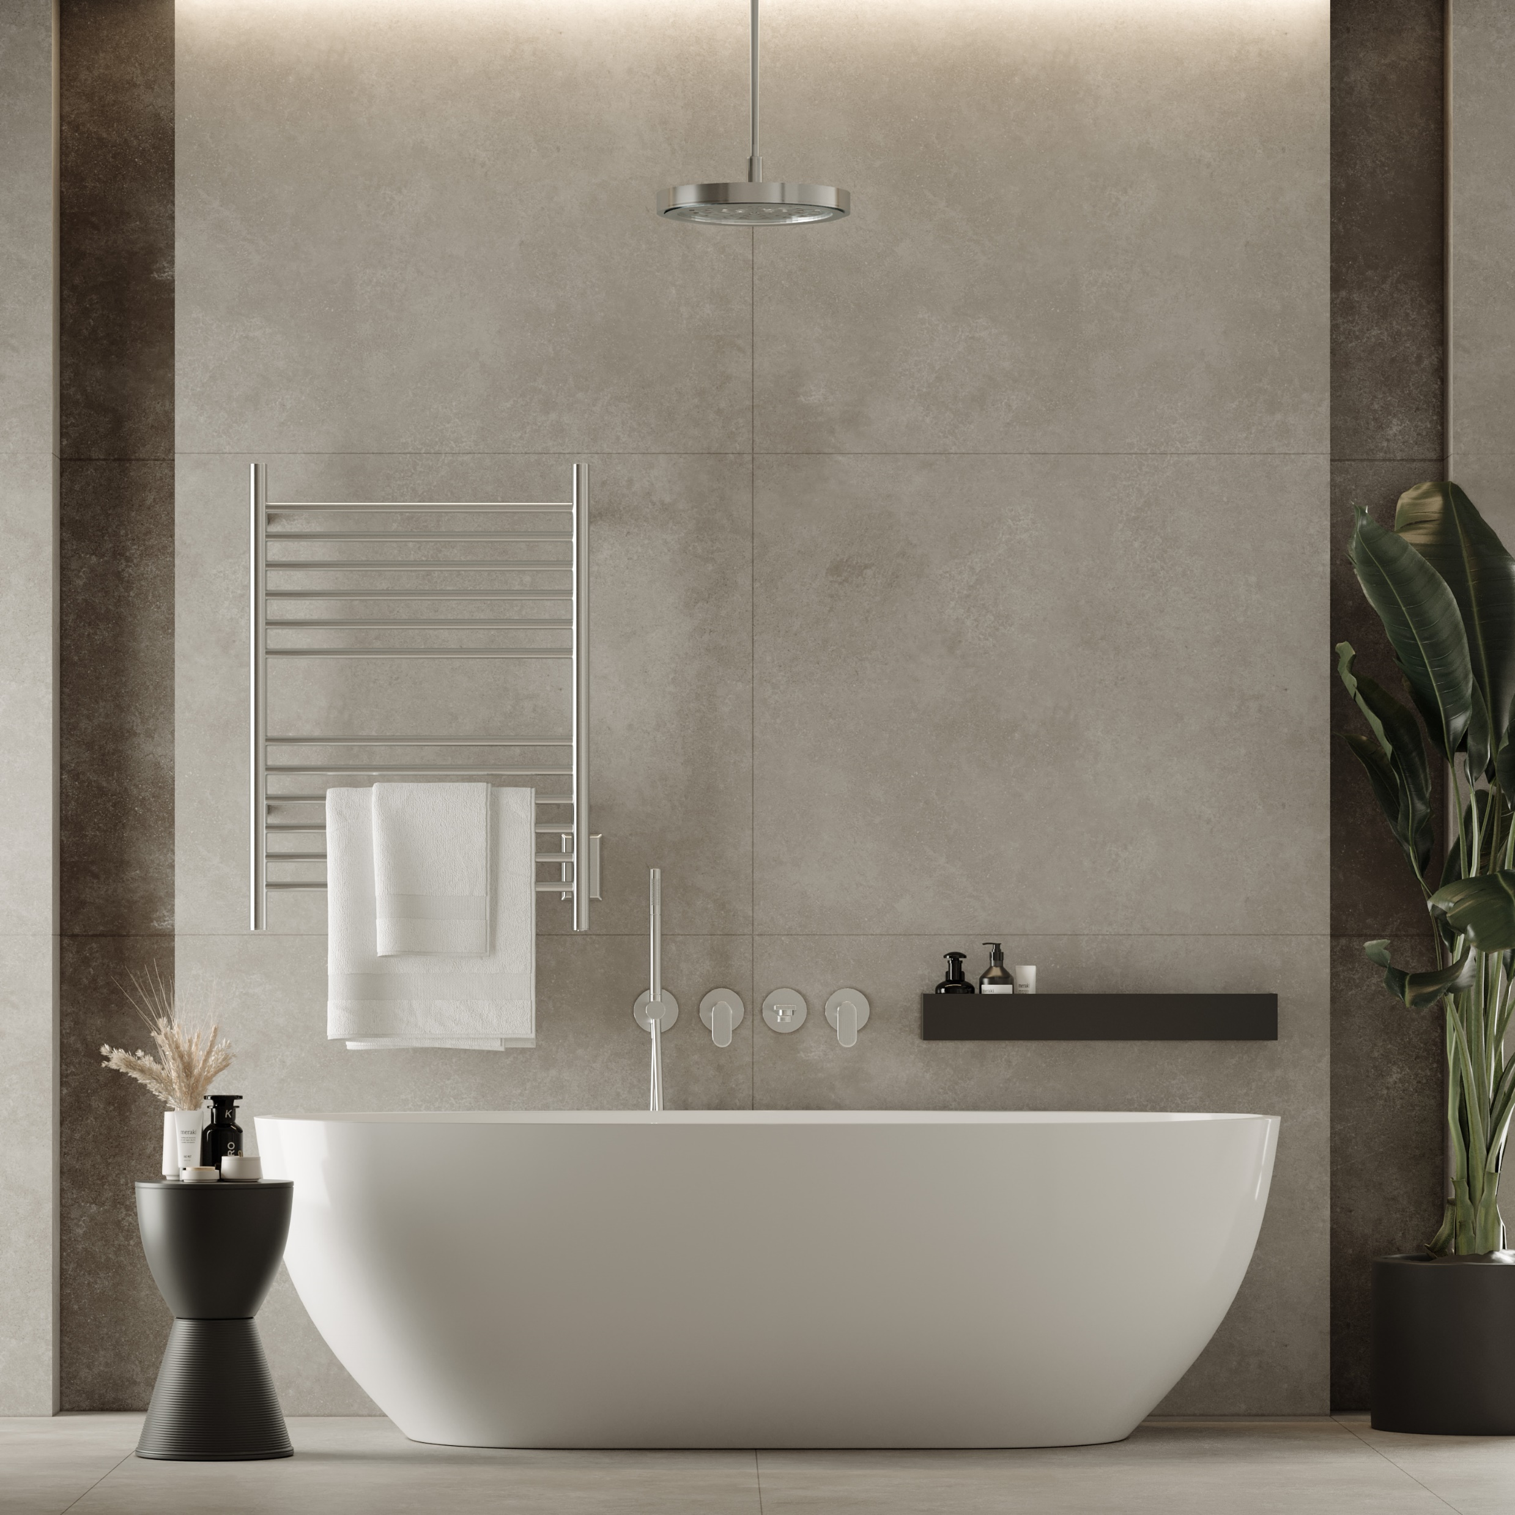
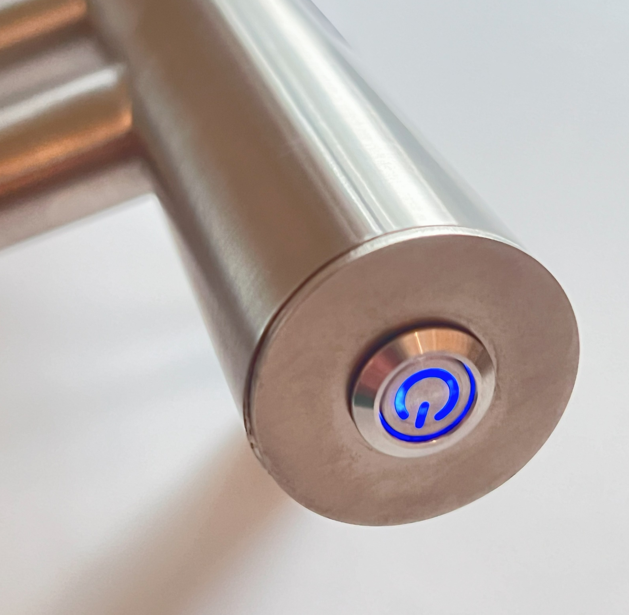
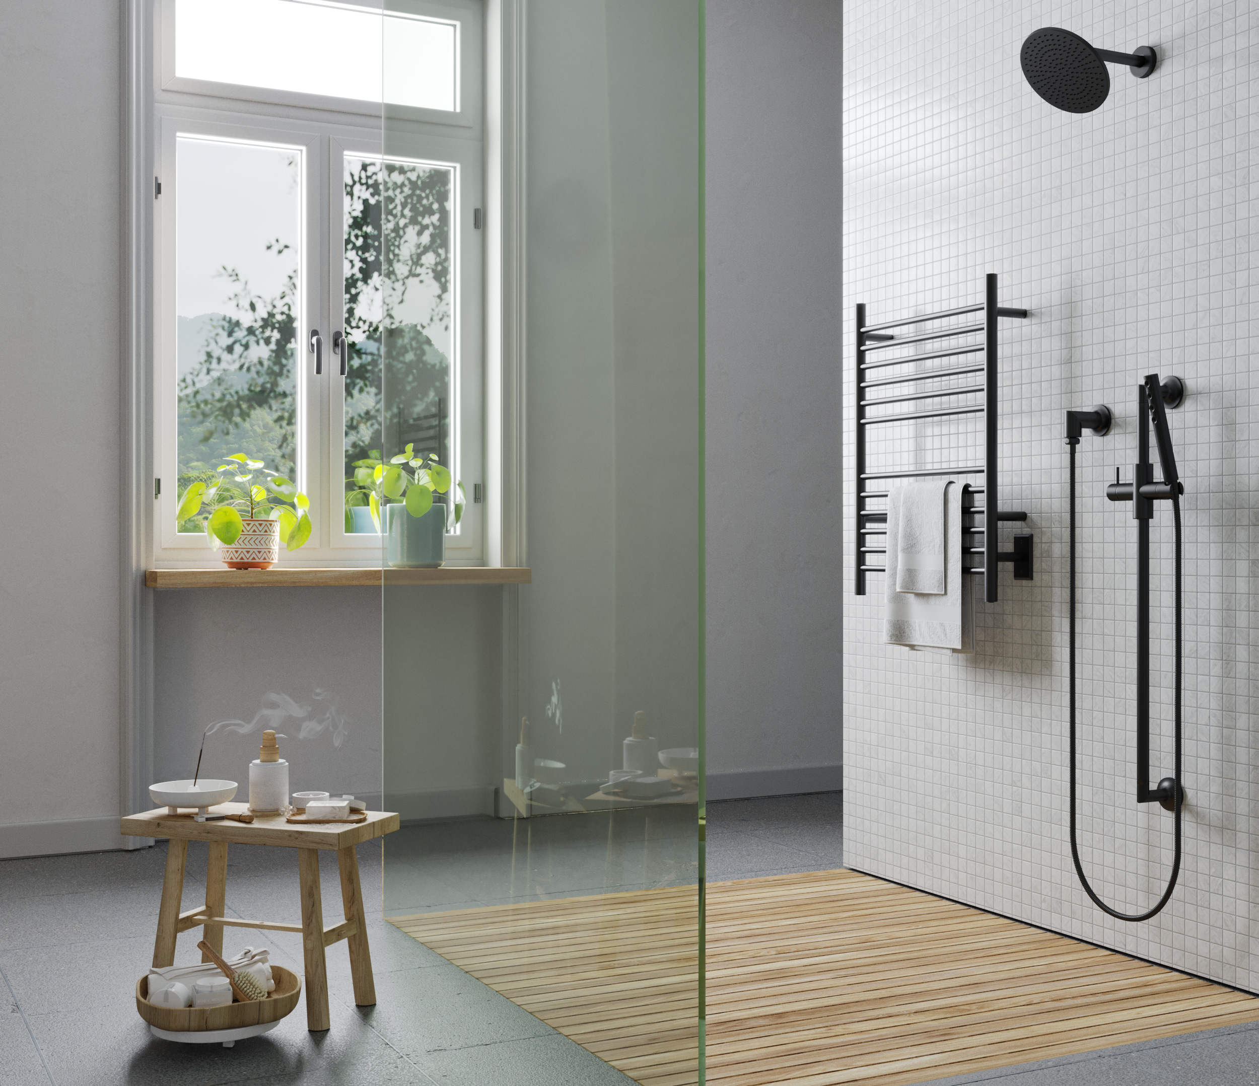
Cape COLLECTION
Highlights:
Plug-in & hardwired combo
3 Stocked Finishes: Brushed, Polished and Matte Black
UL-certified “Wet-rated Kit” available
Dry element technology: 10-15min heat up time
Integrated On/Off switch
What to Order:
Included: Unit comes with plug-in / hardwire kit & mounting hardware
Required: Nothing additional
Optional: Double gang plate; Timer

Slide 22
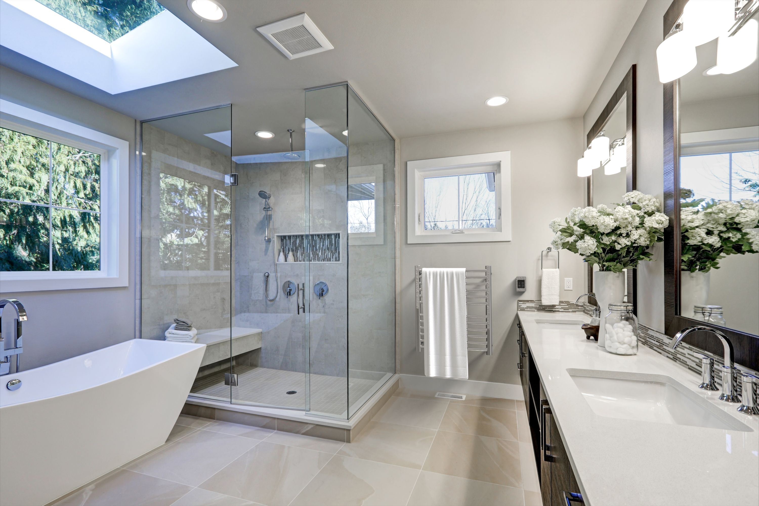
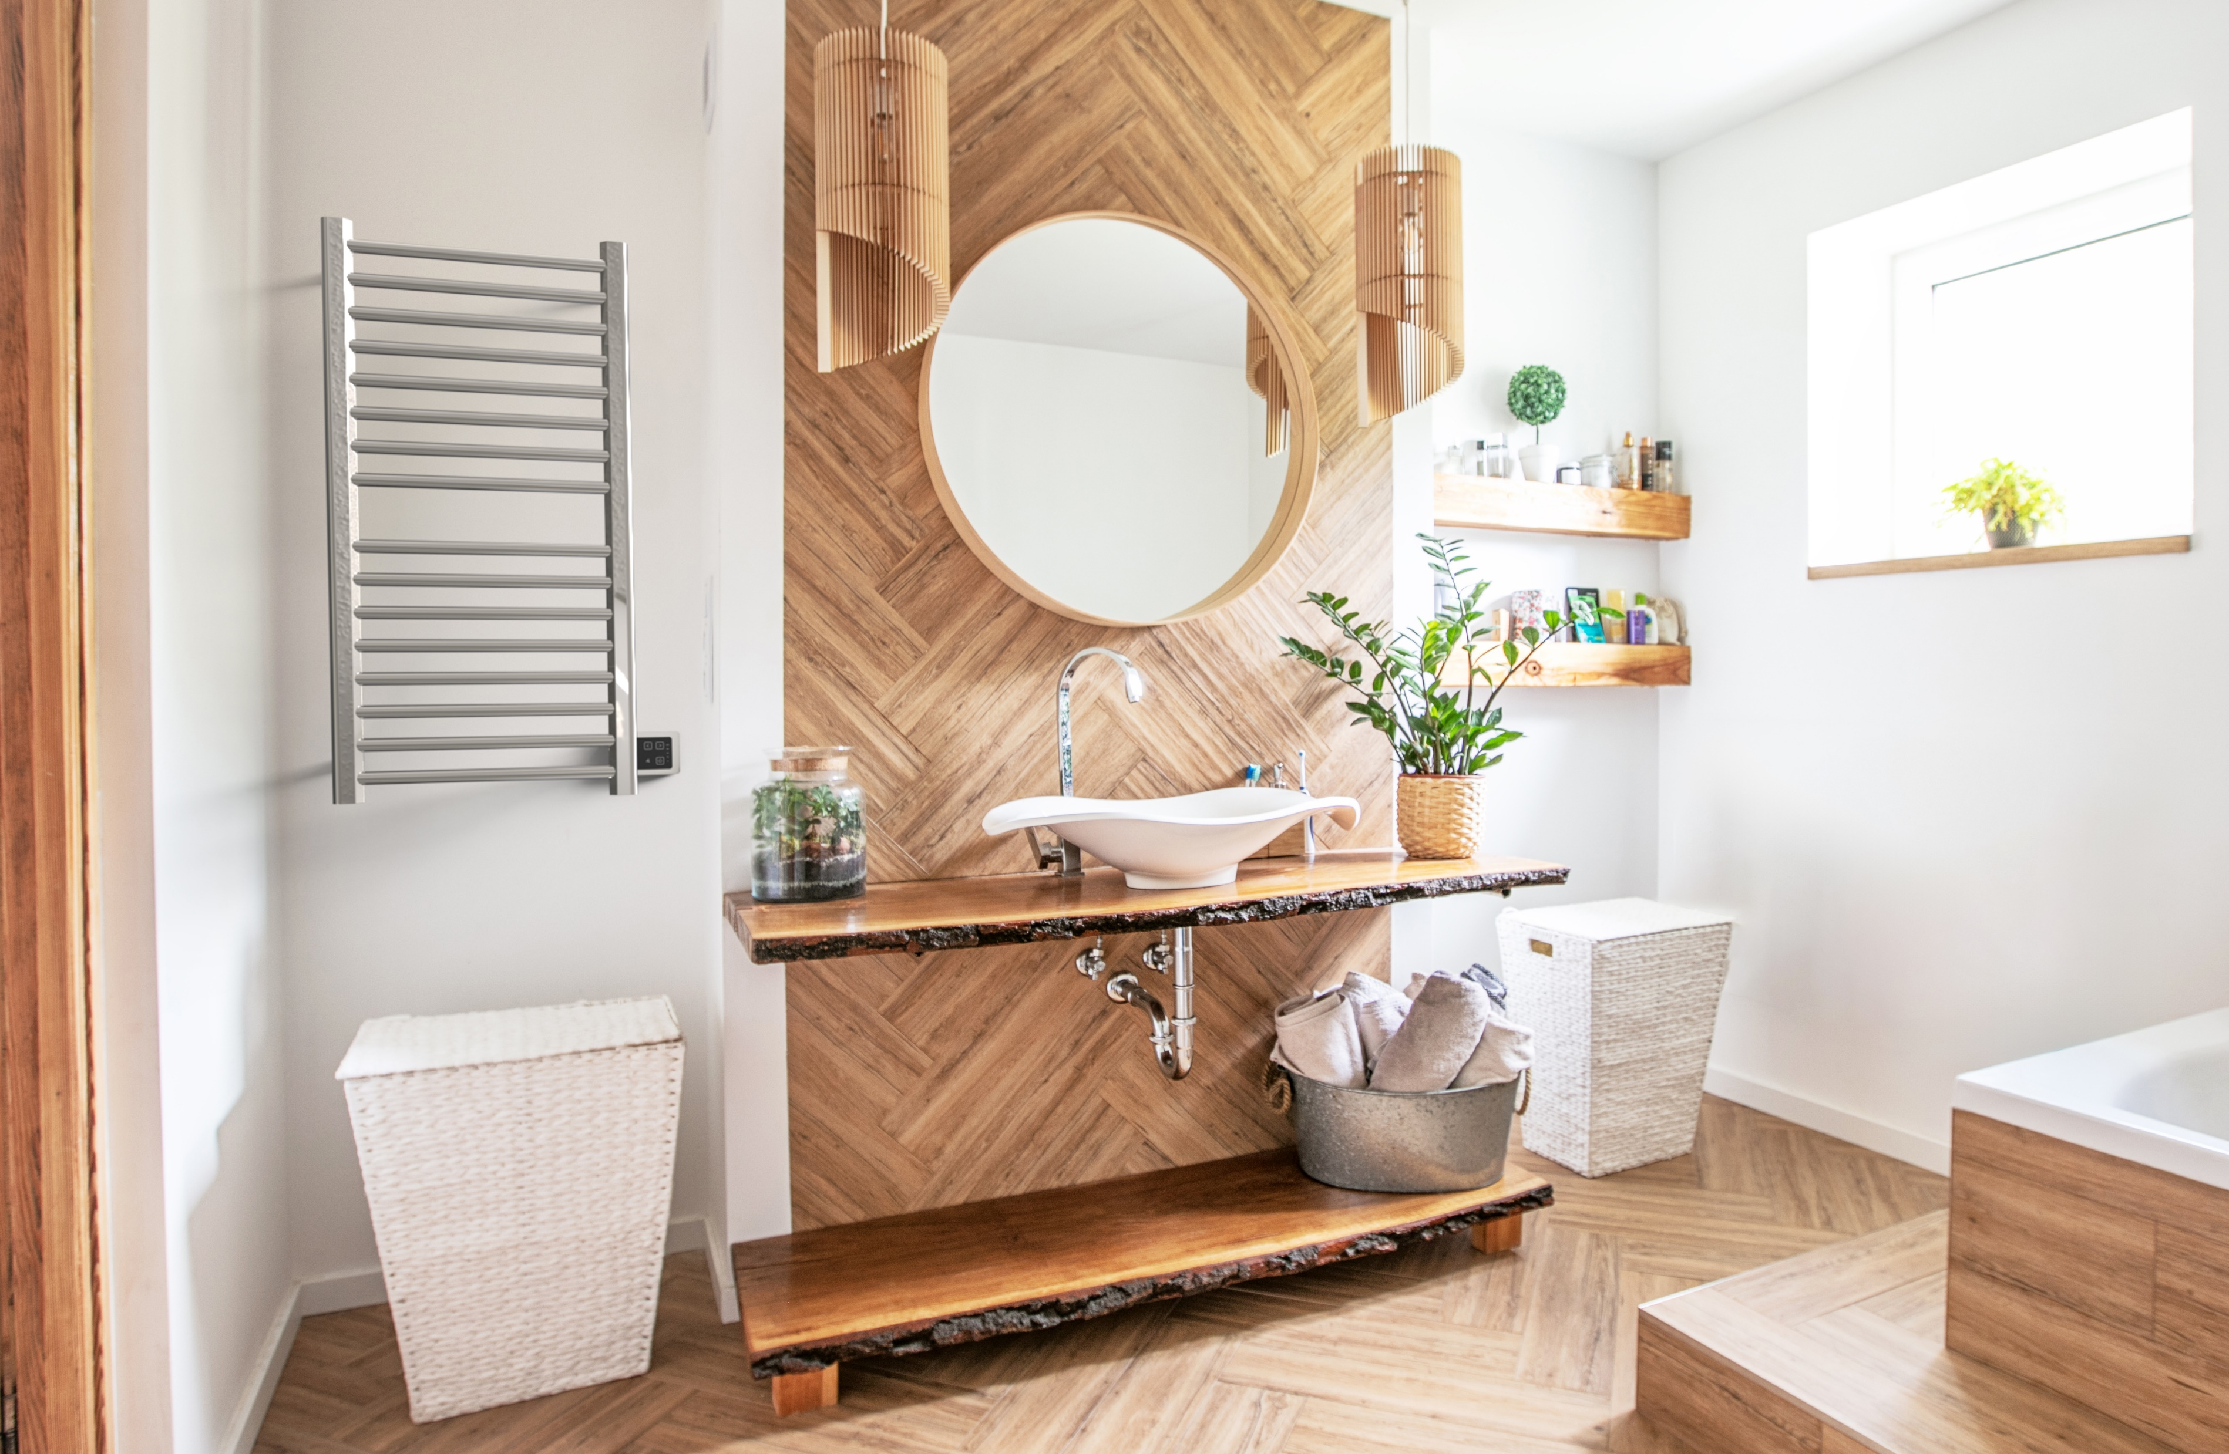
SIRIO COLLECTION
Highlights:
Dry element technology: 10-15min heat up time
Stocked Finishes: Brushed, Polished, Brushed Bronze and Satin Brass
Digital Heat Controller:
Choice between integrated or remote installation
5 levels of temperature control
Temp range between 110F – 194F
Dual-purpose function: Heated Towel rack and space heater
Custom sizes and finishes available – special order
What to order:
Included: Unit comes with hardwire kit & mounting hardware
Required: Touch DHC or Remote Touch DHC + Concealed wall box
Optional: Timer; Bathrobe hanger, Spacers (uneven surfaces)

Slide 23
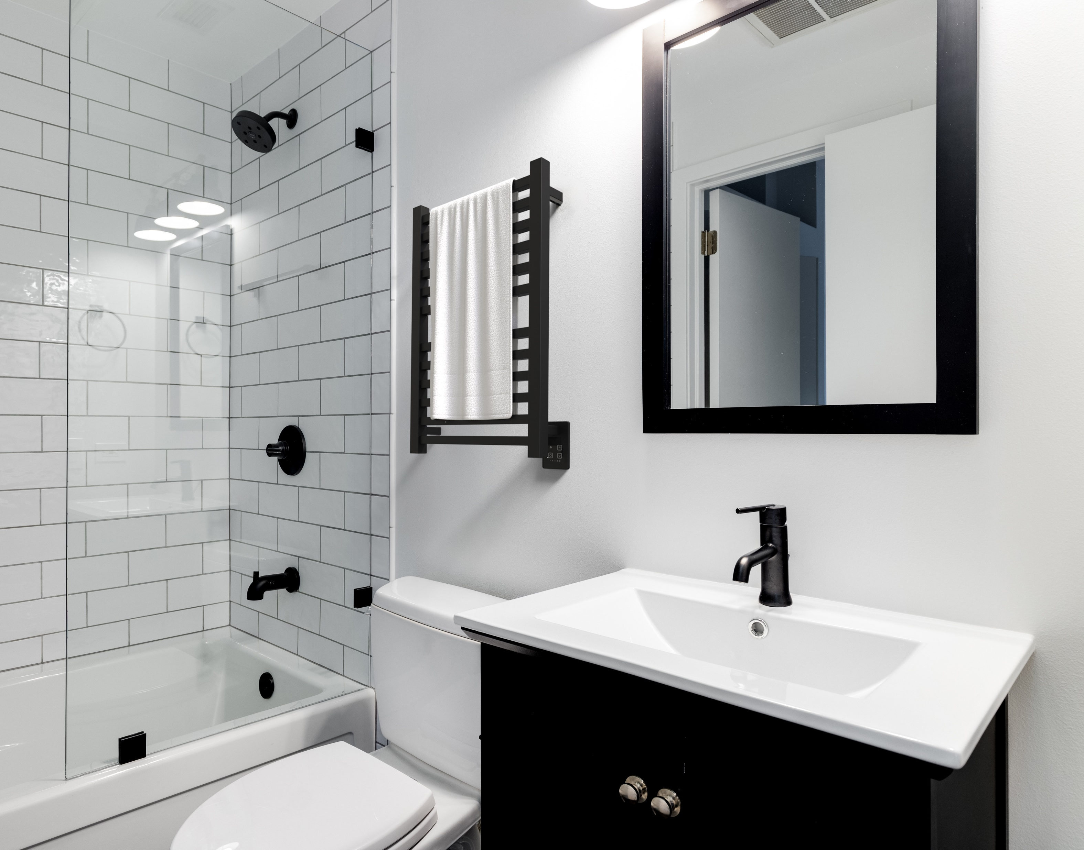
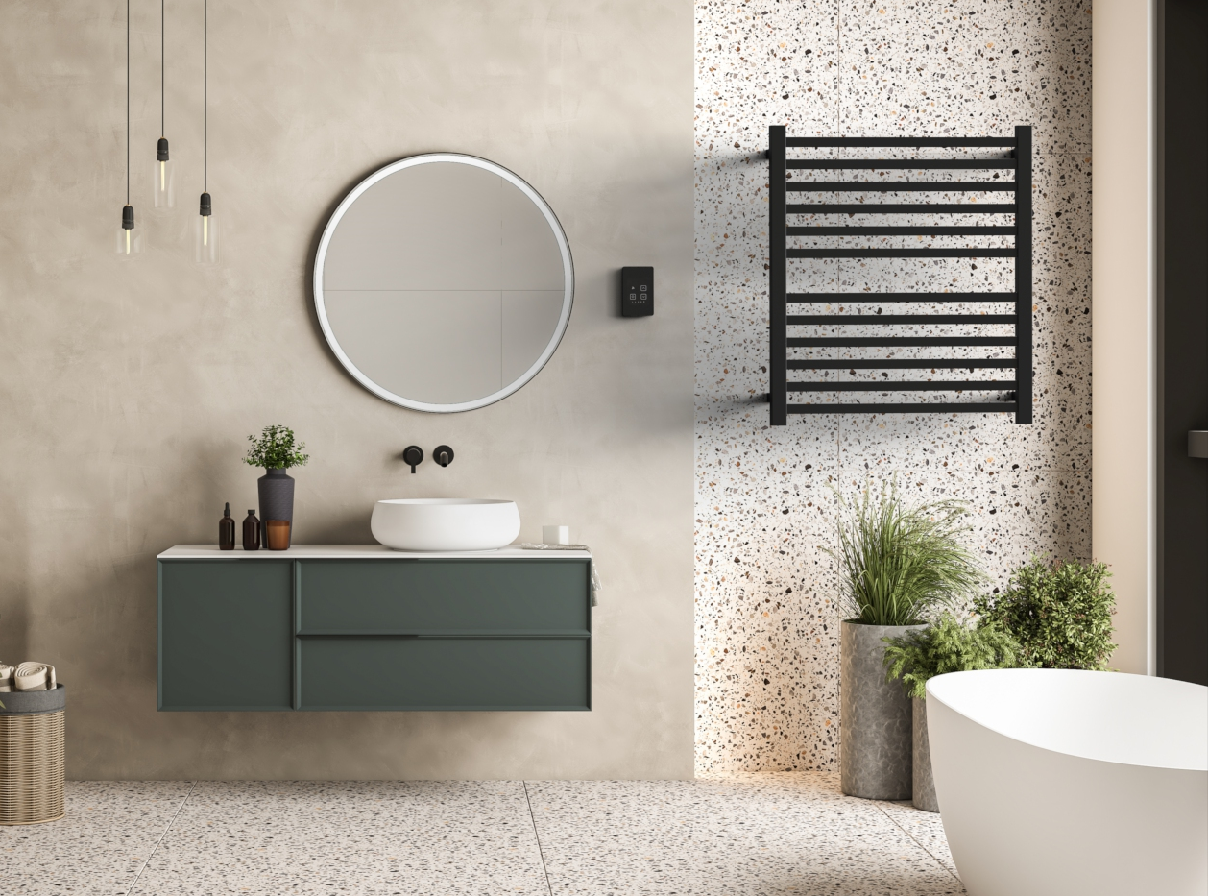
QUADRO COLLECTION
Highlights:
Dry element technology: 10-15min heat up time
Stocked Finishes: Brushed, Polished, and Matte Black; Brushed Bronze in Q2132 model only
Digital Heat Controller:
Choice between integrated or remote installation
5 levels of temperature control
Temp range between 110F – 194F
Dual-purpose function: Heated Towel rack and space heater
Custom sizes and finishes available – special order
What to order:
Included: Unit comes with hardwire kit & mounting hardware
Required: Touch DHC or Remote Touch DHC + Concealed wall box
Optional: Timer; Bathrobe hanger, Spacers (uneven surfaces)

Slide 24
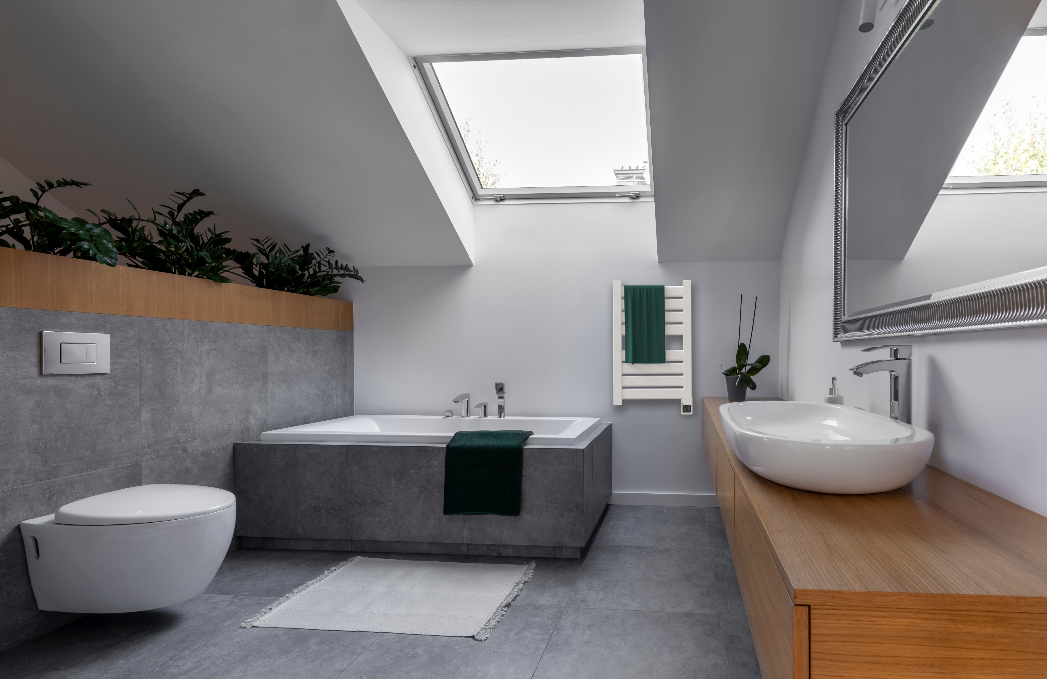
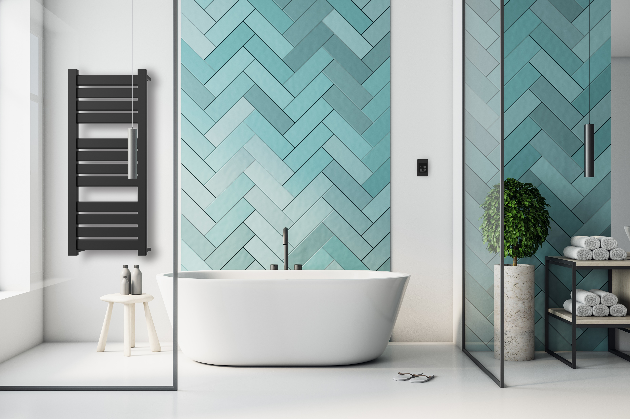
VEGA COLLECTION
Highlights:
Dry element technology: 10-15min heat up time
Stocked Finishes: Brushed, Polished, Matte Black and White
Digital Heat Controller:
Choice between integrated or remote installation
5 levels of temperature control
Temp range between 110F – 194F
Dual-purpose function: Heated Towel rack and space heater
Custom sizes and finishes available – special order
What to order:
Included: Unit comes with hardwire kit & mounting hardware
Required: Touch DHC or Remote Touch DHC + Concealed wall box
Optional: Timer; Bathrobe hanger, Spacers (uneven surfaces)

Slide 25
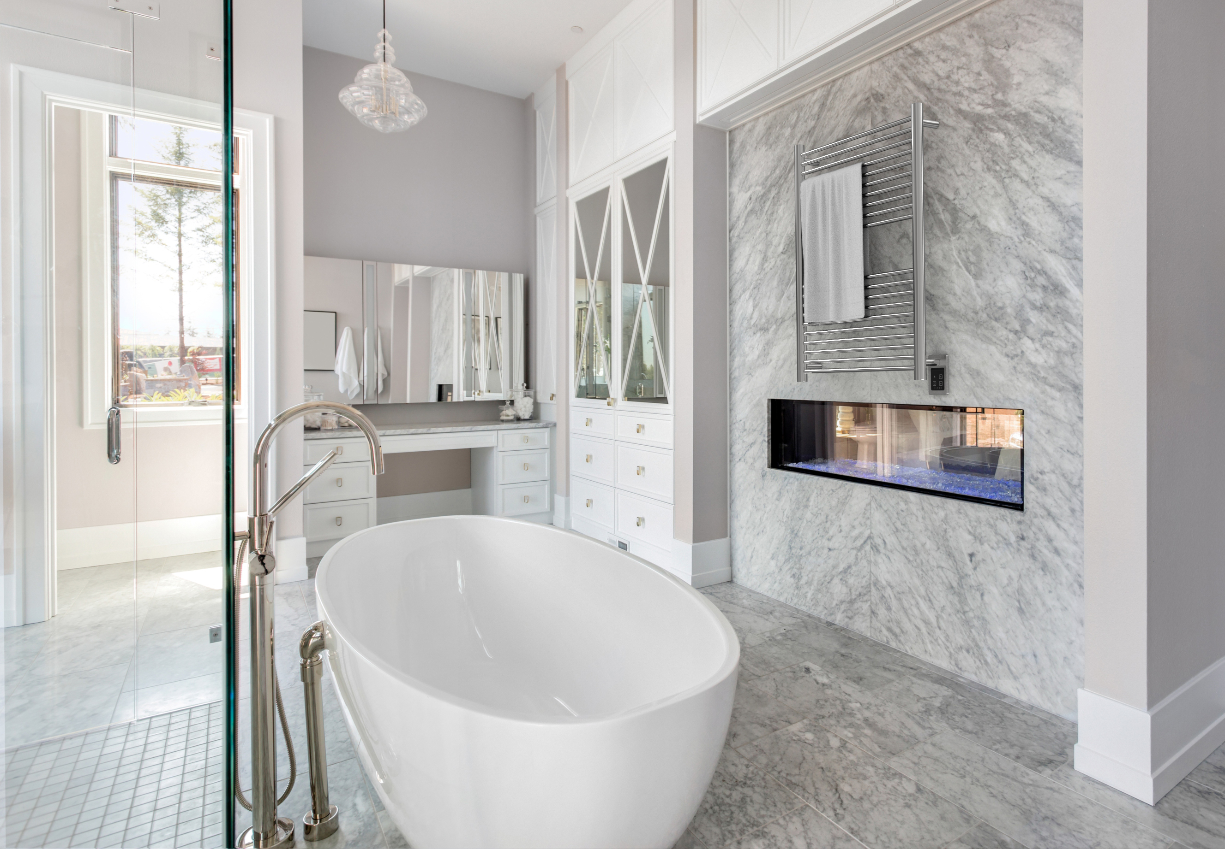
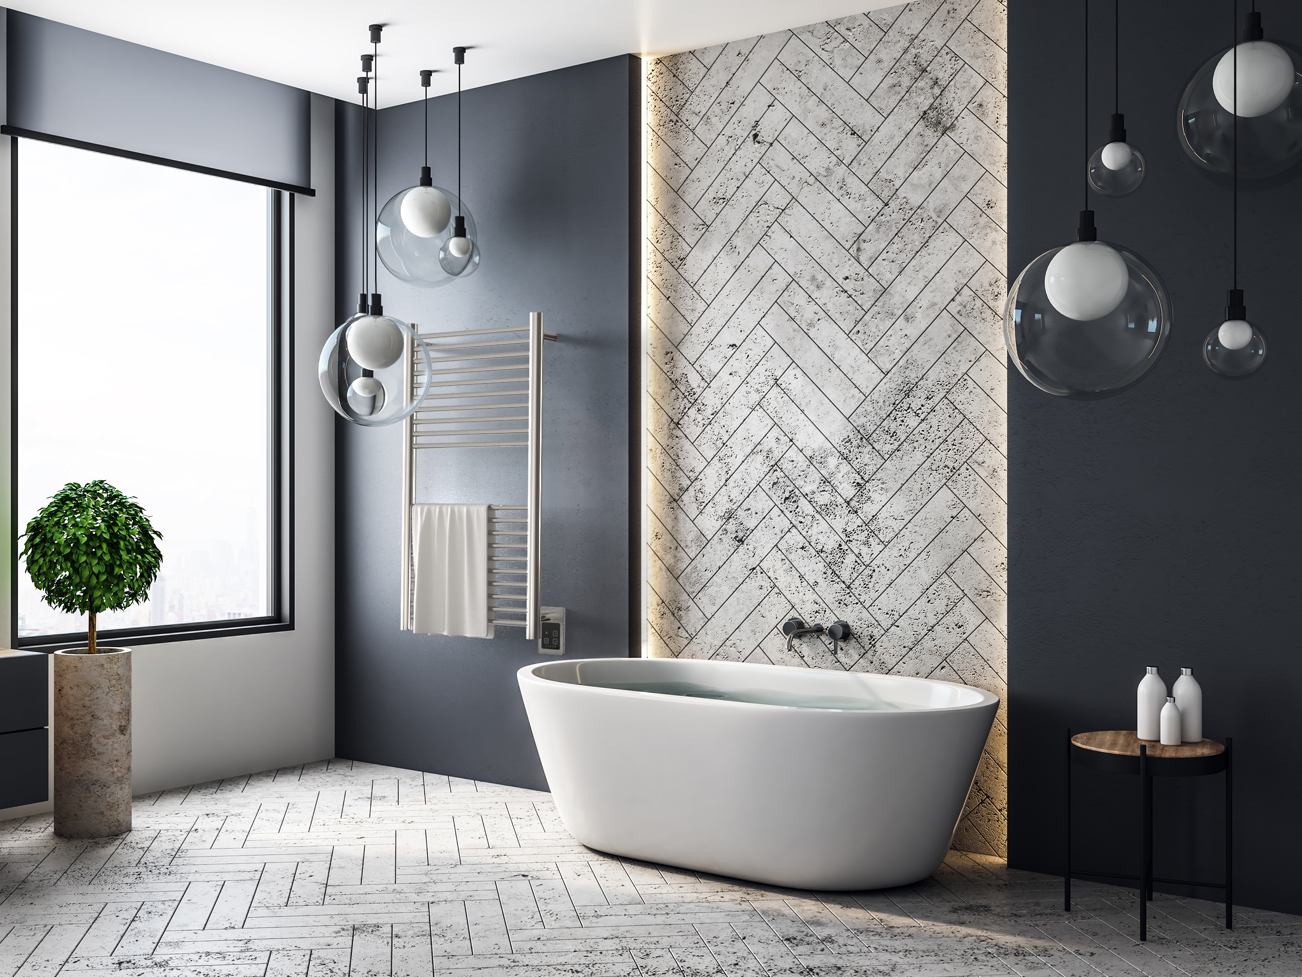
ANTUS COLLECTION
Highlights:
Dry element technology: 10-15min heat up time
Stocked Finishes: Brushed and Polished
Digital Heat Controller:
Choice between integrated or remote installation
5 levels of temperature control
Temp range between 110F – 194F
Dual-purpose function: Heated Towel rack and space heater
Custom sizes and finishes available – special order
What to order:
Included: Unit comes with hardwire kit & mounting hardware
Required: Touch DHC or Remote Touch DHC + Concealed wall box
Optional: Timer; Bathrobe hanger, Spacers (uneven surfaces)

Slide 26
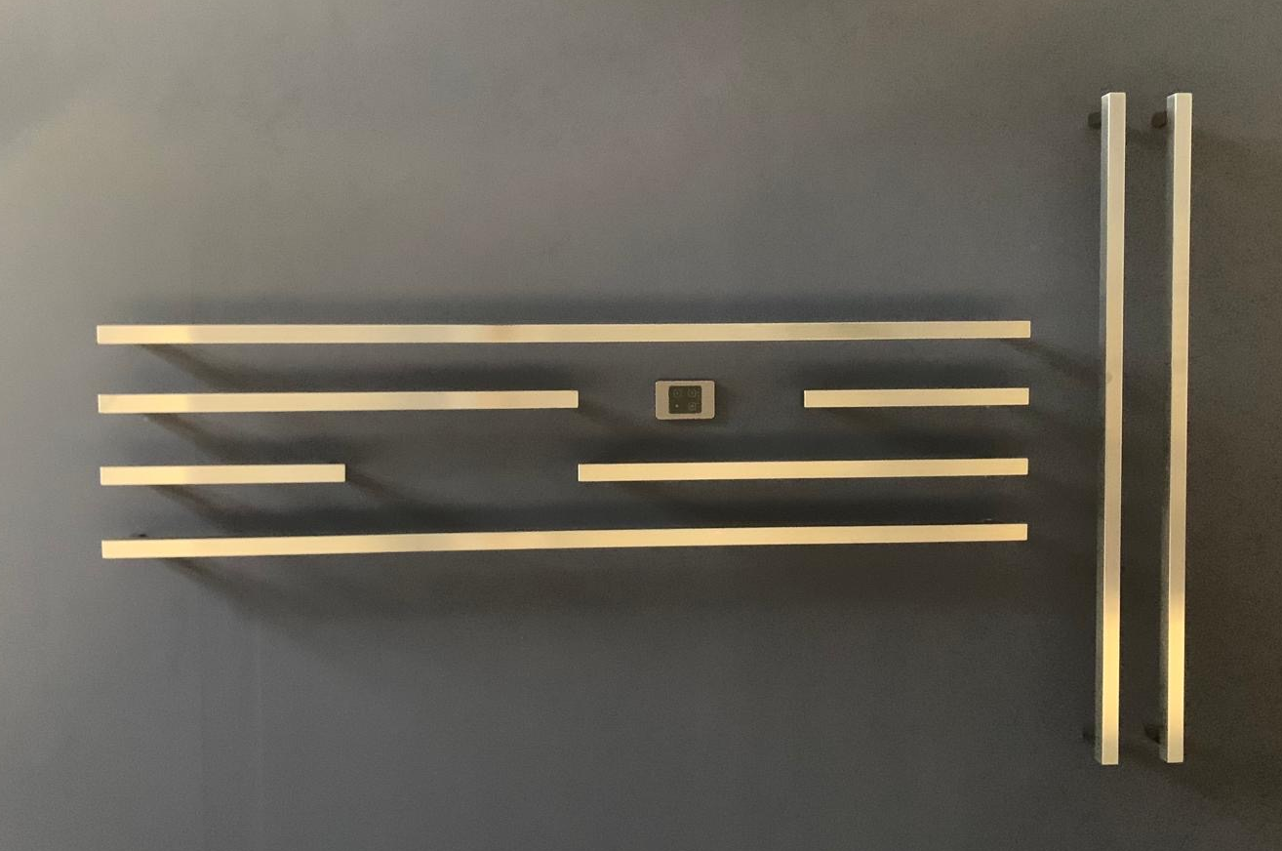
Modello i Collection
Highlights:
Styles: Round or Square bars
Sizes: 20”, 40” & 59” lengths stocked … 78” available by special order
Stocked Finishes: Brushed, Polished, Matte Black and Satin Brass
Mix and match sizes, styles and finishes to create a unique design
Dry element technology: 10-15min heat up time
Digital Heat Controller:
Choice between integrated or remote installation
5 levels of temperature control
Temp range between 110F – 194F
Custom sizes and finishes available – special order
What to order:
Included: Unit comes with hardwire kit & mounting hardware
Required: Touch DHC or Remote Touch DHC + Concealed wall box
Optional: Timer; Spacers (uneven surfaces)

Slide 27
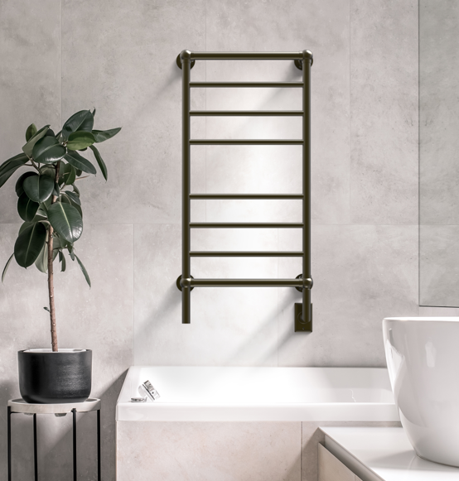
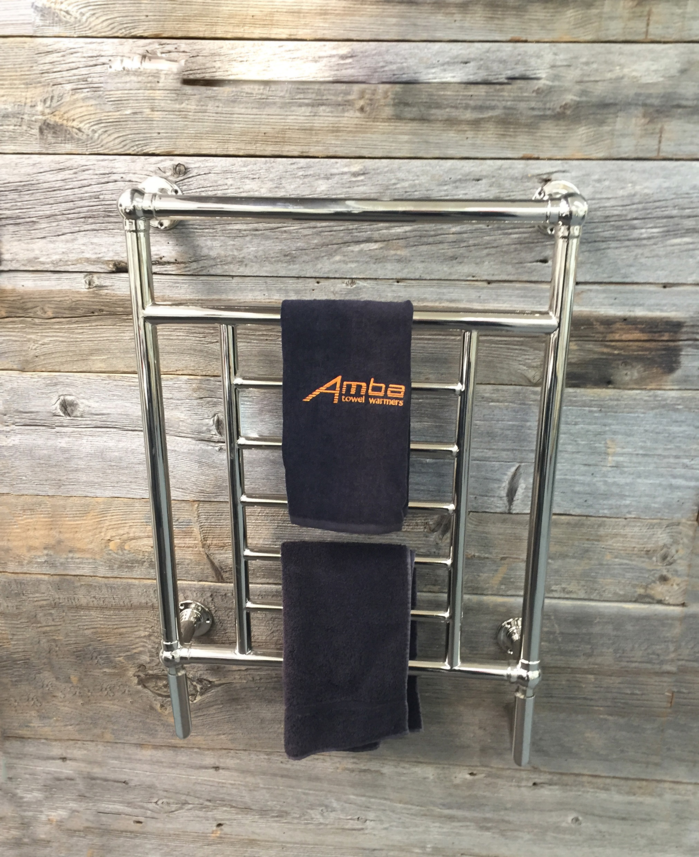
TRADITIONAL COLLECTION
Highlights:
Beautifully crafted finials create a decorative design
Liquid filled heating technology – replaceable heating element
Stocked finishes: Brushed Nickel, Polished Nickel & Brushed Bronze
Heat up time: 30-40min
Left hand electrical wiring available
What to order:
Included: Hardwire kit & Mounting Hardware
Required: Timer or Switch

Slide 28
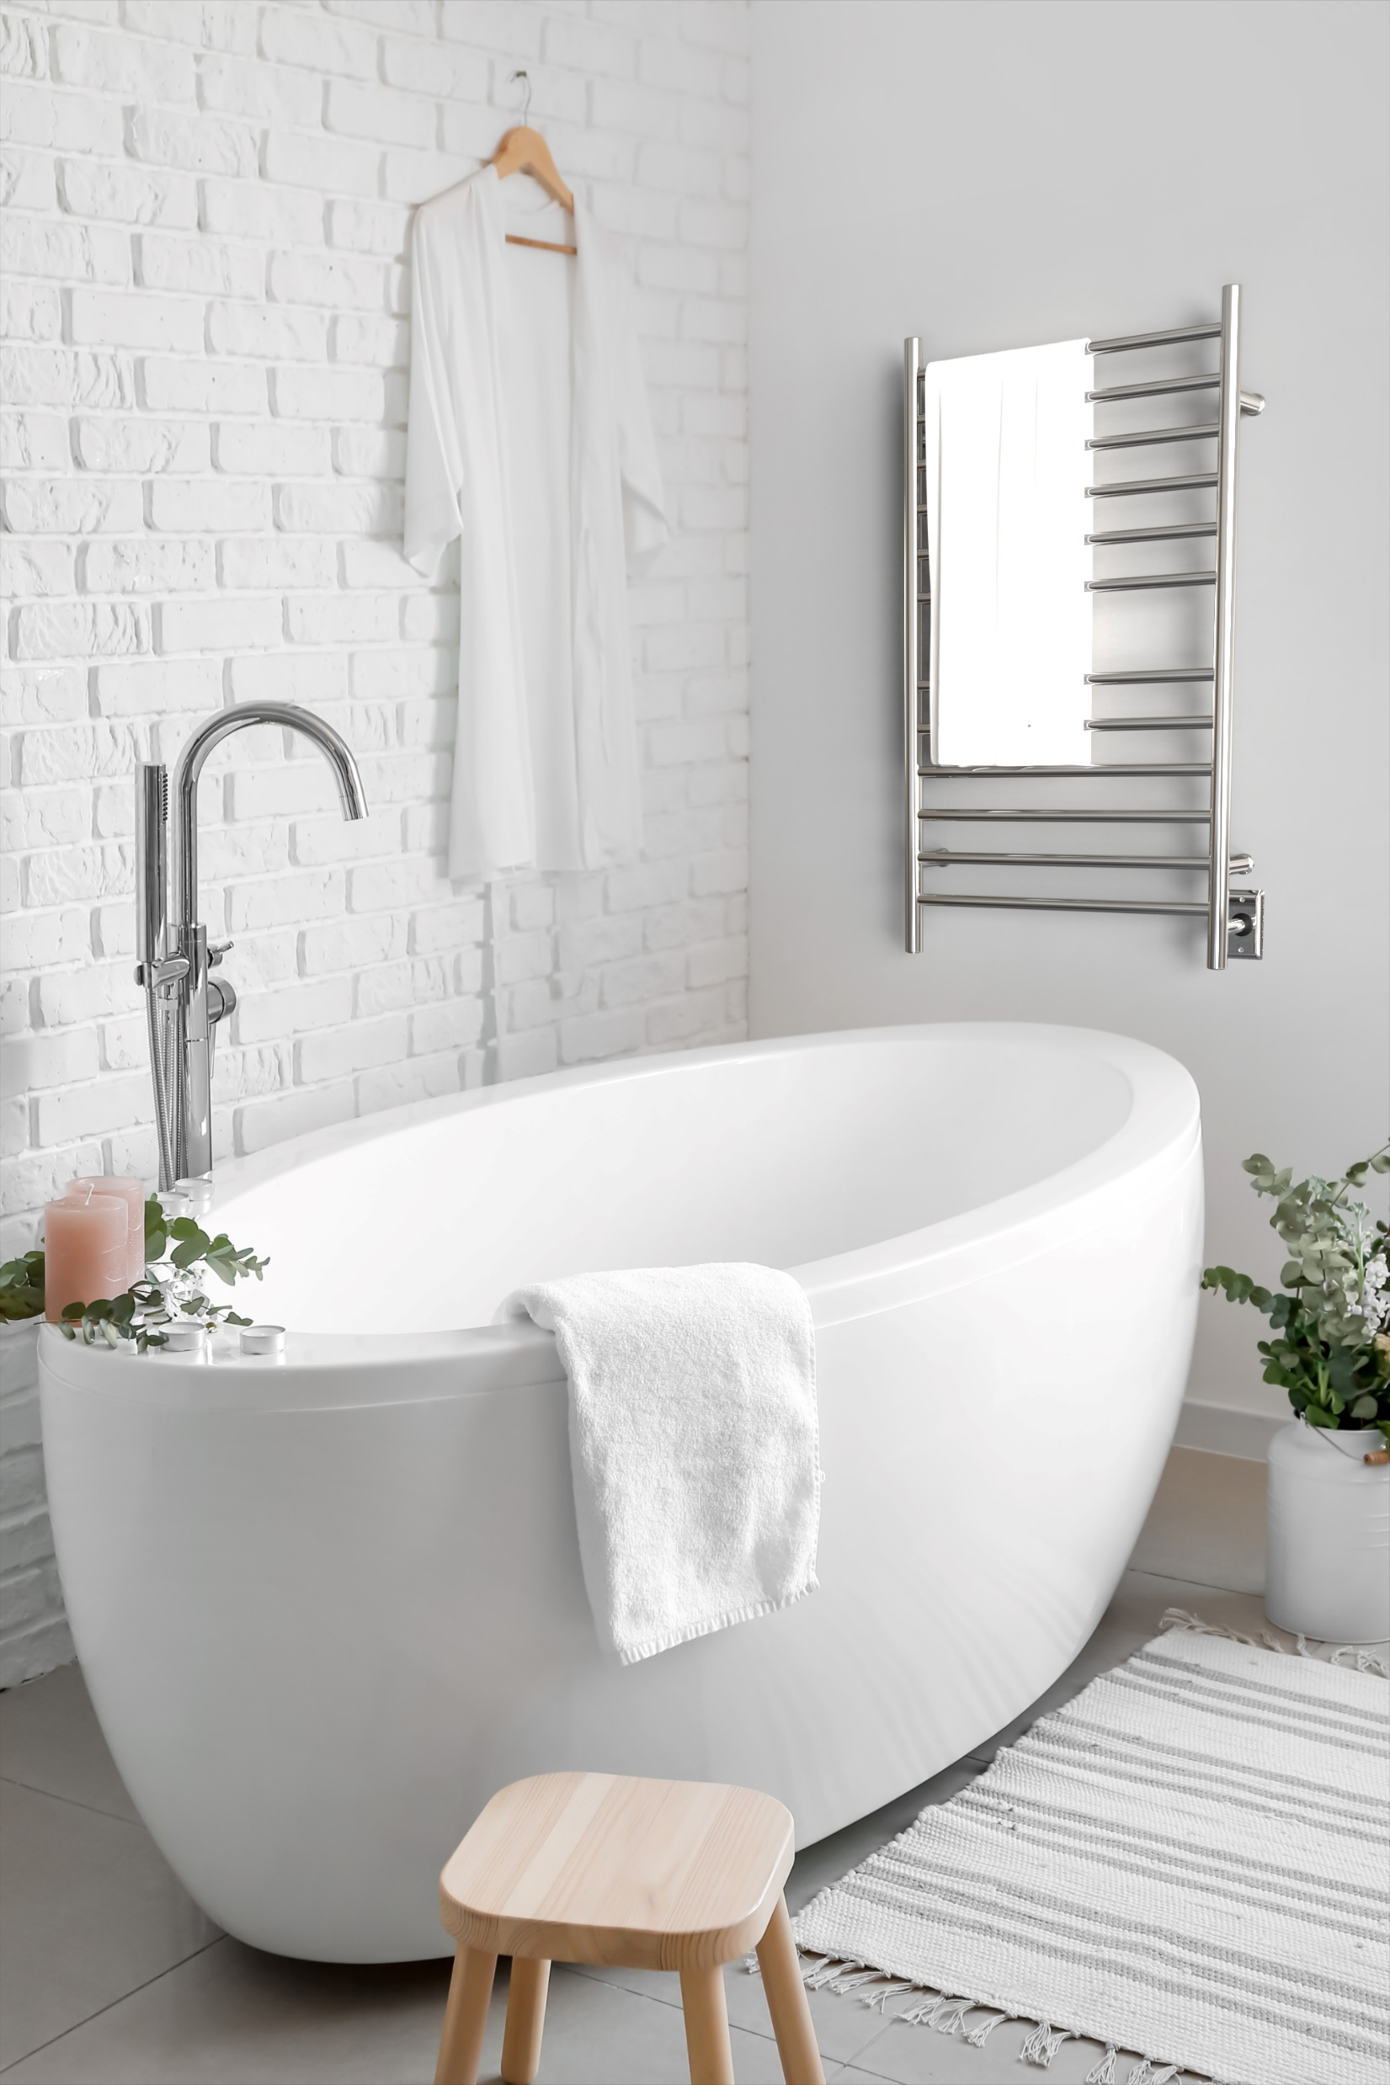
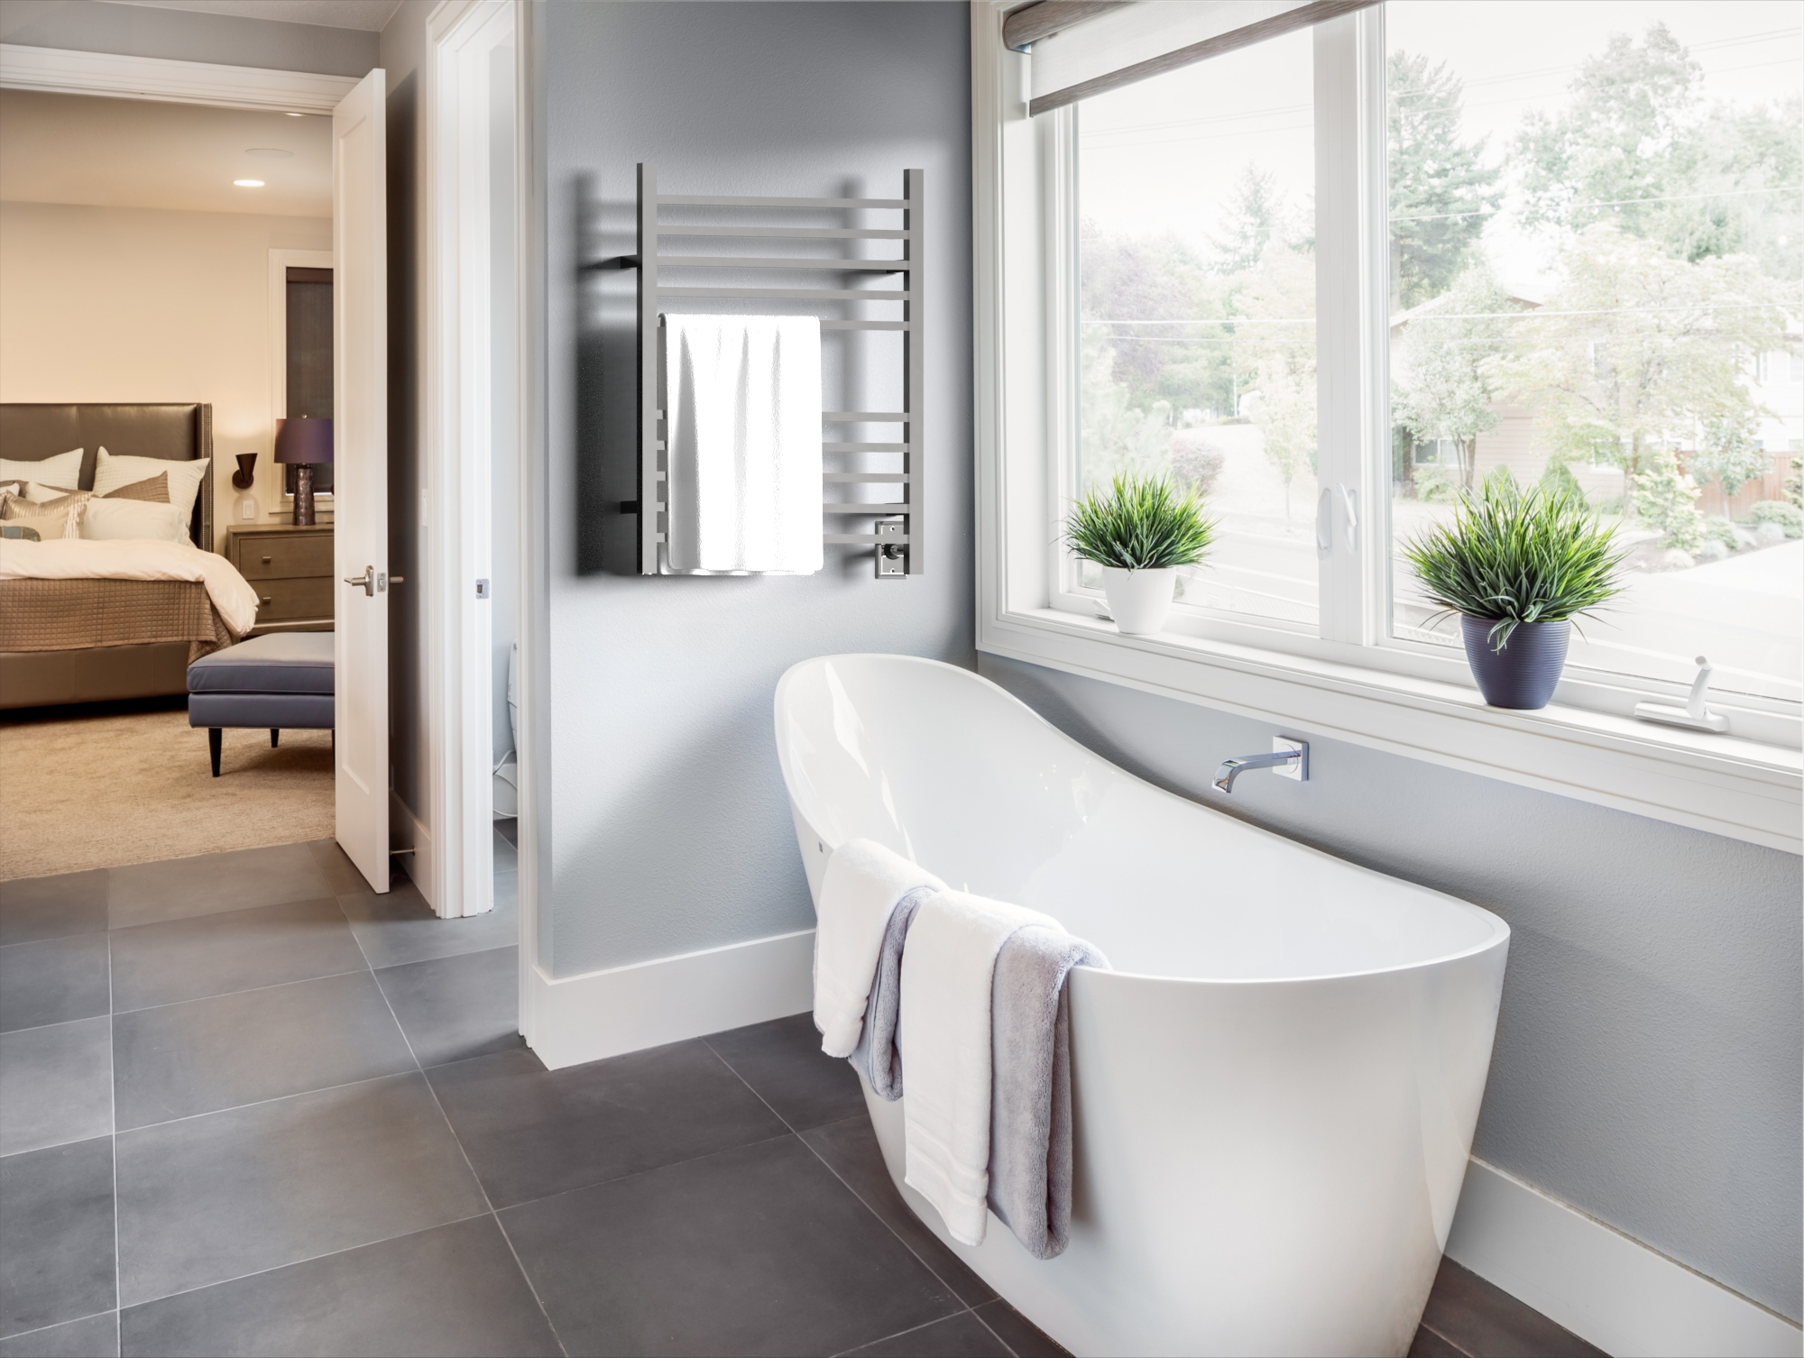
RADIANT COLLECTION
Highlights:
Round and square bar options available to suit your style
Plug-in & Hardwired combo – single sku for either installation type
Stocked finishes: Brushed & Polished (all models); Matte Black, Satin Brass, Brushed Bronze and Polished Gold in specific models only
Sizes: Small, Medium & Large and a Shelf unit
Dry element technology: 10-15min heat up time
Integrated On/Off switch located on bottom of vertical bar
What to order:
Included: Plug-in + Hardwired kit; Mounting Hardware; On/Off switch
Required: Nothing additional
Optional: Timer; Double gang plate

Slide 29
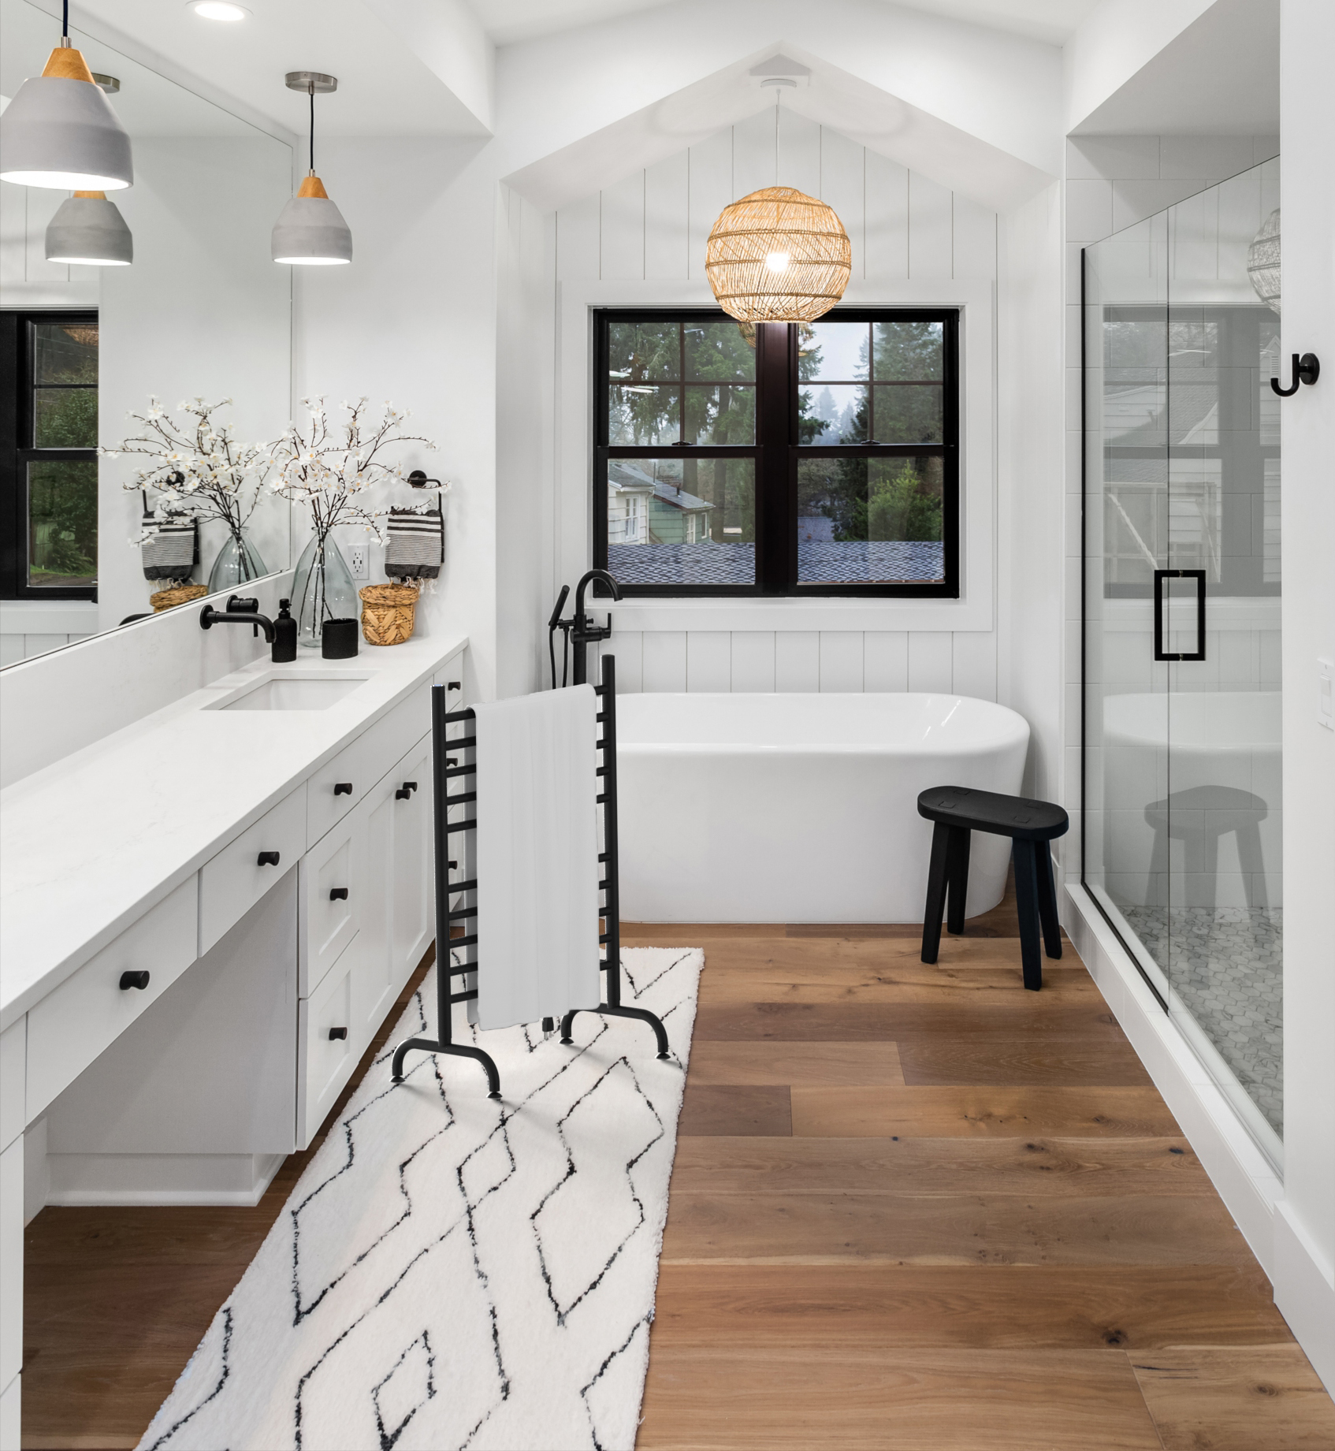
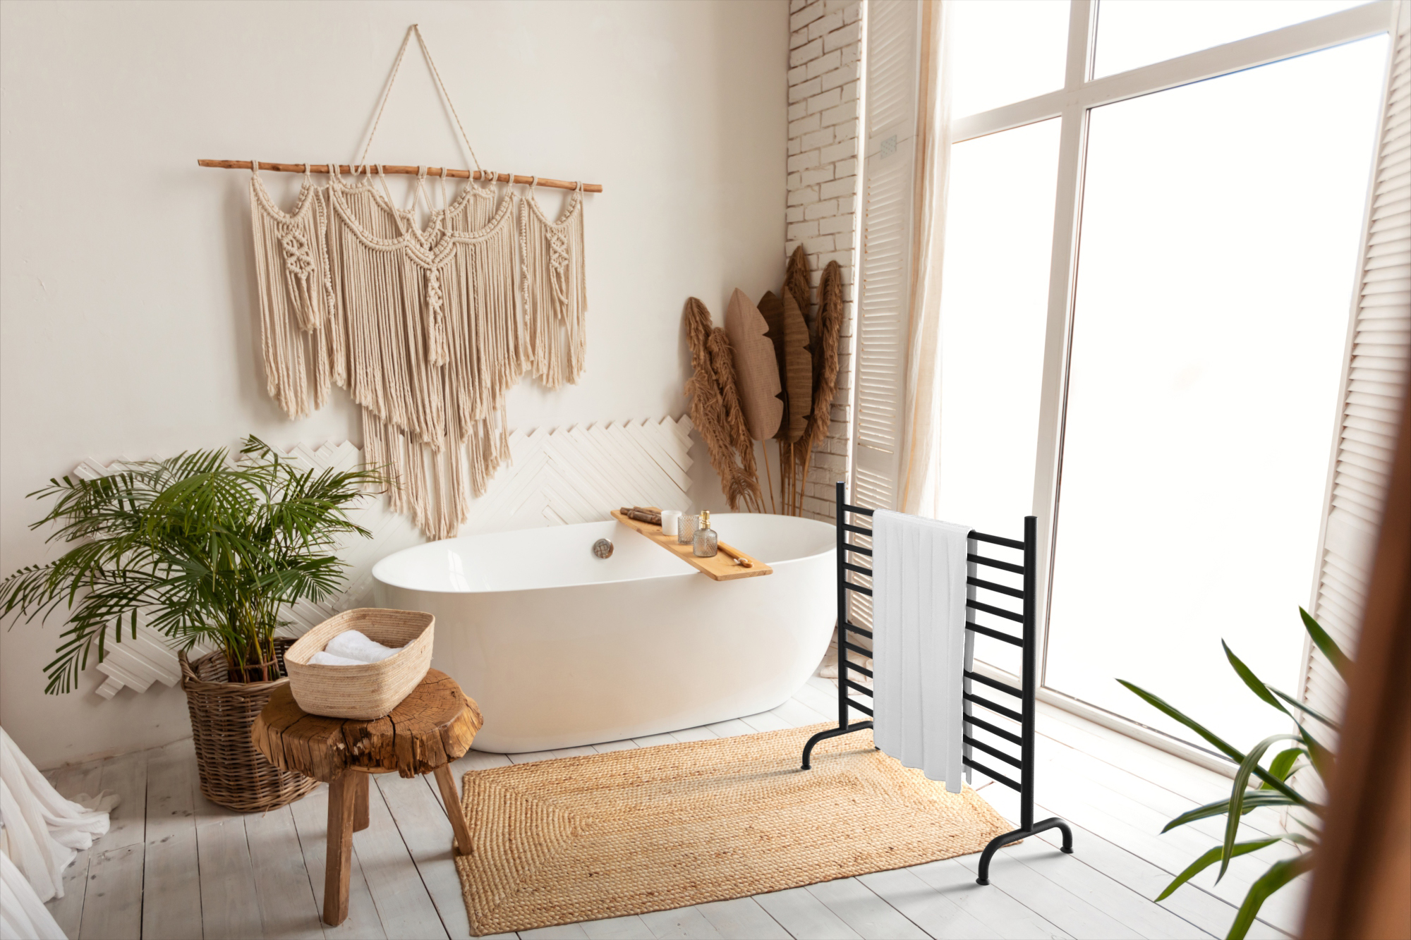
SOLO COLLECTION
Highlights:
Freestanding model – stands on its own and plugs into outlet
Stocked finishes: Brushed, Polished & Matte Black
Lightweight & portable – move from bathroom to laundry room or outdoor pool/jacuzzi etc
Ideal for use next to freestanding and walk-in bathtubs
Dry element technology: 10-15min heat up time
What to order:
Included: Mounting legs, plug-in kit, On/Off Switch
Optional: Plug-in programmable timer

Slide 30
Touch DIGITAL HEAT CONTROLLER
Compatible with our Italian collections: Quadro, Sirio, Antus, Vega & Modello i.
5 temperature levels - allows users to control temperature.
Integrated Countdown Timer
Wi-Fi Connectivity – control temperature level & set timer from phone
Choose between integrated & remotely wired option
Must add this when ordering any of these collections
Integrated Touch DHC
Remote Touch DHC
Wi-Fi Control Display

Slide 31
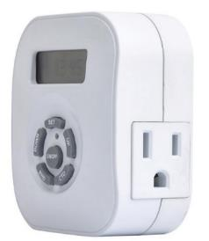
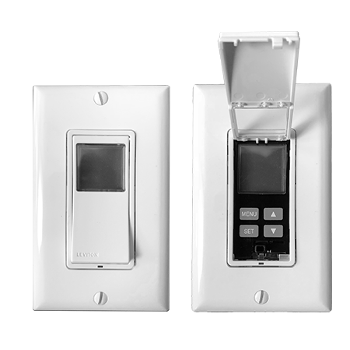
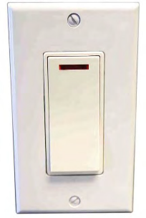
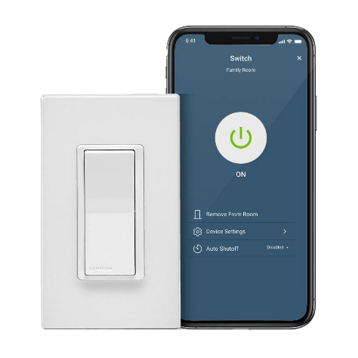
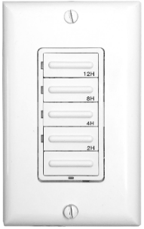
TIMERS & SWITCHES
A choice of controls that can be used with our heated towel racks. All controls are made by Leviton – any brand can be used with our products should your customer prefer an alternative option
On/Off switch:
ATW-S-W – Hardwired
24hr/7day Programmable Timers:
ATW-T24 – Hardwired
ATW-T24-BL – Black color change kit
ATW-P24 – Plug-in
Wi-Fi Smart switch:
ATW-SS - Hardwired
ATW-SS-BL – Black color change kit
Countdown timer:
ATW-CDT – Hardwired
ATW-CDT-BL – Black color change kit
Plug-In Programmable Timer
On/Off Switch
Hardwired Programmable Timer
Wi-Fi Smart Switch
Hardwired Countdown Timer
Note: BLACK COLOR CHANGE KITS SOLD SEPARATELY

Slide 32
DOUBLE GANG PLATE
Compatible with Jeeves, Cape & Radiant Collections SKU: AJ-DGP-*finish code*
SKU: AJ-DGP-*Finish Code*
The double gang plate is an optional accessory which replaces the standard single gang plate.
It allows for placement of switch/timer next to towel warmer. This makes for a cleaner, more purpose designed look.
Fits a standard US double gang box, and comes in matching finishes

Slide 33
BATHROBE HOOKS
Available for Jeeves, Sirio, Quadro, Vega & Antus Collections.
Only stocked in Brushed & Polished finishes
Easily secures to the unit

Slide 34
Shipping & Handling chart
1. Take the first 3 digits of
the Ship To zip code to
determine your zone
2. Find the collection and model you are shipping, then find the appropriate zone to see the freight cost
Ex: Jeeves model E, shipping to zip: 10005
Step 1: First three digits of zip = “100” … so it falls within Zone 2
Step 2: Find the Collection & model on chart
Step 3: Freight rate is $40

Slide 35
CUSTOMER SERVICE
Fast deliver of all stocked items – 24hr order processing time
Drop shipping at no extra price
Telephone Customer support available 8am–5pm EST: +1(404)350-9738

Slide 36
ONLINE RESOURCES
CATALOGS & PRICE LISTS:
ambaproducts.com/catalogs
SHOWROOM LOCATOR
EASY ORDER TRACKING:
ambaproducts.com/order-status/
STOCK CHECK: ambaproducts.com/stockcheck/
RGA/Warranty Claims:
ambaproducts.com/RGA
ambaproducts.com/showrooms
Display Program
EMAIL CONTACTS:
orders@ambaproducts.com returns@ambaproducts.com
customerservice@ambaproducts.com

Slide 37
IN SUMMARY
Pamper and indulge yourself with an affordable luxury
Prevent growth of bacteria and promote health, wellness & hygiene
Replaces the need for towel bars & robe hooks
Use in a variety of locations, not just bathrooms
Help keep rooms mold and mildew free
Variety of designs, finishes, and sizes
US List Prices start at $310
Add comfort to any room
Keep towels warm and dry
Reduce laundry loads, electricity and water consumption

