Slide 1
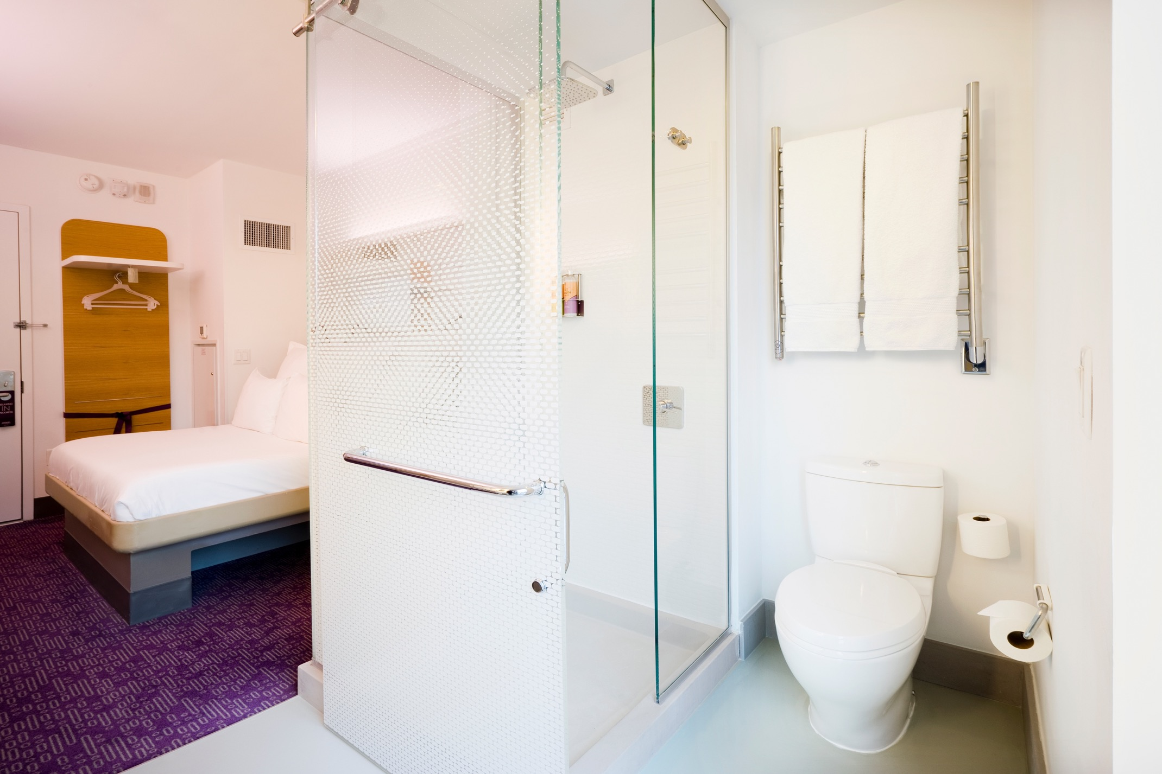
HEATED TOWEL RACKS Training 101
TOWEL WARMERS | SPACE HEATERS | DRYING RACKS

Slide 2
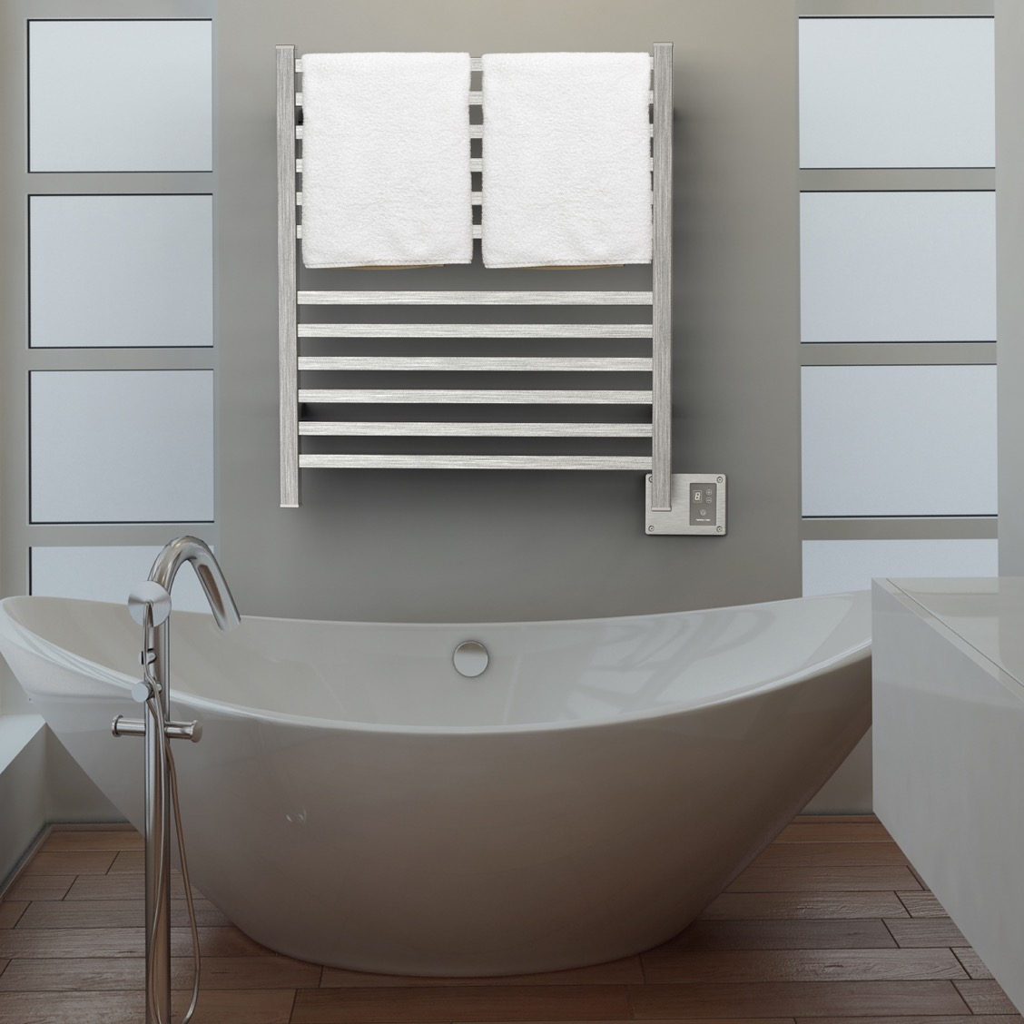
Learning Objectives
Functions, benefits, and applications
How to Sell
Collections and Accessories
Q2833B

Slide 3
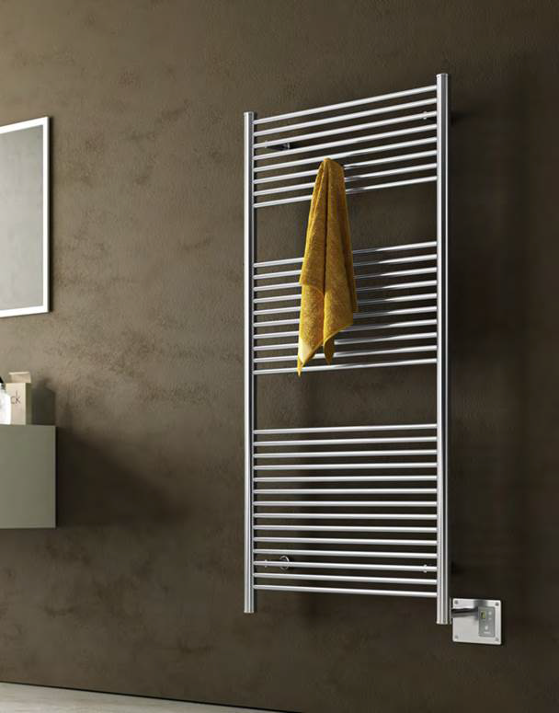
FUNCTIONS AND FEATURES
Designed to dry & warm towels, bathrobes and other articles of clothing
Some models function as space heaters
Many can heat in as little as 15 minutes
Many sizes, styles & finishes to choose from
Installs easily—wired the same as a light or wall sconce; no dedicated circuits required
Units are UL or ETL approved for safety in Canada and the USA
Must be installed at least 3’ from nearest water source unless using optional UL-certified ‘wet-rated upgrade kit’.
Units can be controlled by a variety of switches or timers
Units consume minimal power—as little as one to several light bulbs
A2856B

Slide 4
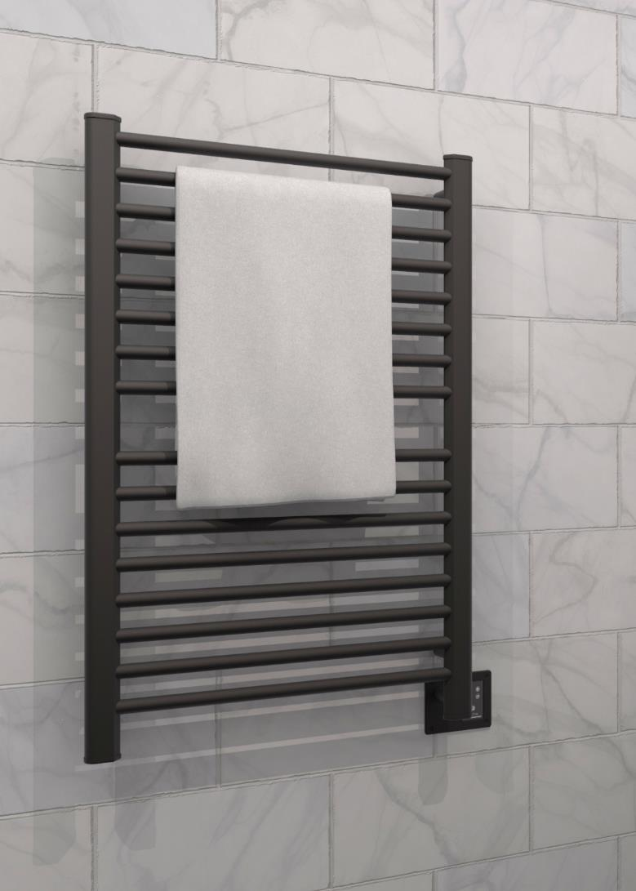
Purpose of a Heated towel rack: Bathrooms
Keep towels or bathrobes dry and warm
Clean smelling and fluffy towels – every time! No more musty odors
Prevents the growth of mold, mildew and bacteria on towels by eliminating moisture
Reduces laundry loads and water consumption by keeping towels warm and dry, allowing longer use between washes
Less laundry = more time
Cost-effective way to upgrade bathroom with functionality and aesthetic appeal
S2942O

Slide 5
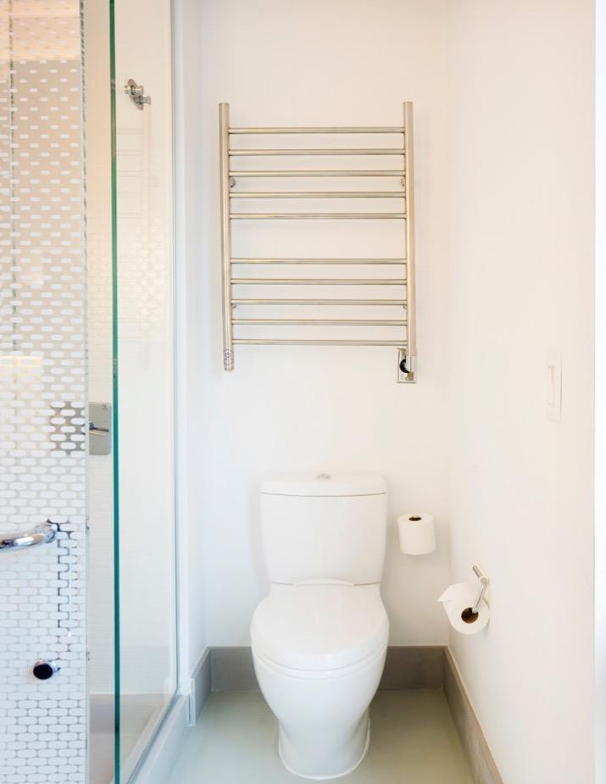
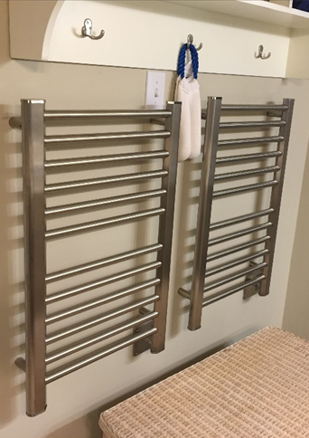
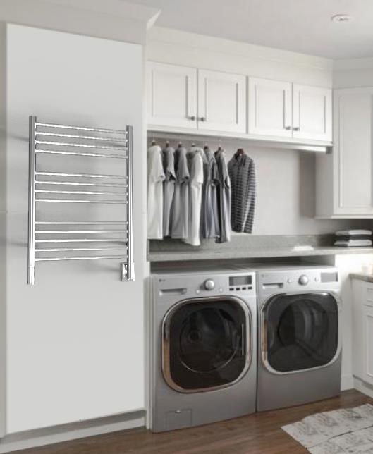
Additional APPLICATIONS
Hotels & Spas
Mud Room
Laundry Room
Laundry Room
Mudroom
Pool
Sauna/Spa
Basement/Garage
Boat
Nursery
Hotel
Additional benefits:
Provide radiant heat to warm colder rooms
Can offer a form a mold prevention for interior rooms with poor or no ventilation by burning off excess humidity
Can be used as a drying rack for delicates, linens, bathing/wet suits, or ski gear
Warm blankets, pajamas, jackets, baby onesies, etc.

Slide 6
Heating Time & Technology
There are 2 main technologies electric heated towel racks utilize
Dry Element (DE) Technology - units have a wire cable run through all vertical & horizontal bars. Many competitors only heat the horizontal bars.
Pros: Fast heat up time – only 10 to 15min with heat starting in as little as 5min
Cons: Heating cables cannot be repaired or replaced
Collections: Sirio, Quadro, Antus, Vega, Radiant, Solo & Swivel
Liquid Filled (LF) technology - Units are filled with a glycol-water solution. A heating element heats the liquid which heats the bars.
Pros: Heating element can be replaced if it fails; entire unit does not need to be replaced
Cons: Longer heat up times – range from 15 to 45min depending on the size of the unit
Collections: Jeeves & Traditional
OTHER EXTERNAL FACTORS THAT INFLUENCE THE HEATING TIME:
Temperature/Size of the room Install location relative to vents Insulation of nearby windows/doors

Slide 7
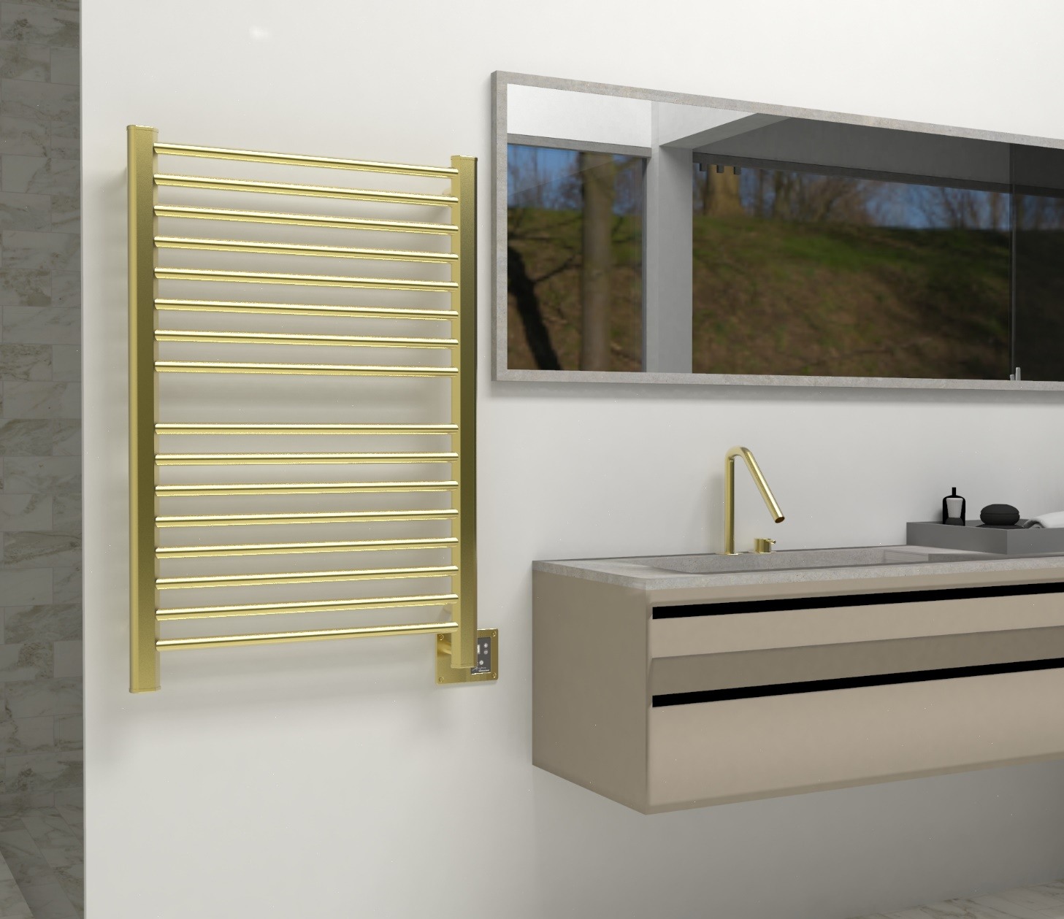
How to sell Heated towel racks
During a bathroom selection, accessories are usually the last to be picked, leaving minimal budget for these items.
In a Primary Bathroom, you need 2x towel bars & 2x robe hooks in most cases
Reallocate money spent on towel bars and robe hooks with one towel warmer.
1 towel warmer replaces all 4 accessories
Upgrades the bathroom and provides a more luxurious, bathroom oasis.
Some models can even save money
Hang bathrobes from top of vertical bars
Section 1
Section 2
There are two sections on this towel warmer to hold 2 towels; the vertical bars double as robe hooks to hold 2 bathrobes

Slide 8
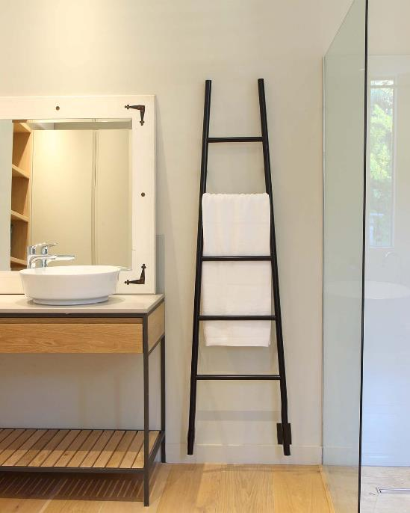
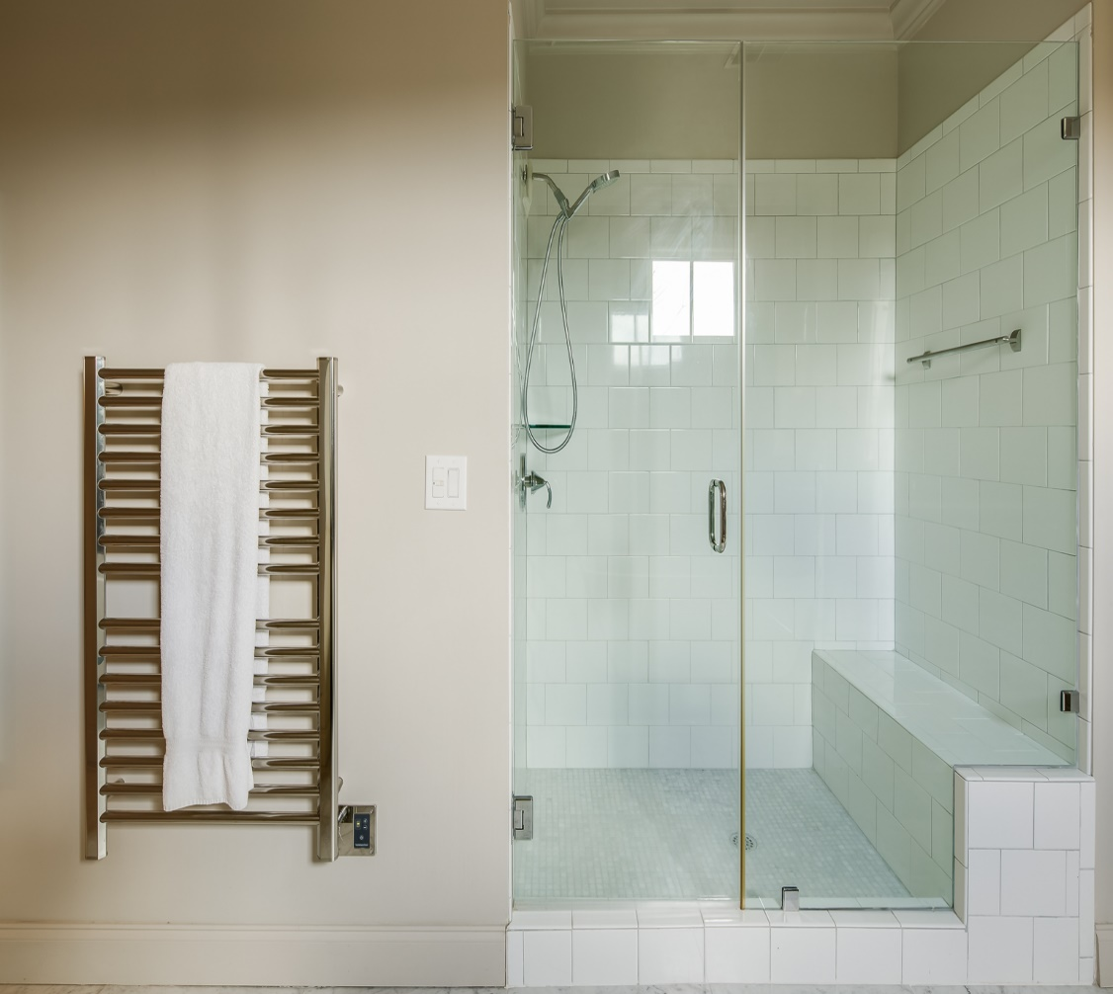
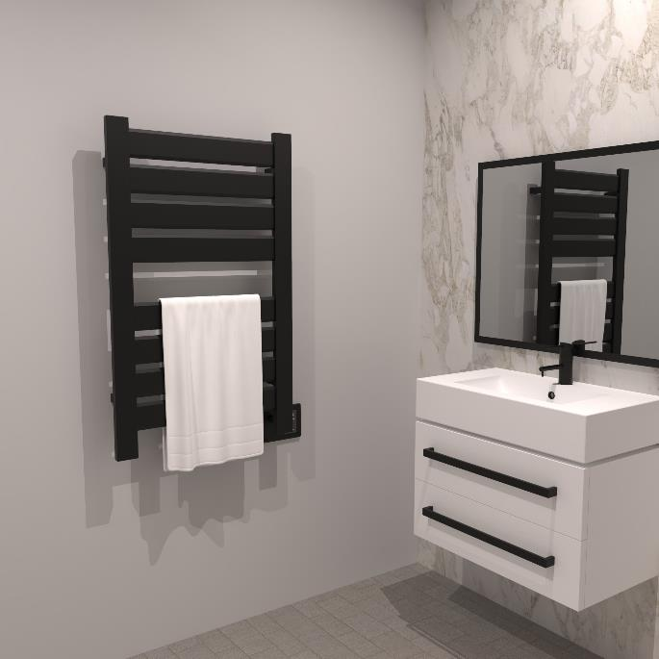
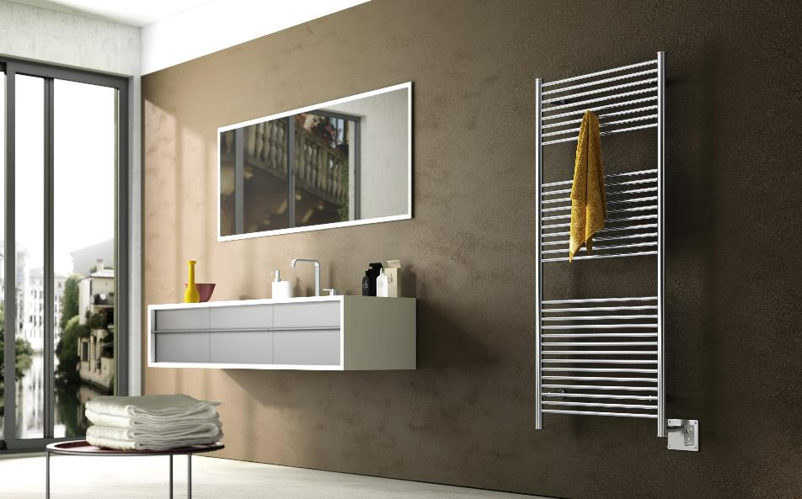
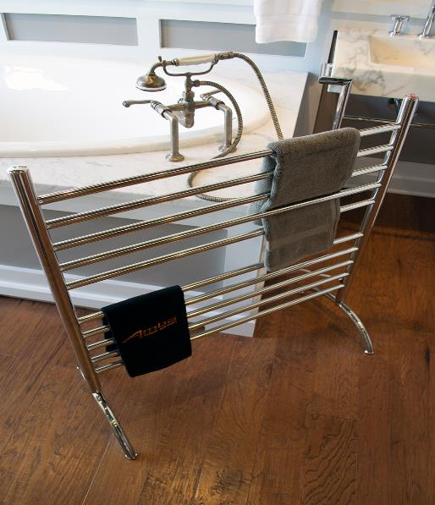
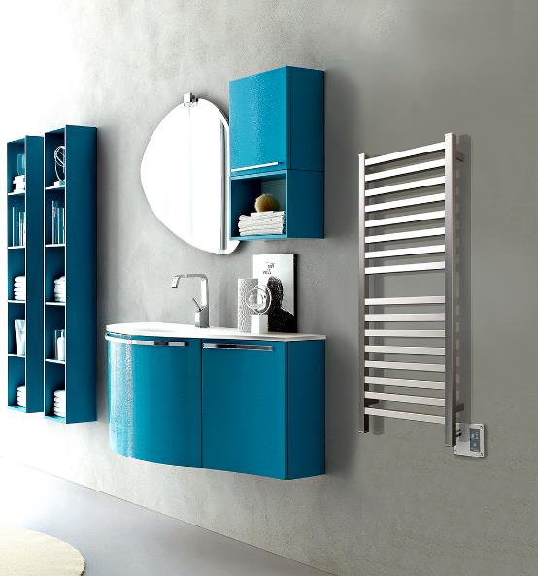
Collections & Accessories

Slide 9
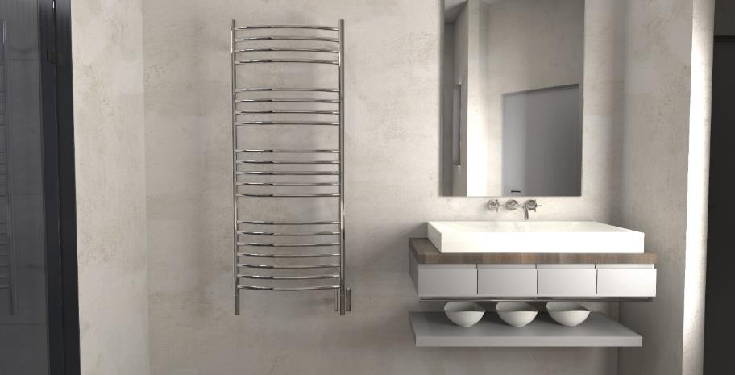
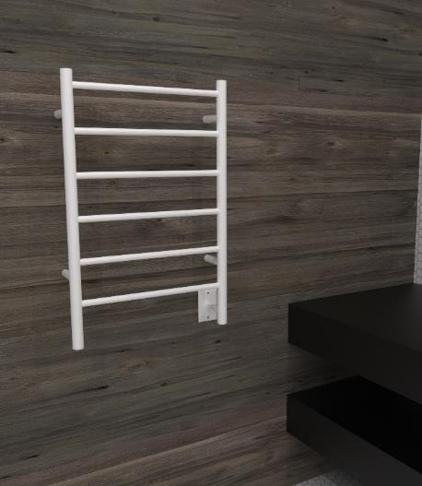
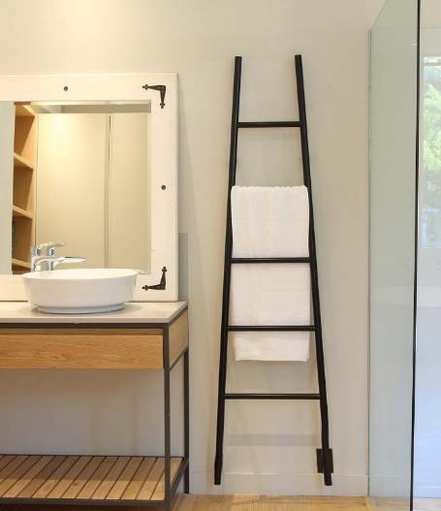
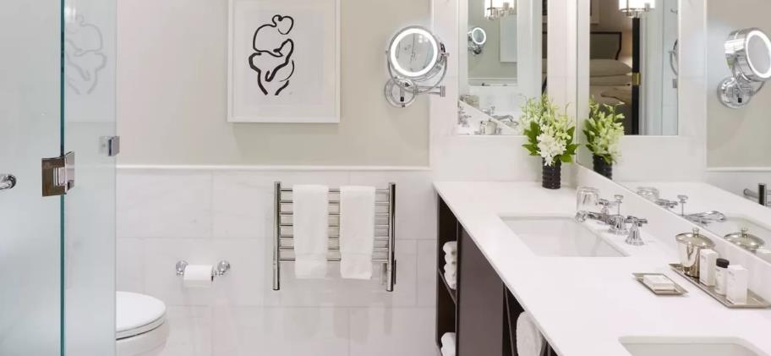
JEEVES COLLECTION
Made in South Africa with Italian made heating elements
Heat up time: 15 to 45min depending on size of unit
Liquid filled heating technology - replaceable heating element
UL-certified “Wet-rated Upgrade Kit” available – install in wet areas, above bathtub or in a shower room.
Made of 304 Stainless Steel
Stocked Finishes: Brushed, Polished, Matte Black, ORB & White
10 year warranty (2 years on element)
Temperature Range: 145 - 154F
Separate switch or timer required - can be integrated with unit using double gang plate
Left hand electrical & special order sizes available
DCP
JSW
ASMB
HSP

Slide 10
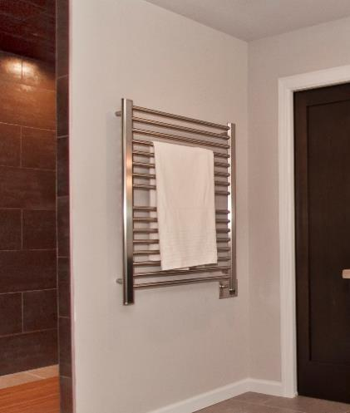
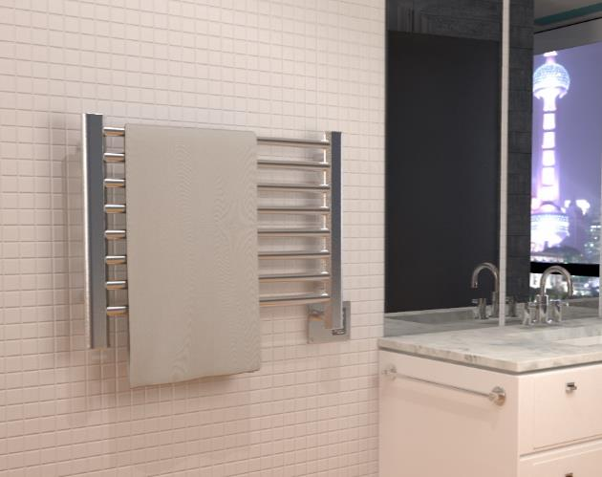
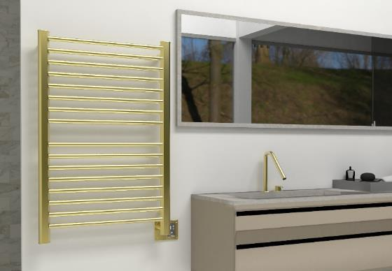
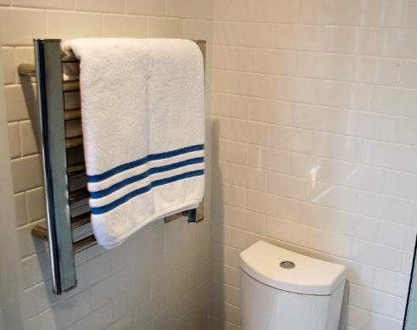
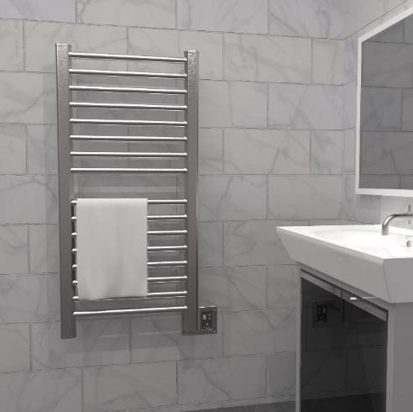
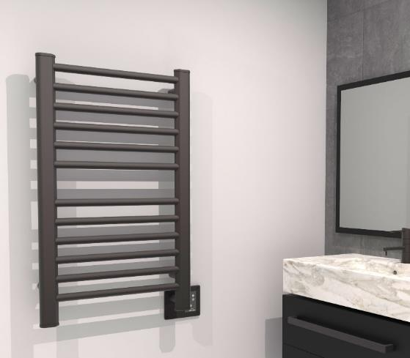
HEATED TOWEL RACK / SPACE HEATER:
SIRIO COLLECTION
Made in Italy
Made of 304 stainless steel
Dry element technology: 10-15min heat up time
Stocked Finishes: Brushed, Polished, ORB and Satin Brass
Digital Heat Controller allows choice of 9 temperature levels (standard on all models except S2121 – optional)
Round horizontal bars, vertical bars have flat face with rounded edge
Dual-purpose function: Heated Towel rack and space heater
Accessories: Robe Hooks and timers can be added for more functionality (optional)
Custom sizes and finishes (RAL Colors) are available by special order
S2942P
S2921B
S2942SB
S2121P
S2142B
S2133O

Slide 11
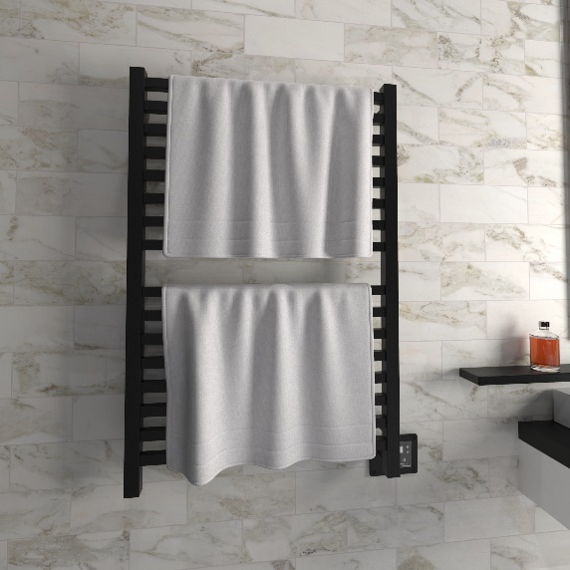
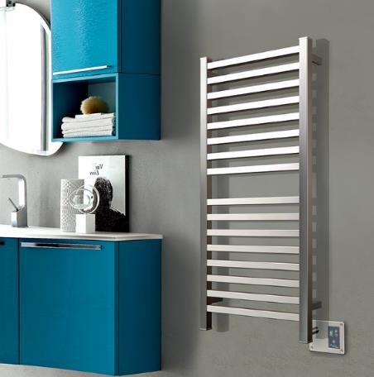
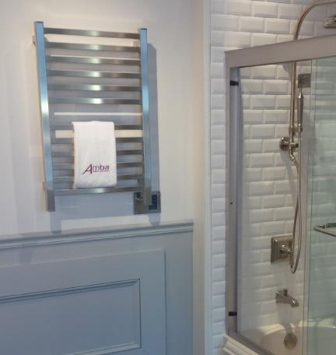
HEATED TOWEL RACK / SPACE HEATER:
QUADRO COLLECTION
Made in Italy
Made of 304 stainless steel
Dry element technology: 10-15min heat up time
Stocked Finishes: Brushed, Polished and Matte Black
Digital Heat Controller allows choice of 9 temperature levels (standard on all models except Q2016 – optional)
Square bars offer a sleek, modern design
Dual-purpose function: Heated Towel rack and space heater
Accessories: Robe Hooks and timers can be added for more functionality (optional)
Custom sizes and finishes (RAL Colors) are available by special order
Q2842MB
Q2042B
Q2033P

Slide 12
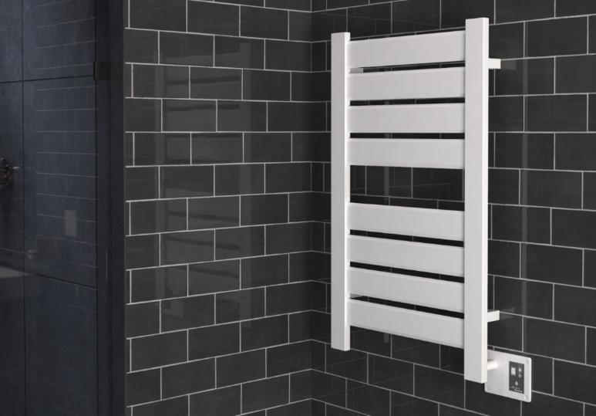
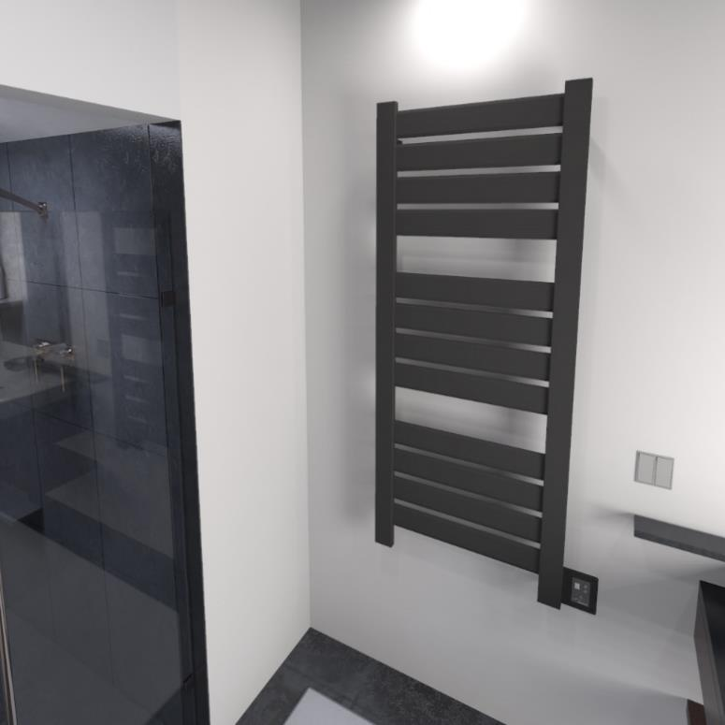
HEATED TOWEL RACK / SPACE HEATER:
VEGA COLLECTION
Made in Italy
Made of 304 stainless steel
Dry element technology: 10-15min heat up time
Stocked Finishes: Brushed, Polished, Matte Black & White
Flat panels give a modern edge and provide a large surface area to dry and warm
Digital Heat Controller allows choice of 9 temperature levels (included with all models)
Dual-purpose function: Heated Towel rack and space heater
Accessories: Robe Hooks and timers can be added for more functionality (optional)
Custom sizes and finishes (RAL Colors) are available by special order
V2338W
V2356MB

Slide 13
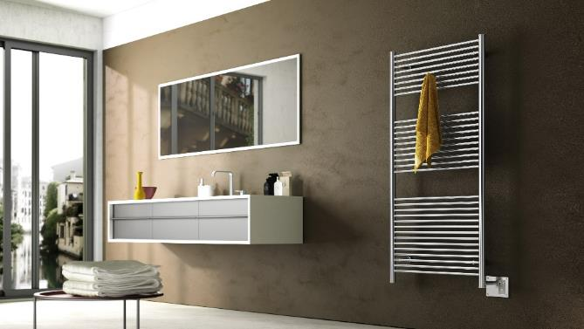
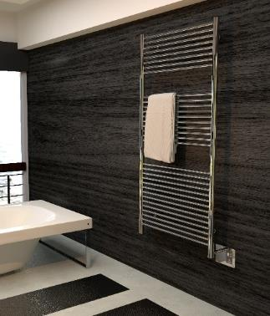
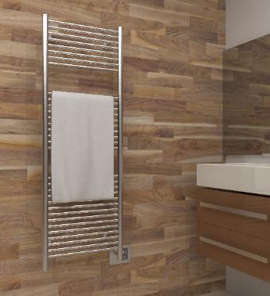
HEATED TOWEL RACK / SPACE HEATER:
ANTUS COLLECTION
Made in Italy
Made of 304 stainless steel
Dry element technology: 10-15min heat up time
Stocked Finishes: Brushed & Polished
Round horizontal and vertical bars for that classic heated towel rack design
Digital Heat Controller allows choice of 9 temperature levels (included with all models)
Dual-purpose function: Heated Towel rack and space heater
Accessories: Robe Hooks and timers can be added for more functionality (optional)
Custom sizes are available by special order
A2856B
A2856P
A2056B

Slide 14
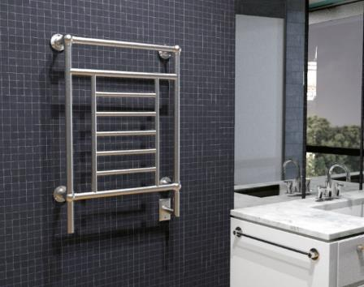
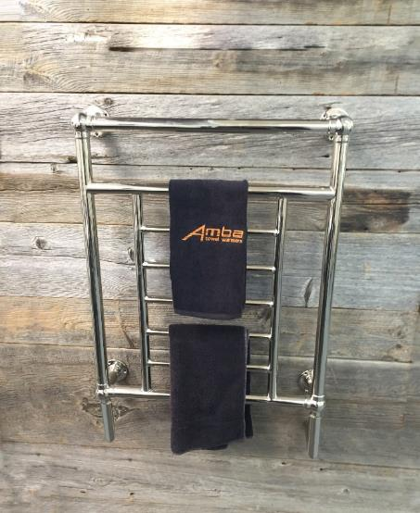
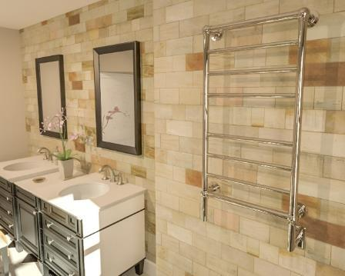
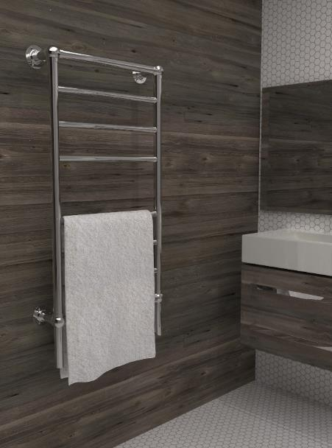
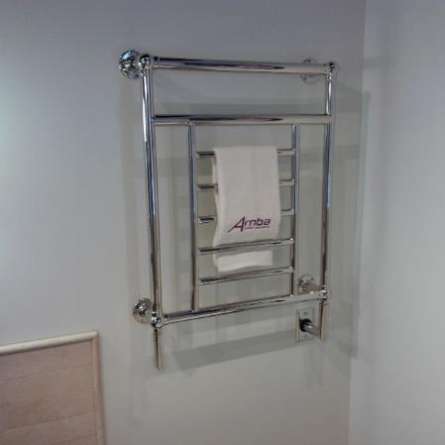
TRADITIONAL COLLECTION
Made in China
Beautifully crafted finials create a decorative design
Liquid filled heating technology – replaceable heating element
Stocked finishes: Brushed Nickel & Polished Nickel
Made of mild steel
3-year warranty (2 years on heating element)
Heat up time: 30-40min
Temperature Range: 145 – 154F
Separate switch or timer required - can be integrated with unit using double gang plate
Left hand electrical wiring available as a special order
T-2536PN
T-2536PN
T-2040BN
T-2536PN
T-2040PN

Slide 15
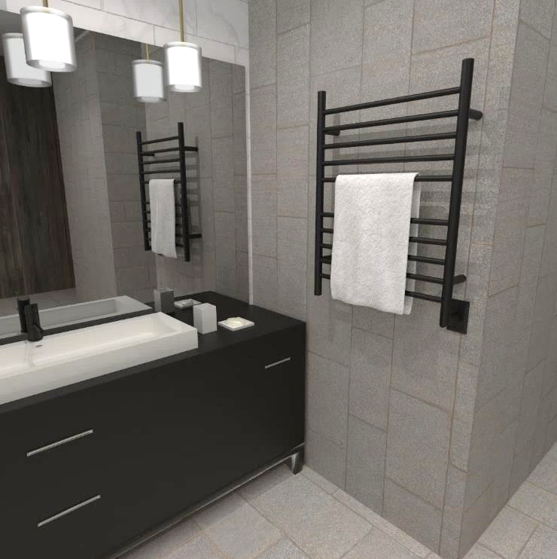
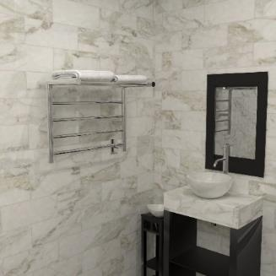
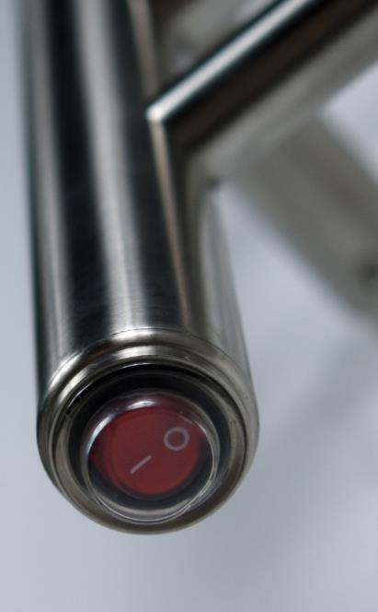
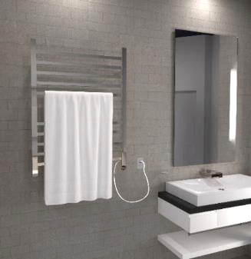
RADIANT COLLECTION
Made in China
Made of 304 stainless steel
Round and square bar options available to suit your style
Stocked finishes: Brushed & Polished (all models); Matte Black, Satin Brass and Polished Gold in specific models only
Sizes: Small, Medium & Large and a Shelf unit
Dry element technology: 10-15min heat up time
Integrated On/Off switch located on bottom of vertical bar
Hardwired and plug-in options available for most models
Temperature range: up to 149F
Can be connected to separate timer or switch (optional)
RWH-SMB
RSH-P
RSWP-P

Slide 16
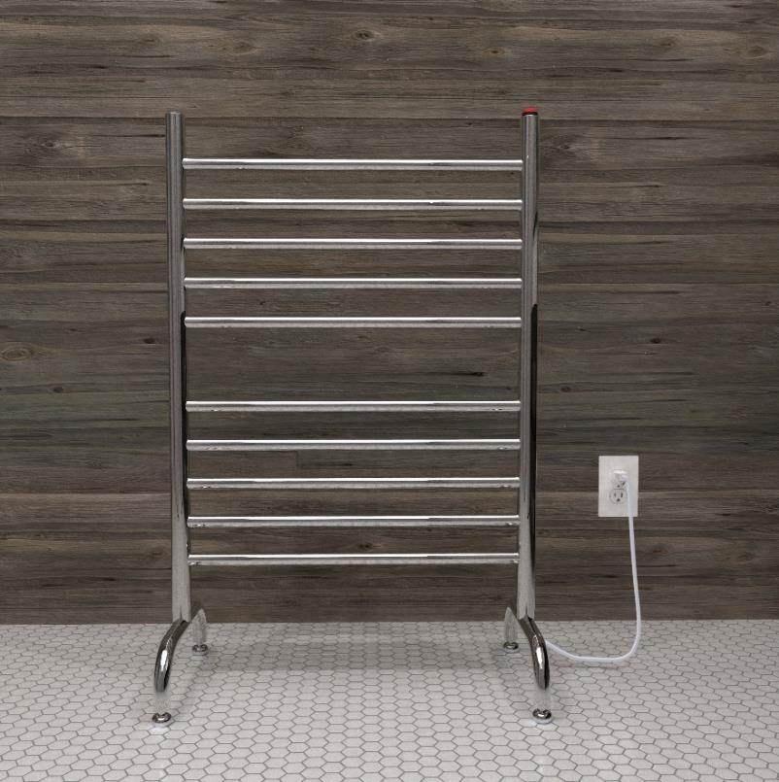
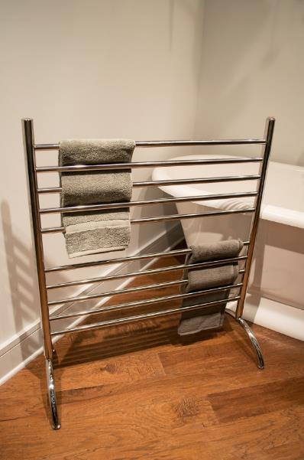
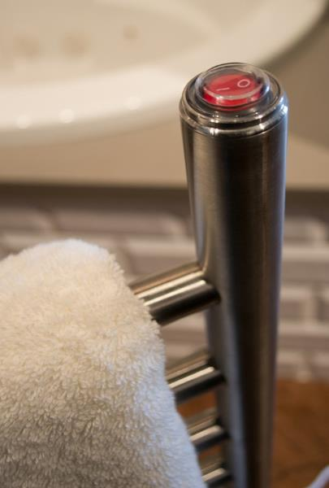
SOLO COLLECTION
Made in China
Made of 304 stainless steel
Stocked finishes: Brushed, Polished & Matte Black
Freestanding model – stands on its own and plugs into outlet
Lightweight & portable – move from bathroom to laundry room or outdoor pool/jacuzzi etc
Ideal for use next to freestanding and walk-in bathtubs
Plug-in only collection
Integrated On/Off switch on top of vertical bar
Accessories: Plug-in 24hr/7day programmable timer for added functionality (optional)
Dry element technology: 10-15min heat up time
SAFSP-24
SAFSB-33

Slide 17
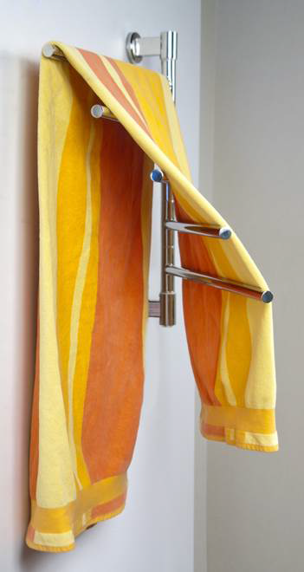
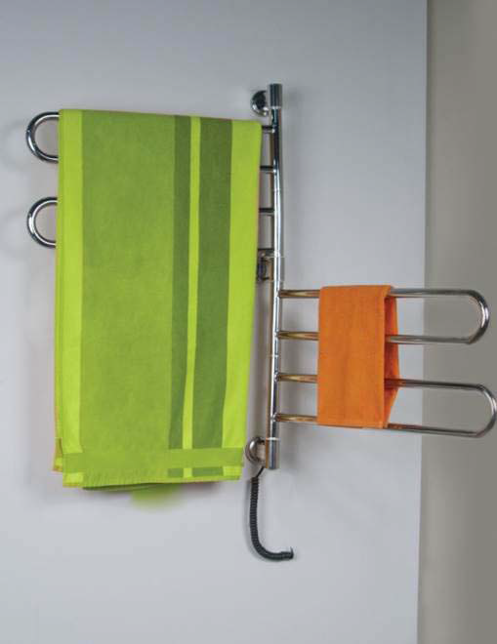
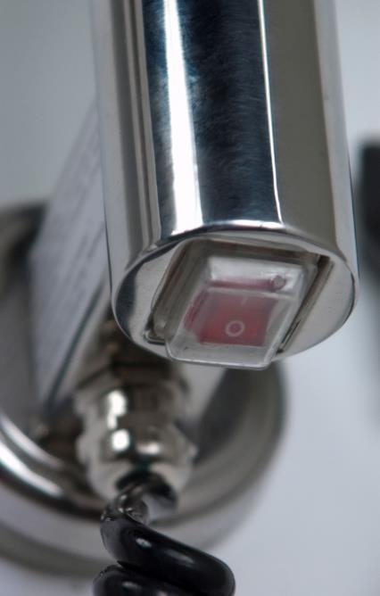
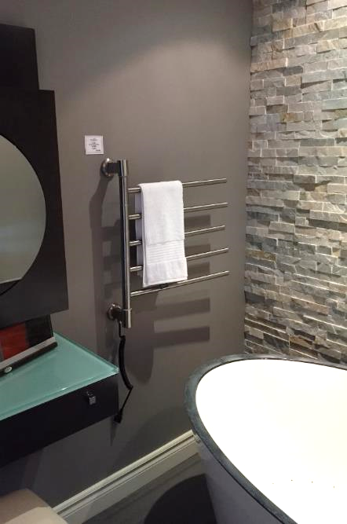
SWIVEL COLLECTION
Made of 304 stainless steel
Temperature range: up to 136F
Plug-in collection
Stocked Finishes: Brushed & Polished
Dry element technology: 10-15min heat up time
Individual bars can swivel 180 degrees
Each arm can be moved independently
Simple to install
J-D005P
J-B004P
J-D005B

Slide 18
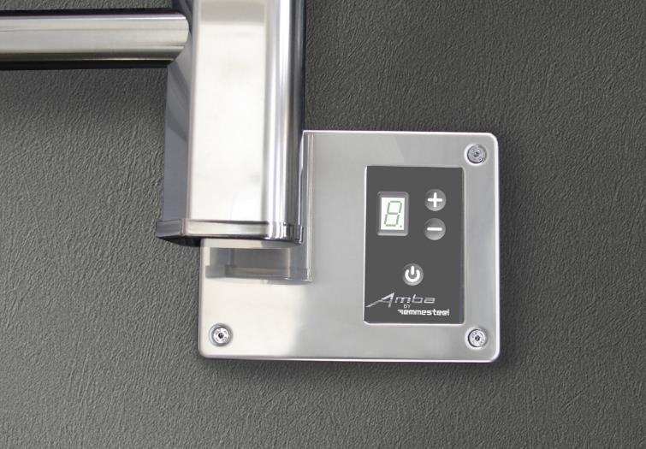
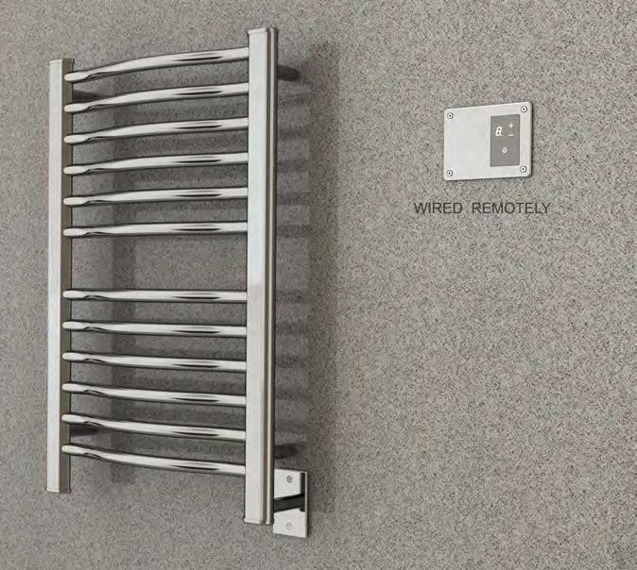
DIGITAL HEAT CONTROLLER
Designed to allow users to have control over the temperature; there are 9 heat levels to choose from.
Digital Heat Controller is included with our Italian collections: Quadro, Sirio, Antus, &Vega.
A remotely wired DHC is available if you want to locate the controller away from the unit itself. This could be due to space constraints or to make it easier to interact with.
Standard Digital Heat Controller
Remotely Wired Digital Heat Controller

Slide 19
TIMERS & SWITCHES
There are a variety of control options available that can be used to control our heated towel racks.
PLUG-IN PROGRAMMABLE TIMER
On/Off switch: Required for our Jeeves & Traditional units. Provides basic functionality. (Hardwired Only)
24hr/7day Programmable Timers: allow user to set precisely when the unit will turn on and off. (Hardwired & Plug-In)
Wi-Fi Smart switch: full functionality of 24hr/7day programmable timer via the convenience of an app (Hardwired Only)
Countdown timers: allow user to turn unit on for predefined amount of time (Hardwired Only)
ON/OFF
SWITCH
COUNTDOWN TIMER
Wi-Fi Smart Switch & Hardwired Programmable Timer
BLACK COLOR CHANGE KITS FOR HARDWIRED TIMERS SOLD SEPARATELY

Slide 20
DOUBLE GANG PLATE
The double gang plate is an optional accessory which replaces the standard single gang plate.
It allows for easy installation and placement of switch/timer next to towel warmer makes for a cleaner, more purpose designed look.
Fits a standard US double gang box, and comes in most available finishes (*not offered in polished gold):
Jeeves: AJ-DGP-*Finish Code*
Radiant: AR-DGP-*Finish Code*
Radiant Square Models use
the Jeeves Double Gang Plate

Slide 21
BATHROBE HOOKS
Available for Jeeves, Sirio, Quadro, Vega & Antus Collections. Only stocked in Brushed & Polished finishes – Special finishes available upon request
Easily secures to the unit and allows you to hang robes, jackets, etc. to dry

Slide 22
Shipping & Handling chart
1. Take the first 3 digits of
the Ship To zip code to
determine your zone
2. Find the collection and model you are shipping, then find the appropriate
zone to see the
freight cost
Ex: Jeeves model E, shipping to zip: 10005
Step 1: First three digits of zip = “100” … so it falls within Zone 2
Step 2: Find the Collection & model on chart
Step 3: Freight rate is $30

Slide 23
CUSTOMER SERVICE
Fast deliver of all stocked items – 24hr order processing time
Drop shipping at no extra price
Telephone Customer support available 8am–6pm EST: +1(404)350-9738

Slide 24
ONLINE RESOURCES
POINT OF SALE MATERIAL:
ambaproducts.com/catalogs
SHOWROOM LOCATOR
EASY ORDER TRACKING:
ambaproducts.com/order-status/
CEU COURSE:
ambaproducts.com/CEU
EMAIL CONTACTS:
customerservice@ambaproducts.com
ambaproducts.com/showrooms
orders@ambaproducts.com

Slide 25
IN SUMMARY
Pamper and indulge yourself with an affordable luxury
Use in a variety of different locations, not just bathrooms
Help keep rooms mold and mildew free
Variety of designs, finishes, and sizes
US List Prices start at $320
Economical and efficient decorative source of heat
Add comfort to any room
Keep towels warm and dry
Reduce laundry loads and water consumption
FSP

